Slide 1
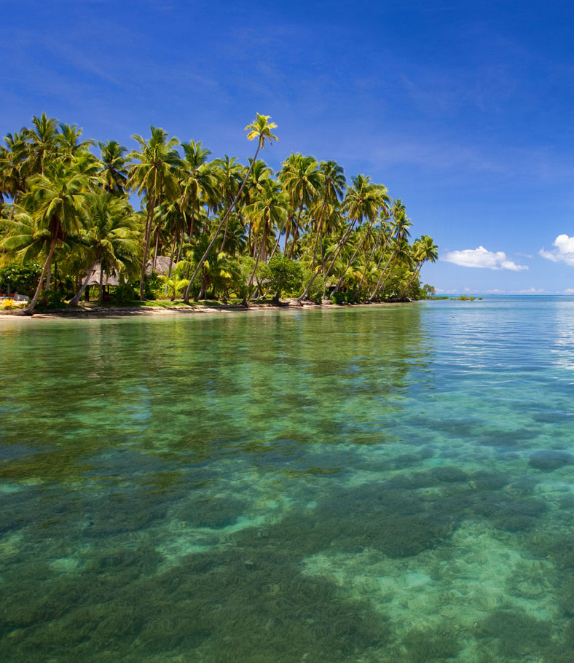
Breaking Barriers:
My Path to Success in Engineering
Strengthening Women’s Participation in Engineering
Angela Waradi
Engineering Manager, Natural Waters of Viti Pte Limited
Women in Engineering

Slide 2
My Journey in Engineering
• Engineering Manager at Natural Waters of Viti Pte Limited, Fiji
• 17+ years of experience in Civil and Structural Engineering
• Extensive work in private consultancy across Fiji and the Pacific Islands

Slide 3
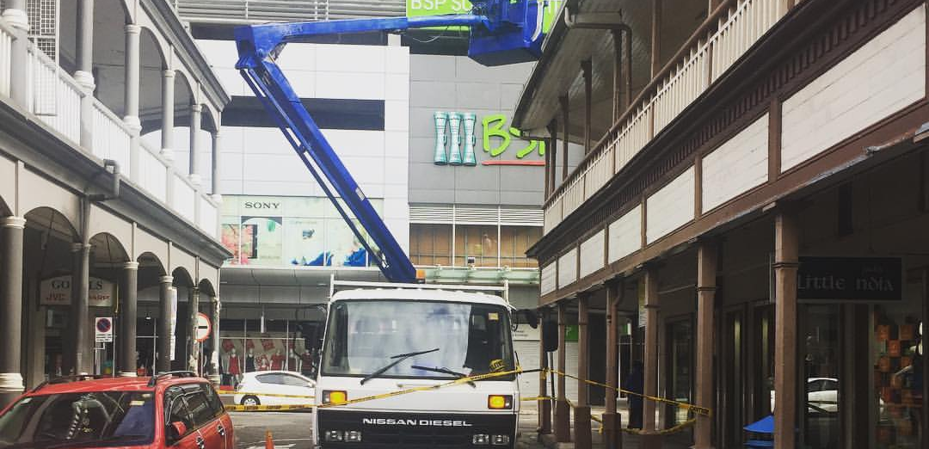
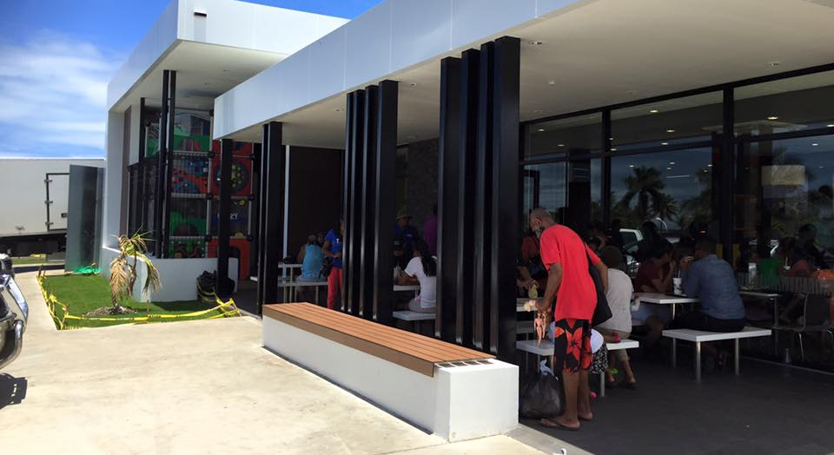
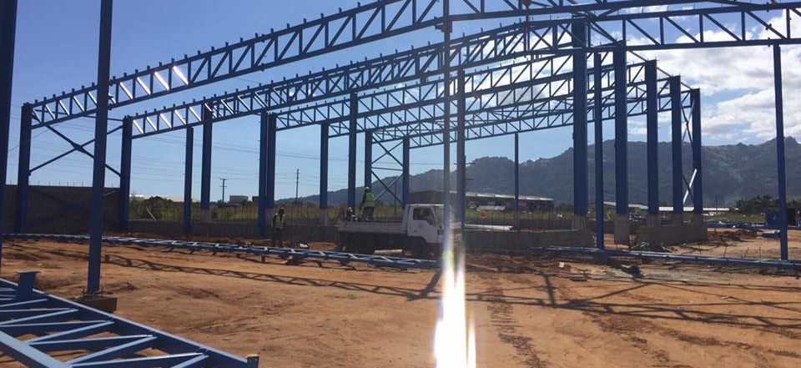
My Journey in Engineering
Structural Engineering Projects – Fiji
  Renovations to a Heritage Building in Suva City
  Design of a Commercial Facilities
  Design of Commercial Warehouses

Slide 4
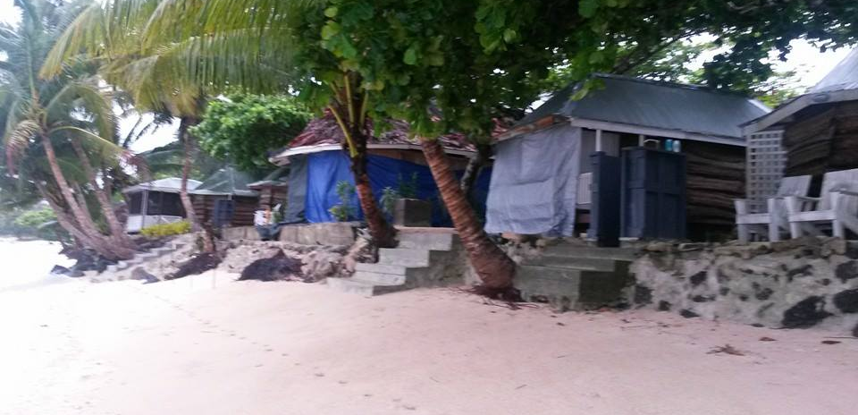
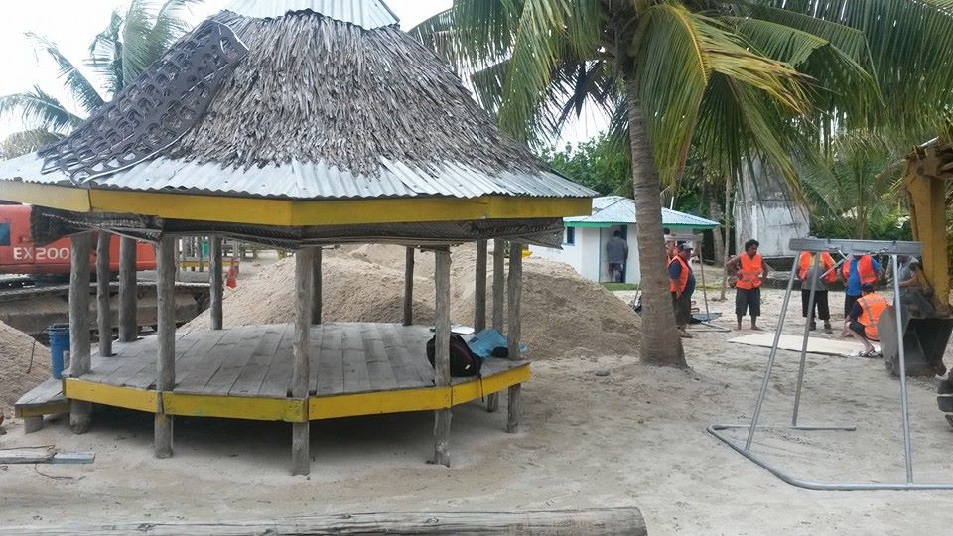
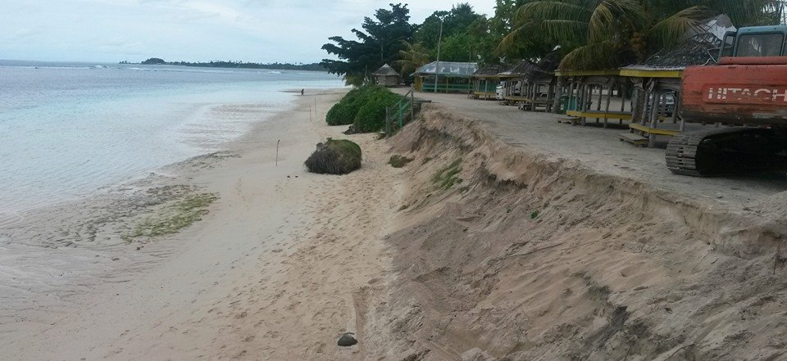
My Journey in Engineering
Coastal Protection Project - Samoa

Slide 5
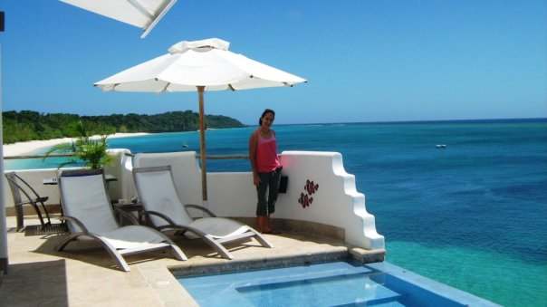
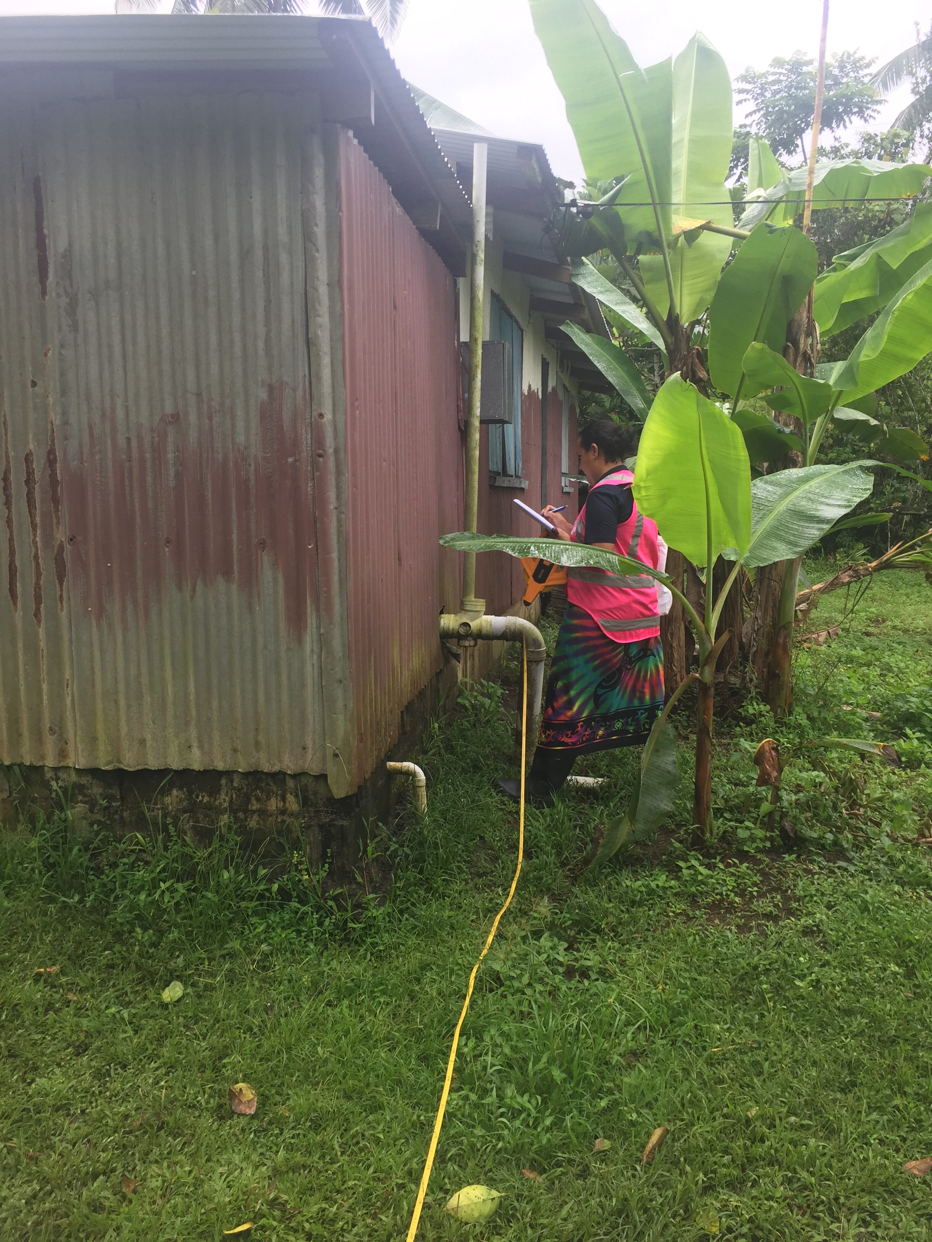
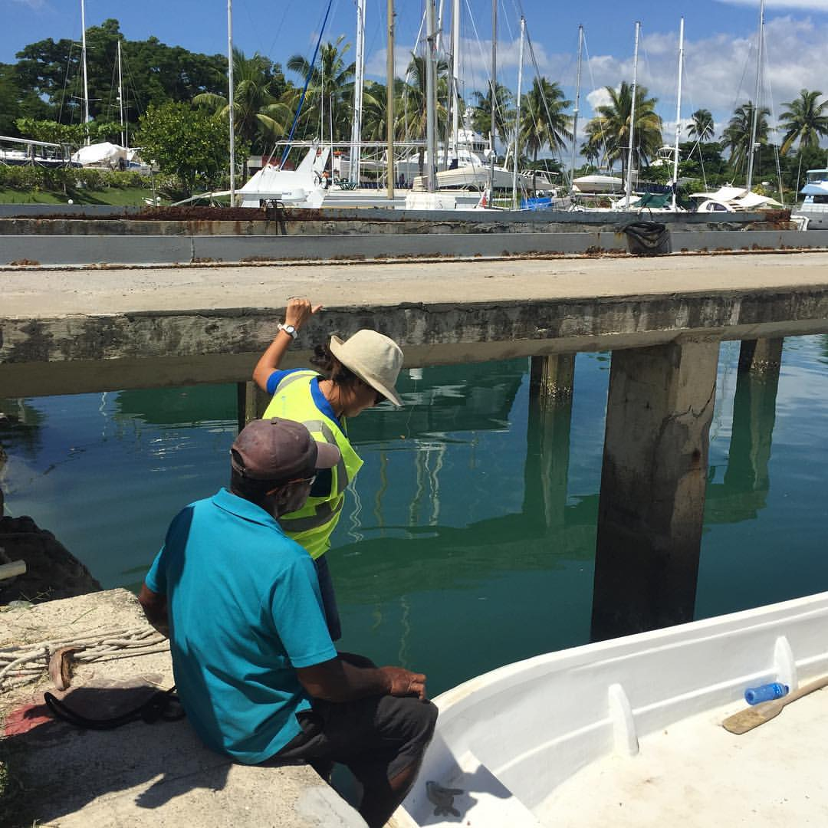
My Journey in Engineering

Slide 6
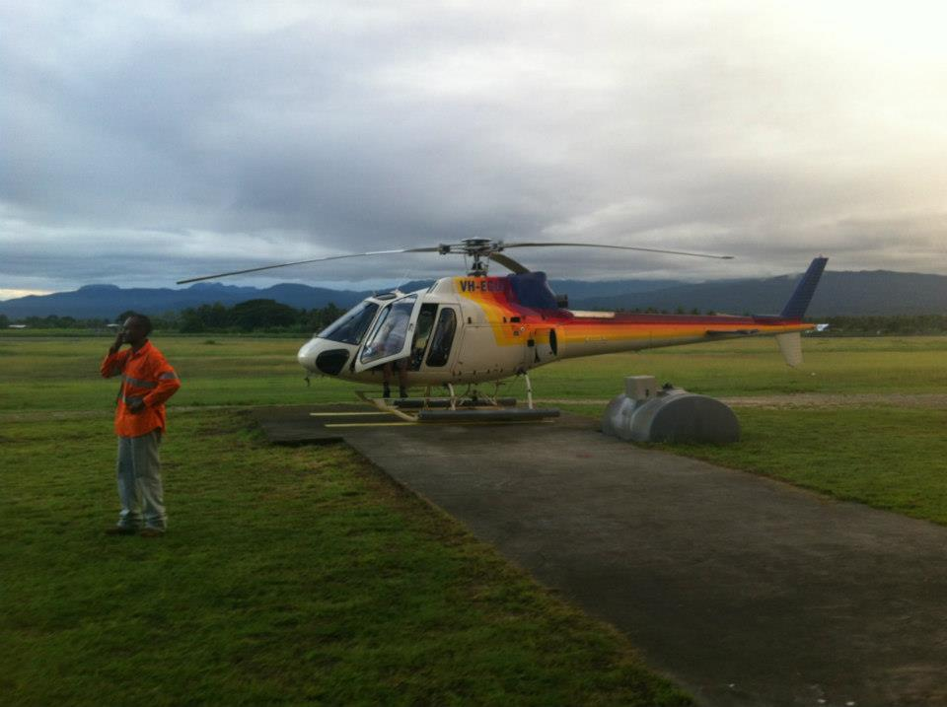
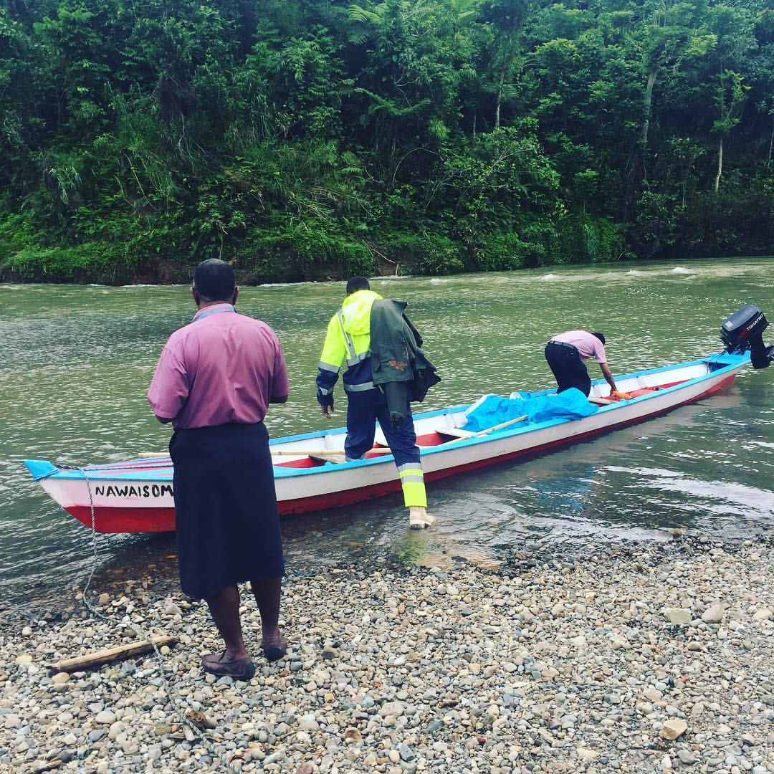
My Journey in Engineering

Slide 7
Overcoming Challenges in Engineering
• Finding mentors in a male-dominated field
• Learning from mistakes with the support of great leaders
• The value of exploring all aspects of Engineering

Slide 8
The Power of Mentorship
• Mentorship shapes professional growth
• Sharing knowledge leads to continuous improvement
• Creating a collaborative learning environment

Slide 9
The Importance of Women in Engineering
• Underrepresentation of women in Engineering
• Unique contributions women bring to problem-solving
• Diversity fosters innovation and resilience

Slide 10
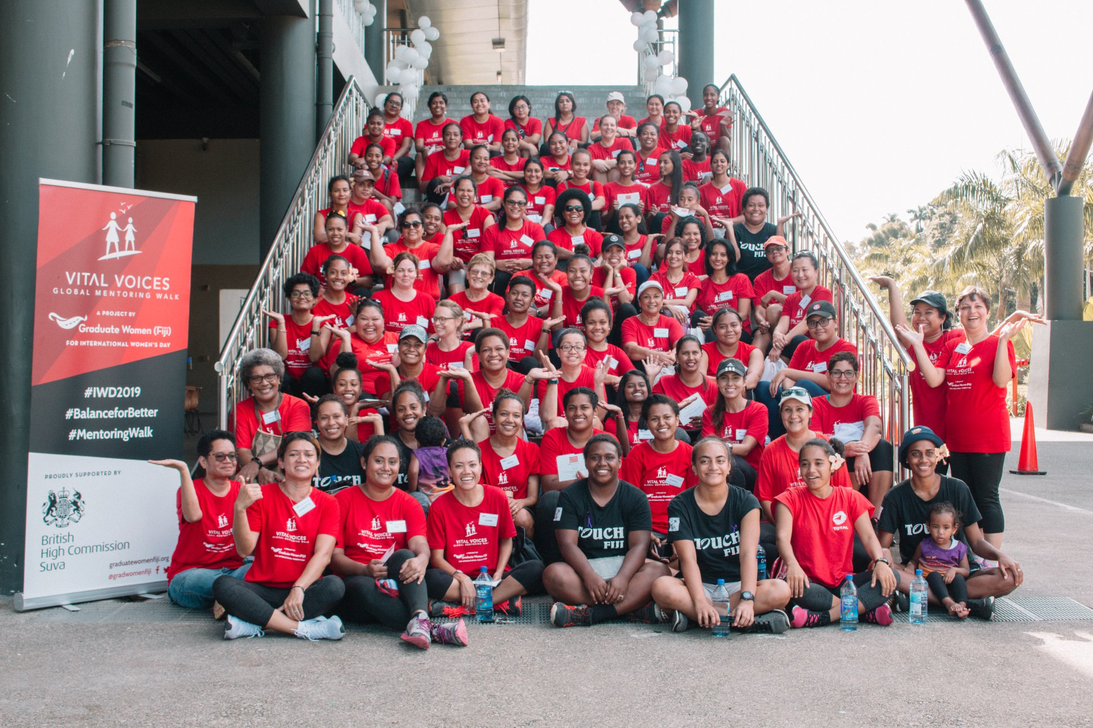
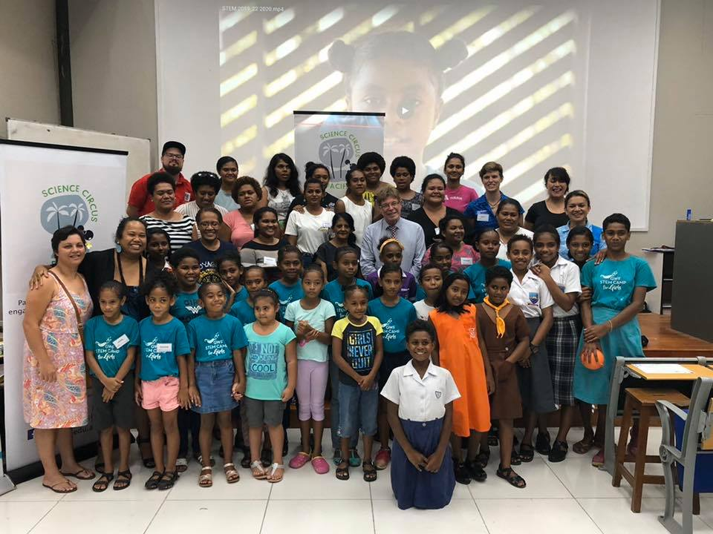
Mentoring programs
Graduate Women Fiji
STEM Girls Camps

Slide 11
Strengthening Women’s Participation in Infrastructure
• Mentorship and sponsorship are key to advancement
• Training and leadership opportunities for women
• Building inclusive workplace policies

Slide 12
The Role of the Private Sector in Promoting Diversity
• Private companies leading gender diversity initiatives
• Creating opportunities for women in infrastructure projects
• Fostering networking and community support

Slide 13
Sustainable and Resilient Infrastructure in the Pacific
• Importance of infrastructure that withstands Pacific environmental challenges
• Women’s contribution to sustainable engineering solutions
• The role of gender diversity in building resilience

Slide 14
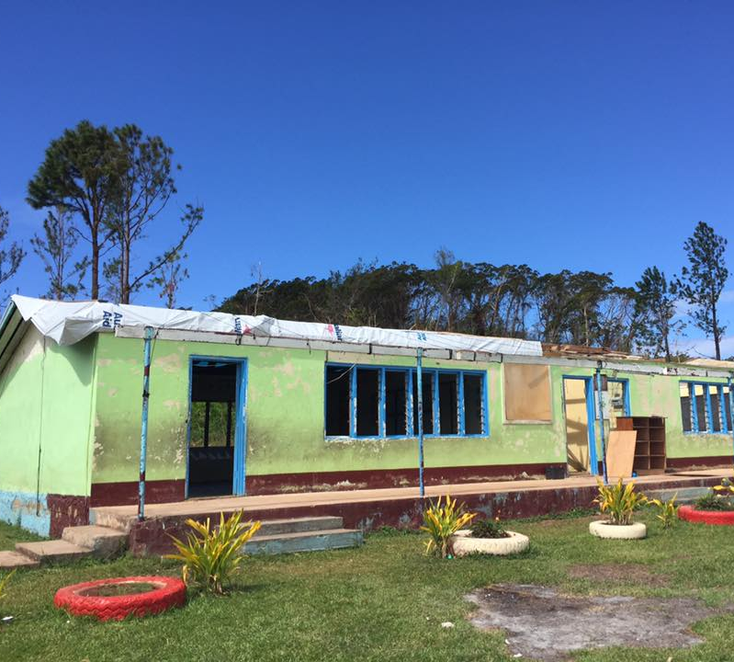
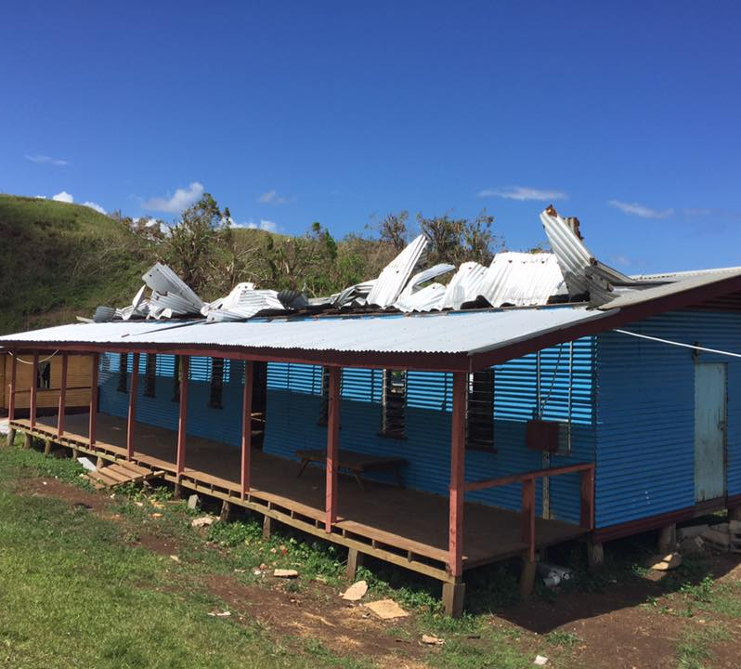
Cyclones

Slide 15
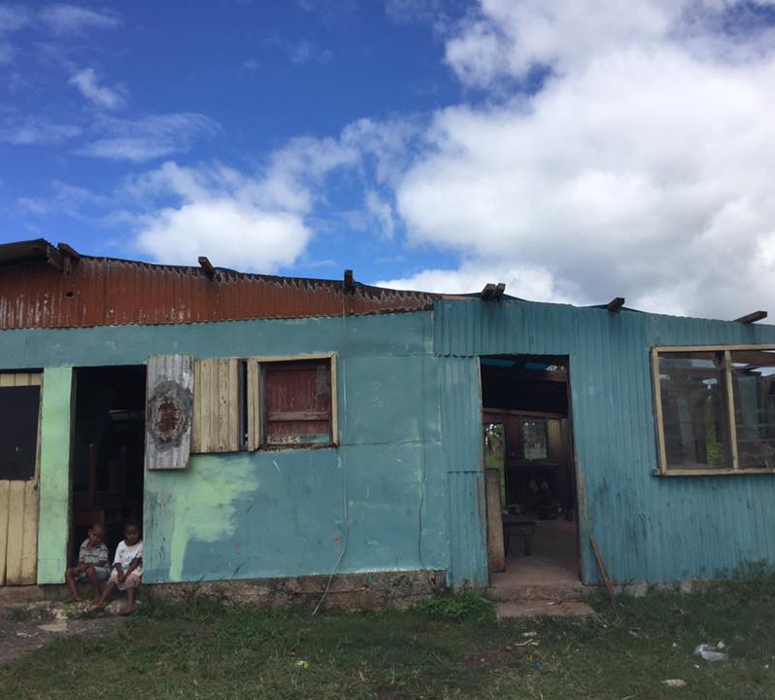
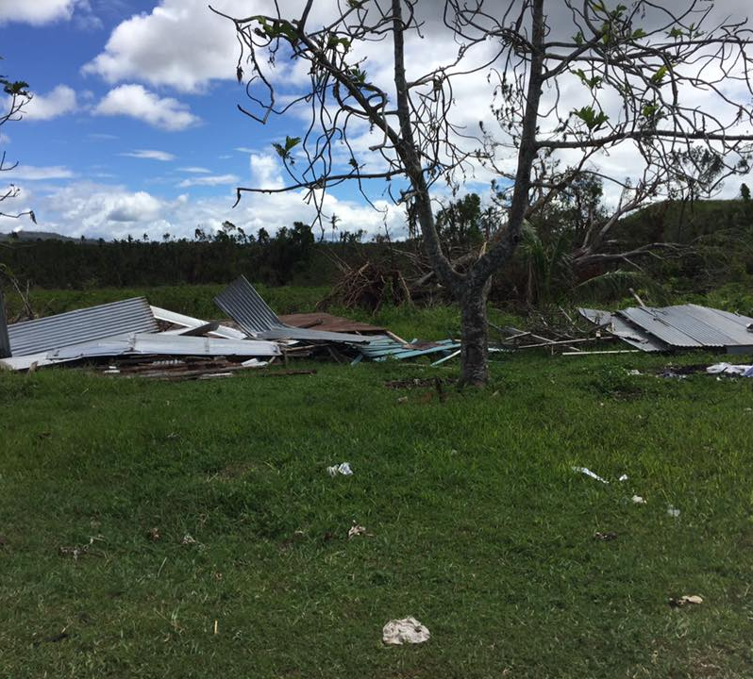
Cyclones

Slide 16
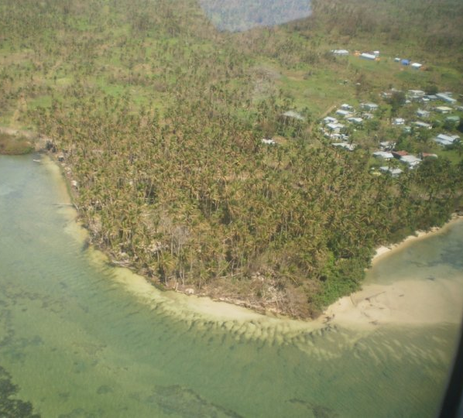
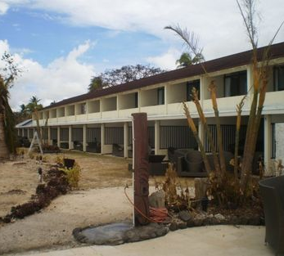
Cyclones

Slide 17
Call to Action: Building a Diverse and Resilient Future
• Encourage mentoring women in Engineering
• Advocate for inclusive policies in the workplace
• Promote women’s participation in sustainable infrastructure

Slide 18
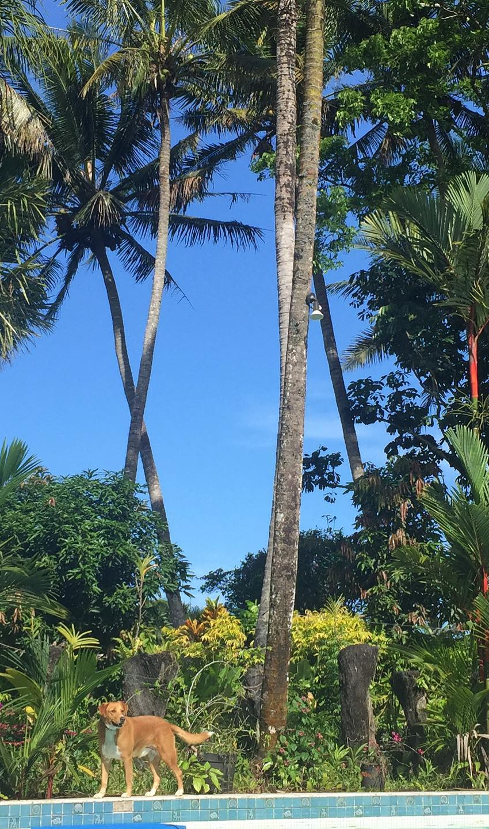
Thank You
Together, we can create a more inclusive and resilient engineering field that thrives in the Pacific.
Angela.Waradi@fijiwater.com

