Slide 1
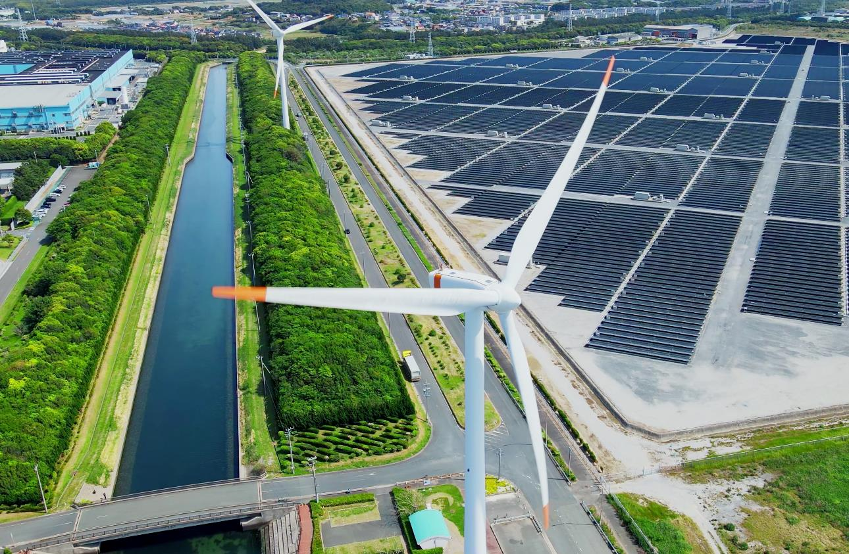
Inclusive infrastructure​
Prif week
2024

Slide 2
Setting the Context:
The World Bank’s mission and responsibilities

Slide 3
The Context: World Bank Environmental and social Framework (ESF)
MISSION:
End extreme poverty and boost shared prosperity on a livable planet
World Bank Responsibilities
Review and
Due Diligence
Borrower Responsibilities
Environmental and social policy
Legal Agreement including Environmental and Social Commitment Plan
Environmental and Social Standards
Bank Directives
Environmental, Health and safety guidelines
Assessment
And Implementation
Good Practice Notes
Guidance Notes

Slide 4
Scoping the challenge:
Inclusive Infrastructure

Slide 5
What is inclusive infrastructure?
Economic inclusion
Gender equity
Social inclusion
Access

Slide 6
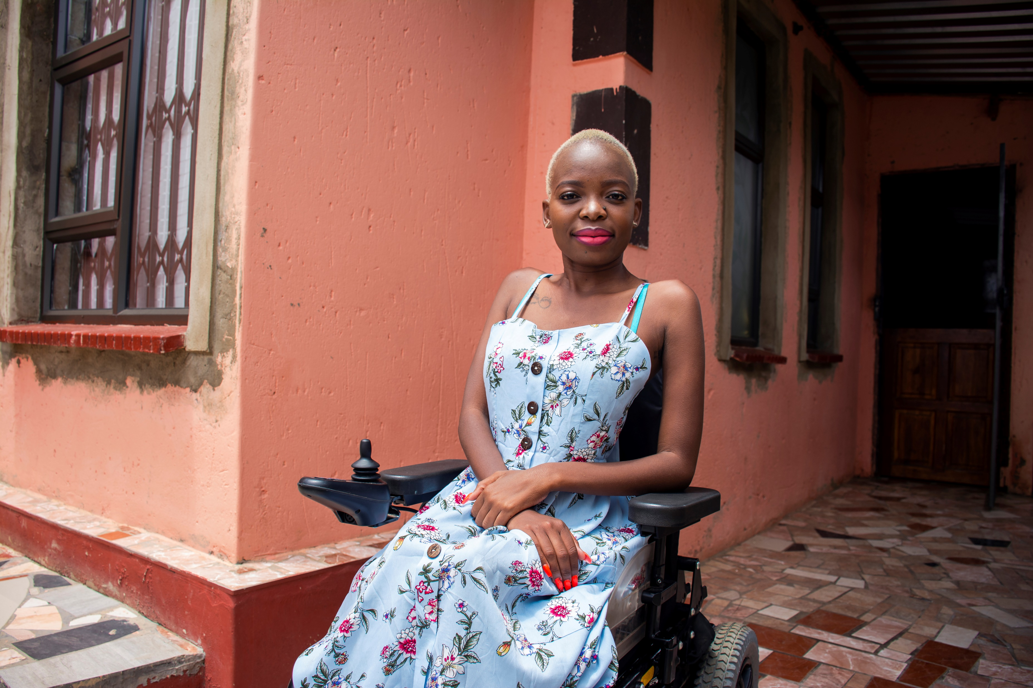


Why do we need inclusive infrastructure?
In every region, women have markedly different transport patterns to men – investment needs to recognize this
Globally, a 10% increase in broadband can boost GDP by up to 2.8%
Low investment in accessibility reduces mobility choice and GDP growth

Slide 7
Tools for driving inclusive infrastructure
Economic inclusion
Gender equity
Social inclusion
Access
World Bank PPP Gender Toolkit
PPIAF Inclusive Infrastructure Tool

Slide 8
Tools for delivering inclusive infrastructure

Slide 9
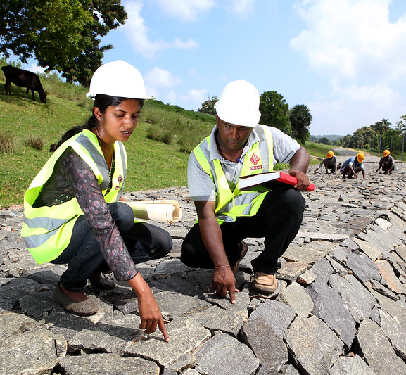
The PPP Gender Toolkit
Identify project
Exit
process
Module 1:
PPP Identification and Screening
Select project
Screen project as PPP
Other options
Prepare as PPP
Appraise PPP
Structure PPP
Module 2:
PPP Appraisal and Structuring
Module 5:
Transparency and Auditing
Other options
Proceed as PPP
Draft PPP contract
Module 3:
Transaction
Manage PPP transaction
Exit PPP process
Sign contract
Manage contract
Module 4:
Contract Management
9
Notes:
Questions that anchor the gender policy:
1. What are the policy, legal and socio-cultural constraints to women and men becoming full beneficiaries of MCC investments, and what design elements are required to remove or compensate for these constraints?
(2) What are the different roles and responsibilities of women and men and how do any differences affect the proposed project? How do these gender differences vary by other demographic and social characteristics of the beneficiary population?
(3) Are there gender inequalities in access and control of productive resources relevant to the proposed project, and how will they be corrected or mitigated in design?
(4) How will the proposed projects meet both practical needs and strategic gender interests, or those interests that correct structural inequalities that are impediments to economic growth and poverty reduction in a Compact program?
The purpose of the toolkit is to help governments, PPP practitioners, MDBs, and private sector participants mainstream gender consideration in infrastructure PPPs.
The toolkit aims to give key stakeholders practical tools that make it easy for them to incorporate gender aspects in the PPP project lifecycle to ensure better development outcomes.
It has delved into all the significant examples of PPPs that incorporated gender measures across the globe, and from these, it has curated the current best practices at each stage of the project cycle
The toolkit is meant to provide resources to help one think through the project and most effectively address gender issues
However, given the cultural and social aspects of gender gaps, users will have to customized the proposed solutions of the toolkit to the reality that it is being applied.
We invite you to test and pilot this toolkit, provide us with feedback so together we can strengthen and the business case for closing gender gaps through PPP projects in infrastructure.
Suggested transition between slides: as you can see in the slide, the toolkit follows the PPP project cycle and suggests tools that can be used at each stage of the project cycle… (go to next slide)

Slide 10
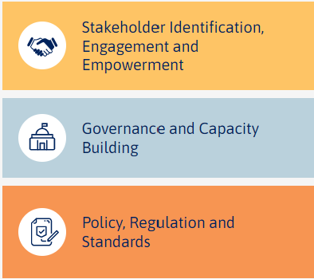
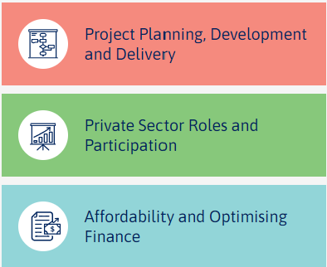
Inclusive Infrastructure Tool

Slide 11
CASE STUDY
Womens’ drivers’ licenses in Samoa

Slide 12


Case Study: Supporting women’s drivers’ license in Samoa
The Challenge…
In 2023, just 27% of licensed drivers in Samoa were women
A series of transport infrastructure upgrades to make roads safer and more climate resilient
Targeted program led by Samoa Land Transport Authority to encourage women to take their learner’s test led to hundreds of women working towards their license
Driving
Change

Slide 13
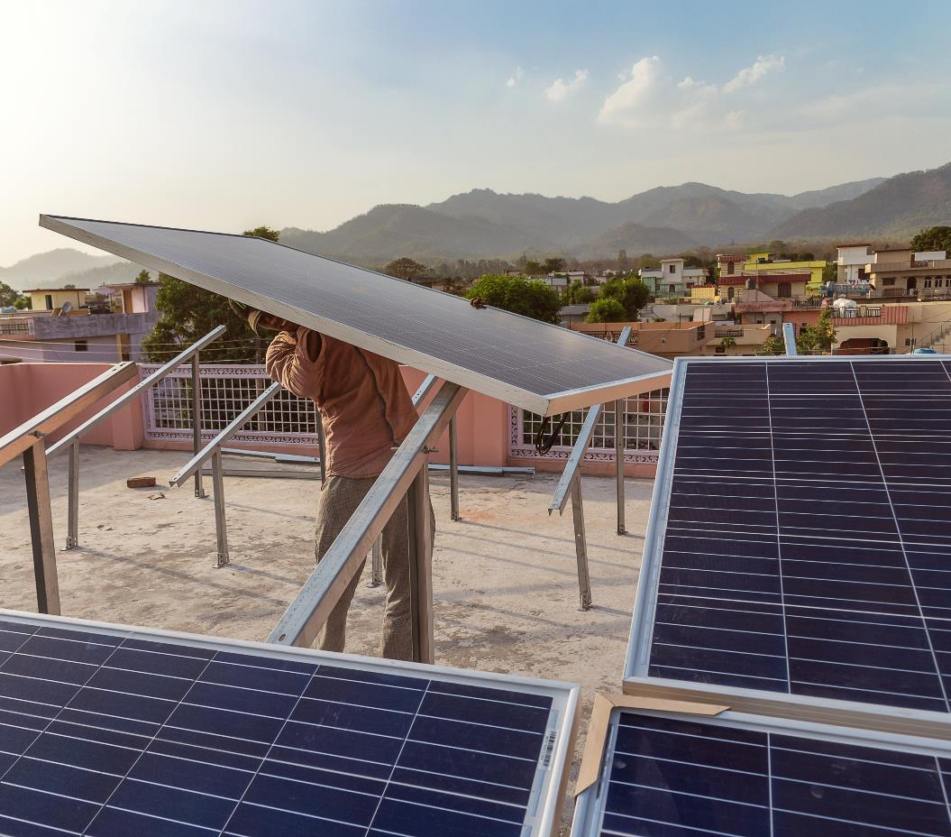
Thank you
Sam barr
Infrastructure specialist
sbarr@worldbank.org

