Slide 1
ADB Gender Mainstreaming Approaches
(Mitigating risks and enhancing gender benefits)
PRIF Week 2024: Sustainable and Resilient Infrastructure in the Pacific
Uzma Altaf
ADB Gender Specialist
8th October 2024)

Slide 2
Presentation Outline
ADB’s gender mainstreaming approach with a focus on gender responsive infrastructure in the Pacific across transport, energy, urban and water sectors
Gender analysis address climate change
Workplace discrimination and mitigating negative impacts

Slide 3
ADB’s gender mainstreaming approach

Slide 4

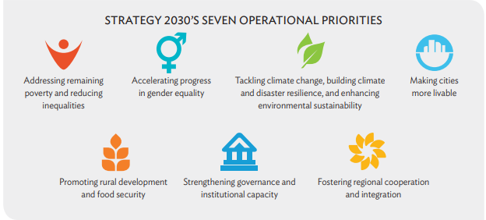

ADB Strategy 2030
Notes:
Strategy 2030 Document
https://www.adb.org/sites/default/files/institutional-document/435391/strategy-2030-main-document.pdf
p. 15-16

Slide 5
ADB’s gender mainstreaming Categories
ADB approaches gender mainstreaming from two perspectives:
(i) “do no harm” mitigating the negative gender impacts through social safeguard policies and practices and
(ii) “do more good” maximizing gender benefits for the project beneficiaries with a focus on women and vulnerable groups. Gender targets and indicators are included in the gender action plans (GAPs) prepared for the project implementation.

Slide 6
ADB’s gender mainstreaming approach
Gender equity as a theme (GEN)
Effective Gender Mainstreaming (EGM)
Some Gender Elements (SGE)
No Gender Elements (NGE)

Slide 7
ADB’s gender mainstreaming Categories
Gender Equity Theme-GEN
A Project is assigned GEN theme if its outcome directly addresses gender equality and/or women‘s empowerment by narrowing gender disparities through access to:
  social services (e.g. education, health, and WSS);
  economic and financial resources and opportunities (e.g. employment opportunities, financial services, land, and markets);
  basic rural and urban infrastructure (e.g. rural electrification, rural roads, pro-poor energy distribution, pro-poor urban services);
  enhancing voices and rights (e.g. decision making processes and structures, political empowerment, grievance mechanisms);
The DMF outcome statement explicitly mentions gender equality and women's empowerment and/or, the DMF outcome performance indicators include gender indicators.
Gender Assessment and Action Plan (GAAP) is required

Slide 8
ADB’s gender mainstreaming Categories
Effective Gender Mainstreaming-EGM
A project is assigned EGM if the project outcome is not gender equality or women’s empowerment, but project outputs are designed to directly improve women’s access to social services, and/or economic and financial resources and opportunities, and/or basic rural and urban infrastructure, and/or enhancing voices and rights, which contribute to gender equality and women's empowerment.
Gender mainstreaming requirements:
Outcome does not directly address women’s concerns and needs
At least 50% of project outputs have gender targets, indicators (for women project beneficiaries
Gender Assessment and Action Plan (GAAP) is required

Slide 9
ADB’s gender mainstreaming Categories
Some Gender Elements-SGE:
A project is assigned SGE if it meets either of the following:
by nature likely to directly improve women’s access to services, opportunities and improved voice but does not meet EGM criteria; or
unlikely to directly improve women’s access etc. but significant efforts were made to include some gender features; and where resettlement is included, attention to women in mitigation plans.
Gender Assessment is required, GAP is not required.
No Gender Elements-NGE: A project is assigned NGE category when it does not include any gender design features.

Slide 10
Sector-Specific Strategies
Energy: Promoting women’s participation in energy projects, ensuring women’s access to energy services, and supporting female employment in the energy sector.
Urban Development: Enhancing women’s safety and mobility in urban areas, improving access to urban services, and supporting women’s economic opportunities.
Water and Sanitation: Ensuring women’s involvement in water management, improving access to clean water and sanitation facilities, and addressing women’s specific needs in sanitation projects.
Transport: Women’s access to safe and affordable transportation, promoting gender-sensitive transport planning, women’s employment in the transport sector

Slide 11
Project examples
Fiji Transport Infrastructure Investment Project:
This project aimed to improve the resilience and sustainability of Fiji’s transport infrastructure.
Key features of Gender Action Plan:
Women’s participation in project planning/design
Gender design features like safety and security for women, girls and vulnerable groups
Capacity development of FRA and contractors on gender issues such as Sexual Exploitation Abuse and Harassment (SEAH) and gender-fair work environment.

Slide 12
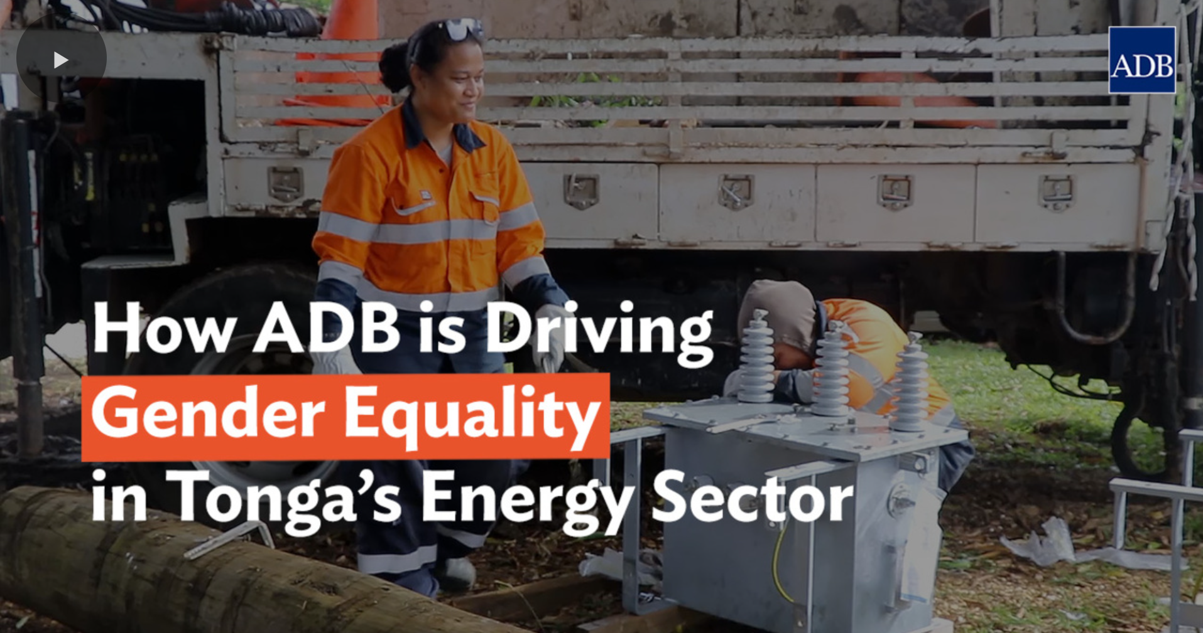
Project examples
Tonga and Outer Islands Renewable Energy Projects:
This project aims to increase the share of renewable energy in Tonga’s energy mix.
Key gender features:
promoting women’s participation in the renewable energy sector,
providing training and employment opportunities for women, and ensuring that women benefit from improved access to reliable and affordable energy

Slide 13
Gender and Climate Change

Slide 14
Gender Analysis – Climate Change
Key aspects for gender analysis
Gender differential roles and responsibilities
Knowledge, Skills and livelihood sources for both men and women
Access and control over productive resources and assets
Women’s role in value chains and coastal zones (urban, coastal forest, mangrove forest, coral reef, seagrass bed, and deep sea)
Who is vulnerable to climate change and how?
Men and women roles in Natural Resources Management
Challenges faced by both men and women
What can be done to ensure that men and women could equally benefit from a coastal resilience investment?
How to maximize the potential of women as “leaders” and “change agents”?

Slide 15
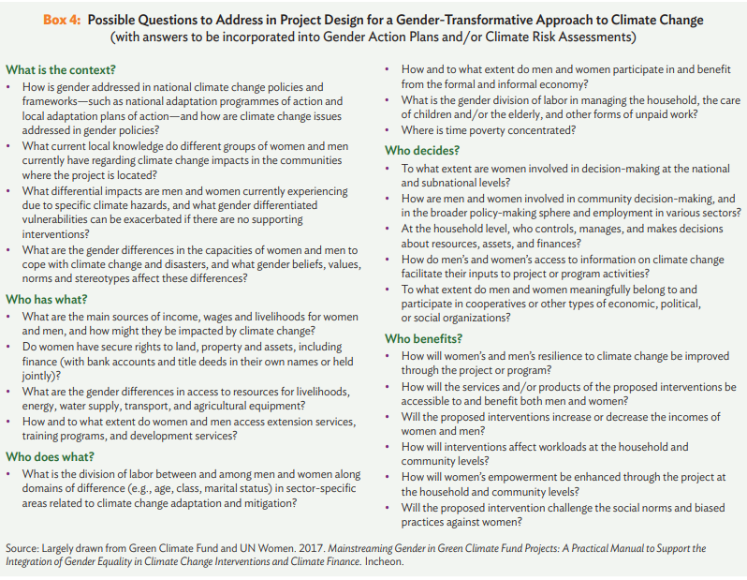
Gender Analysis – Climate Change

Slide 16



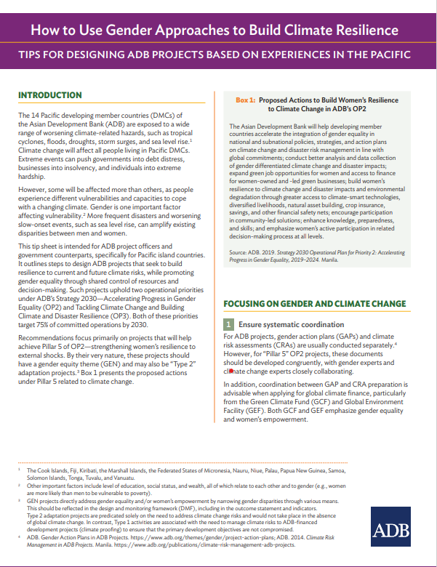
ADB initiatives

Slide 17
Gender discrimination at workplace and mitigating risks

Slide 18
Mitigating negative gender impacts
Typical negative gender impacts may include but not limited to:
  Sexual exploitation, abuse and harassment (SEAH)
  increased gender-based violence e.g. due to relocation and resettlement,
  mobility and privacy of the local communities could be compromised due to construction and influx of workers etc.
SEAH risks are higher in infrastructure projects male-dominated industries or workplaces with characteristics such as (i) lack of gender diversity; (ii) lack of organizational sensitivity; (iii) lack of implementation arrangements for addressing gender issues; (iv) limited understanding of SEAH; (v) remote and isolated work environment; and (vi) socio-cultural norms perpetuating gender stereotypes

Slide 19
Prevention, Mitigation, and Response to SEAH
SEAH risk assessment & project risk category
PSEAH capacity assessment and needs for support
Service mapping for referrals
SEAH action plan, budget, and responsibilities
SEAH in Grievance Redress Mechanism
Project monitoring system and reporting on SEAH
Capacity building

Slide 20
ADB Good Practice Note (GPN) on Addressing SEAH in ADB-Financed Projects with Civil Works
To assist with SEAH risk identification within selected ADB financed sovereign projects with civil works
To advise ADB staff and borrowers on how best to prevent, mitigate and respond to SEAH risks
It is advisory in nature and applies only to new sovereign projects, with civil works, in selected ADB developing member countries, for a pilot period as designated by ADB.

Slide 21
Challenges & Opportunities
Challenges
Capacity at EA and IA level
Quality of Gender assessments and action plans preparation.
GAP implementation and reporting.
Readiness level of women and girls (participation in STEM, lack of clarity and awareness on career pathways, interest and willingness to work in male-dominated sectors)
Readiness level of infrastructure sector (policy environment, capacity, work environment, perceptions and mind set)
Inadequate budget allocations and lack of clarity on roles and responsibilities
Quality of data. (gender diversity, disabilities, vulnerabilities etc)
Reverse gender GAP in Pacific Island Countries Vs ADB’s OP2 results framework focus.

Slide 22
Challenges & Opportunities
Opportunities
Policy Environment is favorable in Pacific Island Countries
Sector specific focus of ADB (institutional capacities, policies and reforms)
Donor Coordination
Integration of gender design features as part of the international standards

Slide 23
Knowledge Products, Tools and Resources
ADB Gender Policies and Plans
ADB Gender Policies and Plans
Operational Priority 2: Accelerating Progress in Gender Equality (adb.org)
https://www.adb.org/sites/default/files/institutional-document/33623/guidelines-gender-mainstreaming-categories-adb-projects.pdf
Midterm Review of ADB’s Corporate Results Framework, 2019-2024

Slide 24
Knowledge Products, Tools and Resources
ADB Gender Tools and Tips
Guidelines for Gender Mainstreaming Categories of ADB Projects
Tip Sheet No. 3 - Implementing Gender Action Plans: Roles and Responsibilities (adb.org)
Gender Tip Sheets | Asian Development Bank (adb.org)
Tip Sheet No. 5 - Gender Inclusive Results in Project Completion Reports (adb.org), Guidelines for the At-Exit Assessment of Gender Equality Results of ADB Projects
Gender Tool Kit: Transport—Maximizing the Benefits of Improved Mobility for All (adb.org)
Gender Tool Kit: Energy: Going Beyond the Meter (adb.org)
Good Practice Note on Addressing Sexual Exploitation, Abuse, and Harassment in ADB-Financed Projects with Civil Works

Slide 25
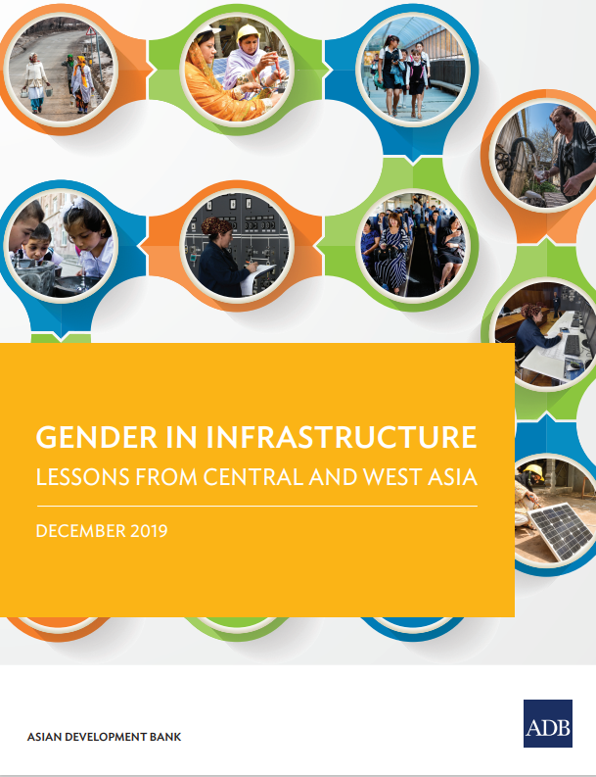
Knowledge Products, Tools and Resources
Resources
Training Manual to Support Country-Driven Gender and Climate Change (adb.org)
Green Jobs for Women: Construction Skills for Fijian Women | Asian Development Bank (adb.org)
Gender in Infrastructure: Lessons from Central and West Asia | Asian Development Bank (adb.org)
When Investing in Infrastructure, Don't Forget Gender | Asian Development Blog (adb.org)

Slide 26
THANK YOU

