Slide 1



The Australia New Zealand Infrastructure Pipeline
Mollie Matich
Head of Policy and Research
Infrastructure Partnerships Australia

Slide 2


Jointly established and owned between the public and private sectors
Focused on policy development and advocacy of efficient infrastructure markets
Publish research outputs at infrastructure.org.au
Produce Infrastructure Pipeline (ANZIP) infrastructurepipeline.org
Notes:
2

Slide 3
What is ANZIP
A single, aggregated database of major economic and social infrastructure projects in Australia and New Zealand
ANZIP tracks infrastructure opportunities by status across:
  Prospective
  Detailed Planning
  Announced
  Under Procurement
  Awarded
  Under Delivery
  Operational
Notes:
Hard part is data availability, data validity and accuracy overtime
3

Slide 4
What is ANZIP (cont).
Tracks:
  economic infrastructure projects over A$300 million and NZ$150 million, and
  social infrastructure projects over A$100 million and NZ$50 million
ANZIP provides a transparent, detailed and independent snapshot of infrastructure investment, construction, operation and privatisation opportunities for investors, constructors, governments, advisors, researchers and the broader community
Notes:
4

Slide 5
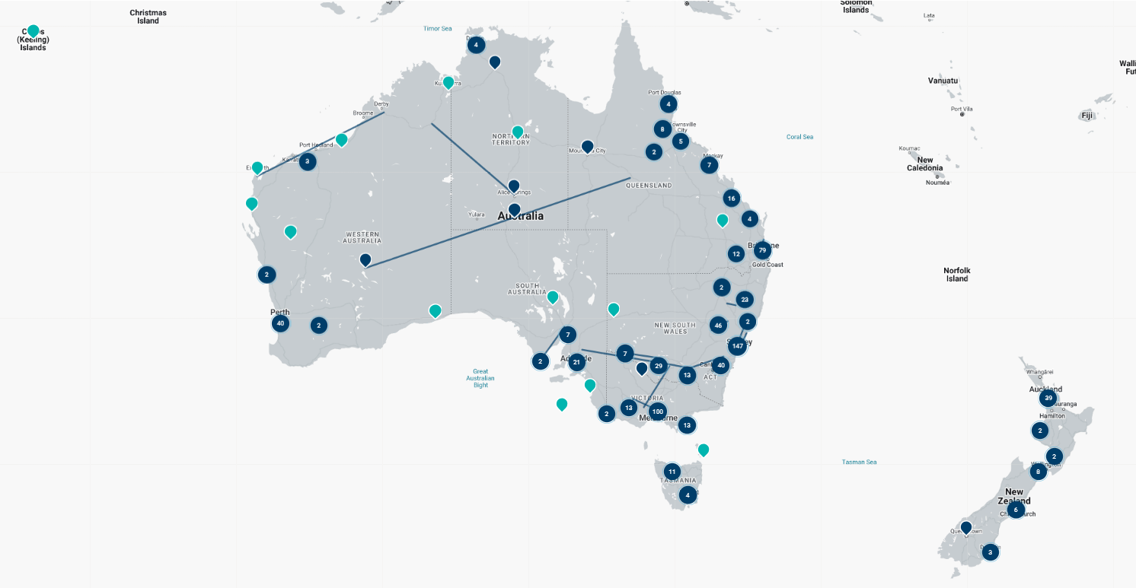
Australia New Zealand Infrastructure Pipeline (ANZIP)

Slide 6
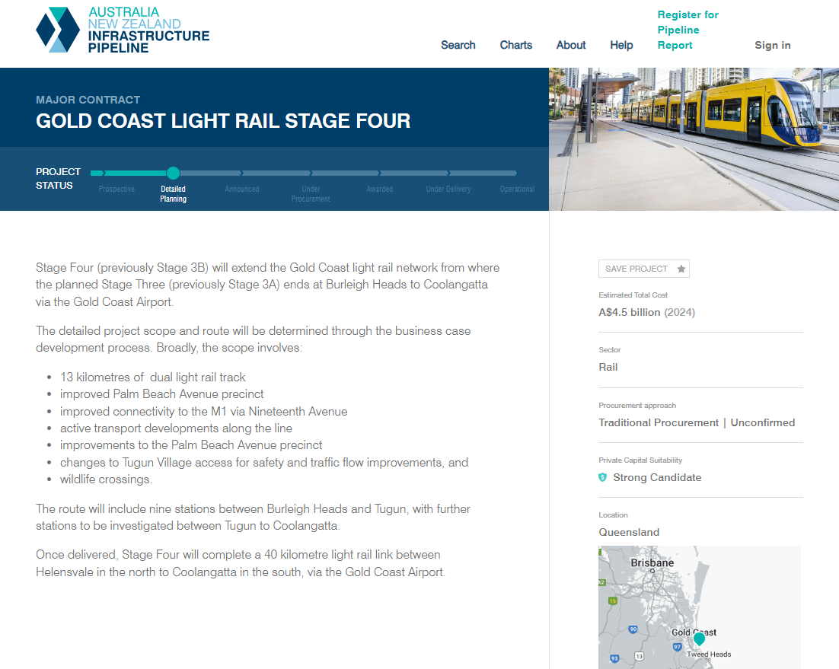

Slide 7
Context
Product with a purpose: a single market
Started simple, expanded with capability
Launched ANZIP 2016
ANZIP 2.0 launched 2021
Notes:
7

Slide 8
Development Horizons
Horizon 1 – Development pathway
Horizon 2 – Snapshot data and comparative analysis
Horizon 3 – Longitudinal data set capability of historic analysis
https://infrastructurepipeline.org/
Notes:
8

Slide 9
Horizon 3 – Longitudinal and comparative analysis

Slide 10
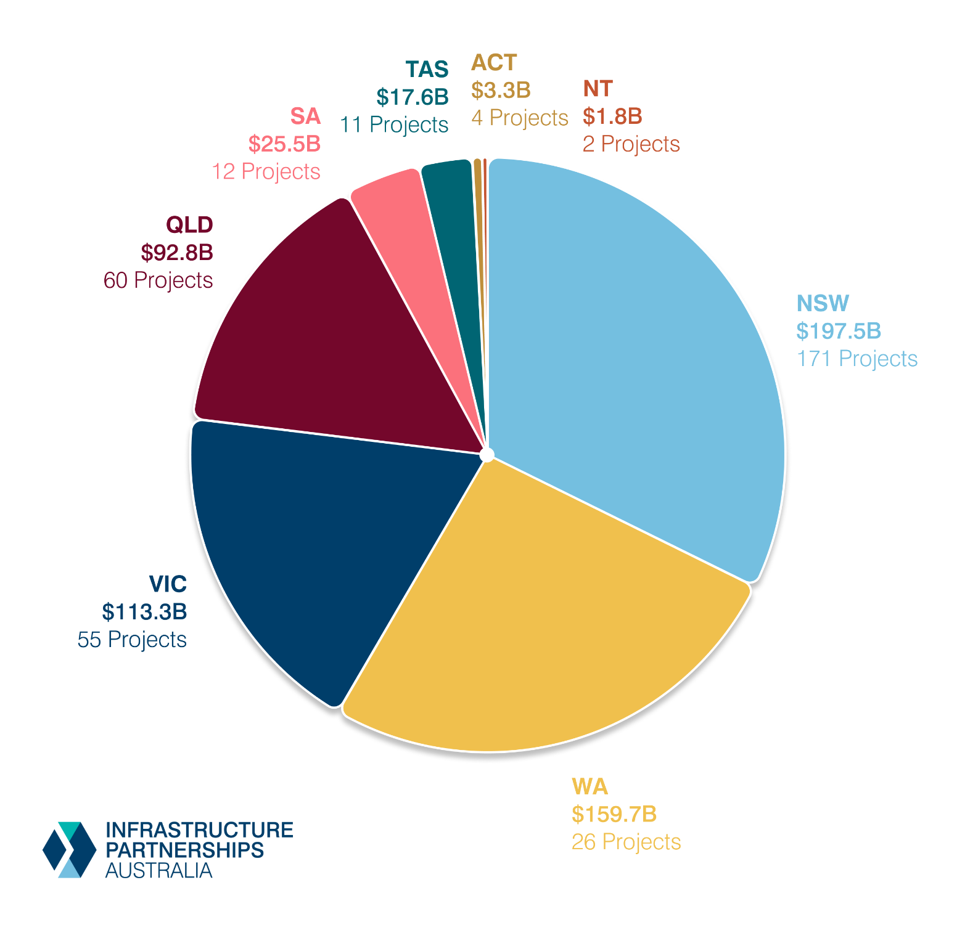
Forward Pipeline by Jurisdiction
341 projects valued at $611 billion on ANZIP yet to have a contract awarded
Notes:
10

Slide 11
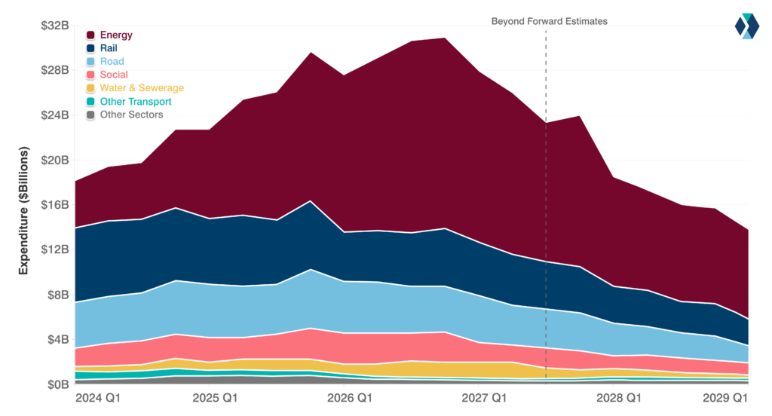
Forecast
Expenditure
by Sector
Total quarterly expenditure forecast to peak at $31.9 billion in Q4 2026
Energy expenditure to peak at $17 billion at same time
Notes:
11

Slide 12
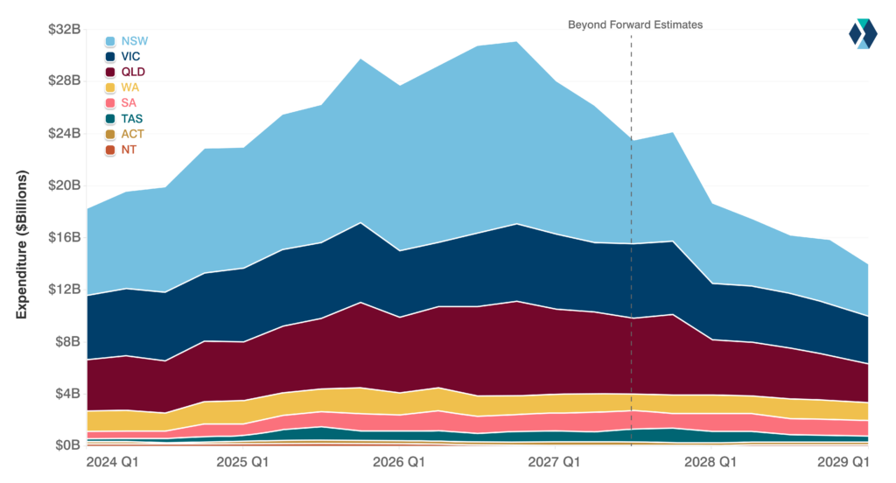
Forecast
Expenditure
by Jurisdiction
NSW quarterly expenditure forecast to average $9.1 billion over the next five years
Notes:
12

Slide 13
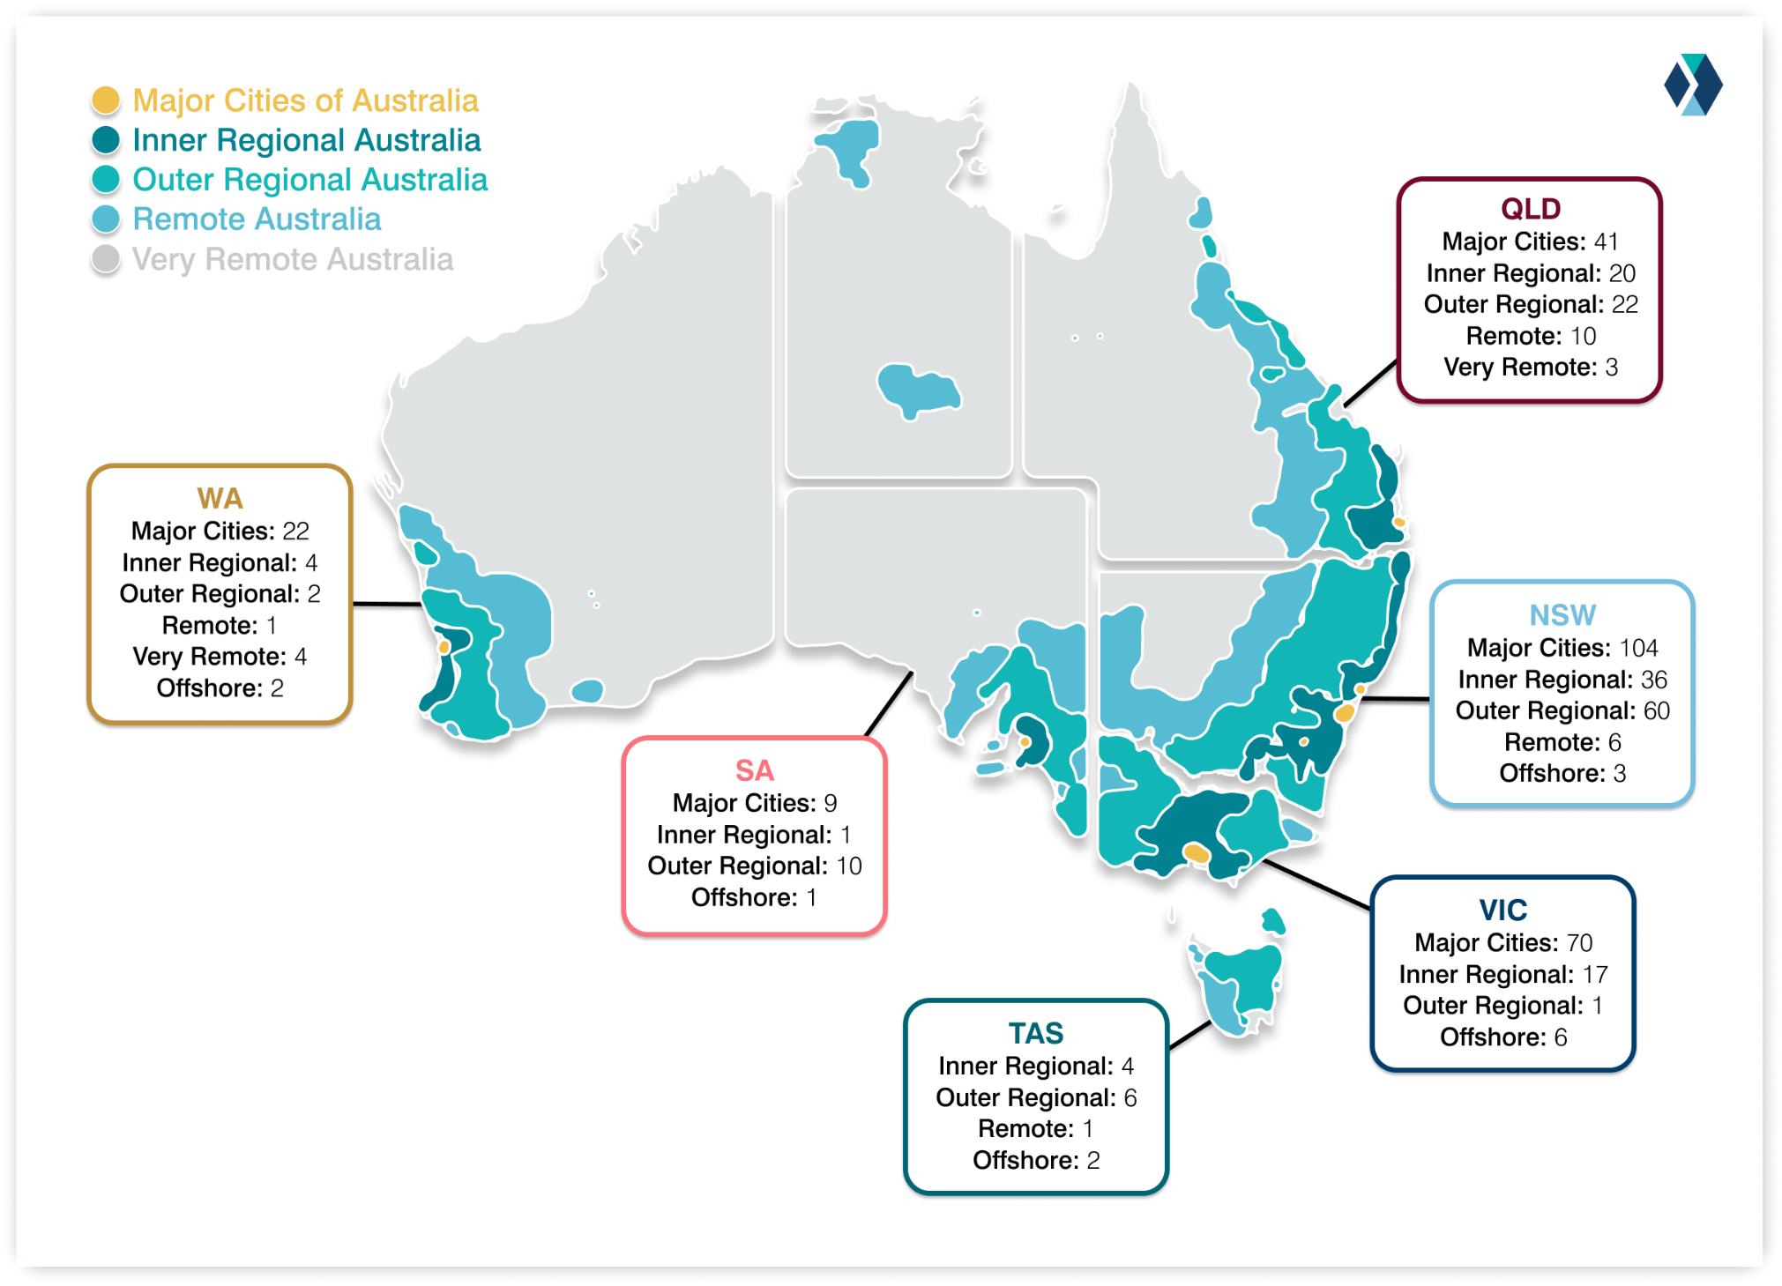
Pipeline by geographic category
Notes:
13

Slide 14
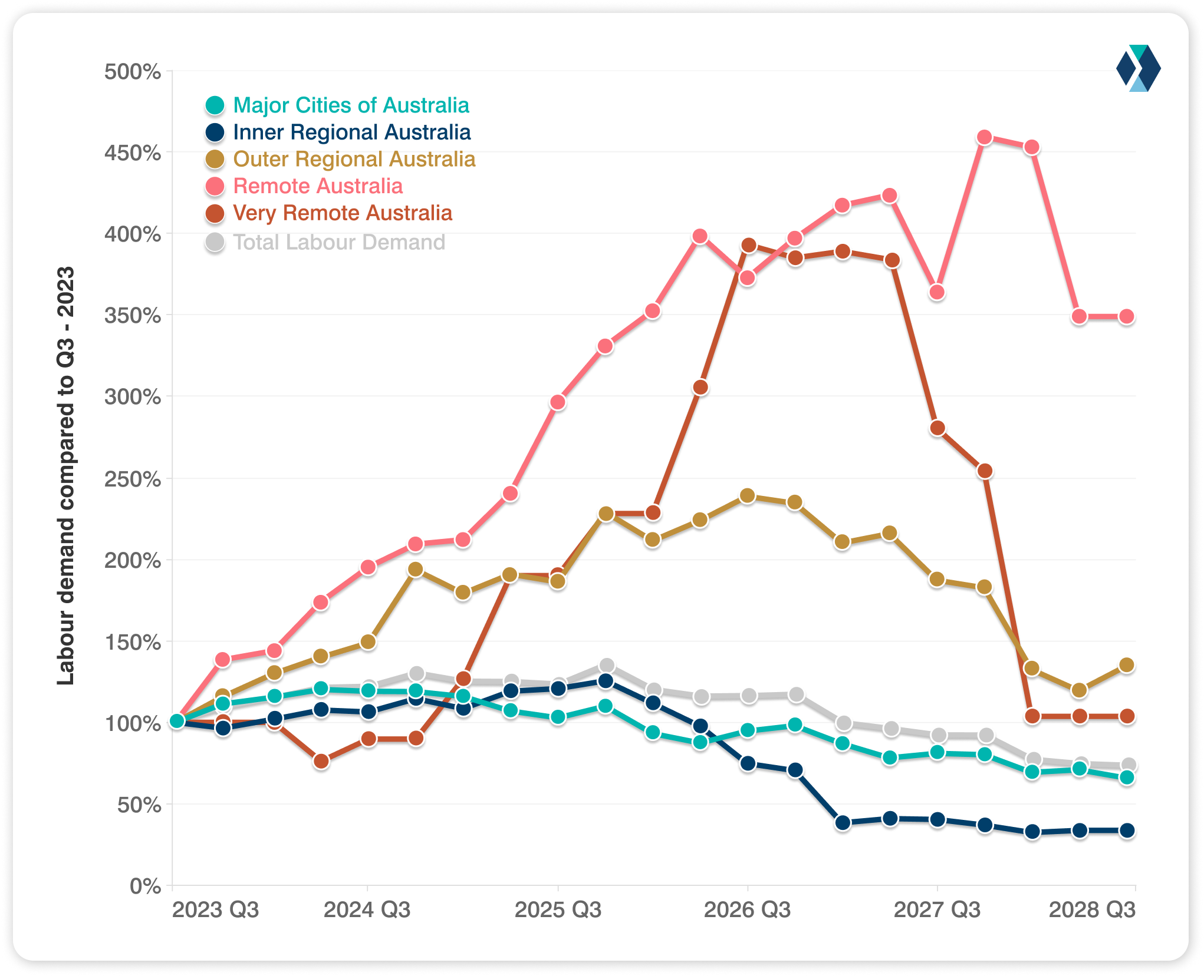
Labour Demand by geographic category
Labour demand for infrastructure in Inner Regional Australia will grow by 30 per cent by 2026, and 150 per cent in Outer Regional areas.
Notes:
14

Slide 15
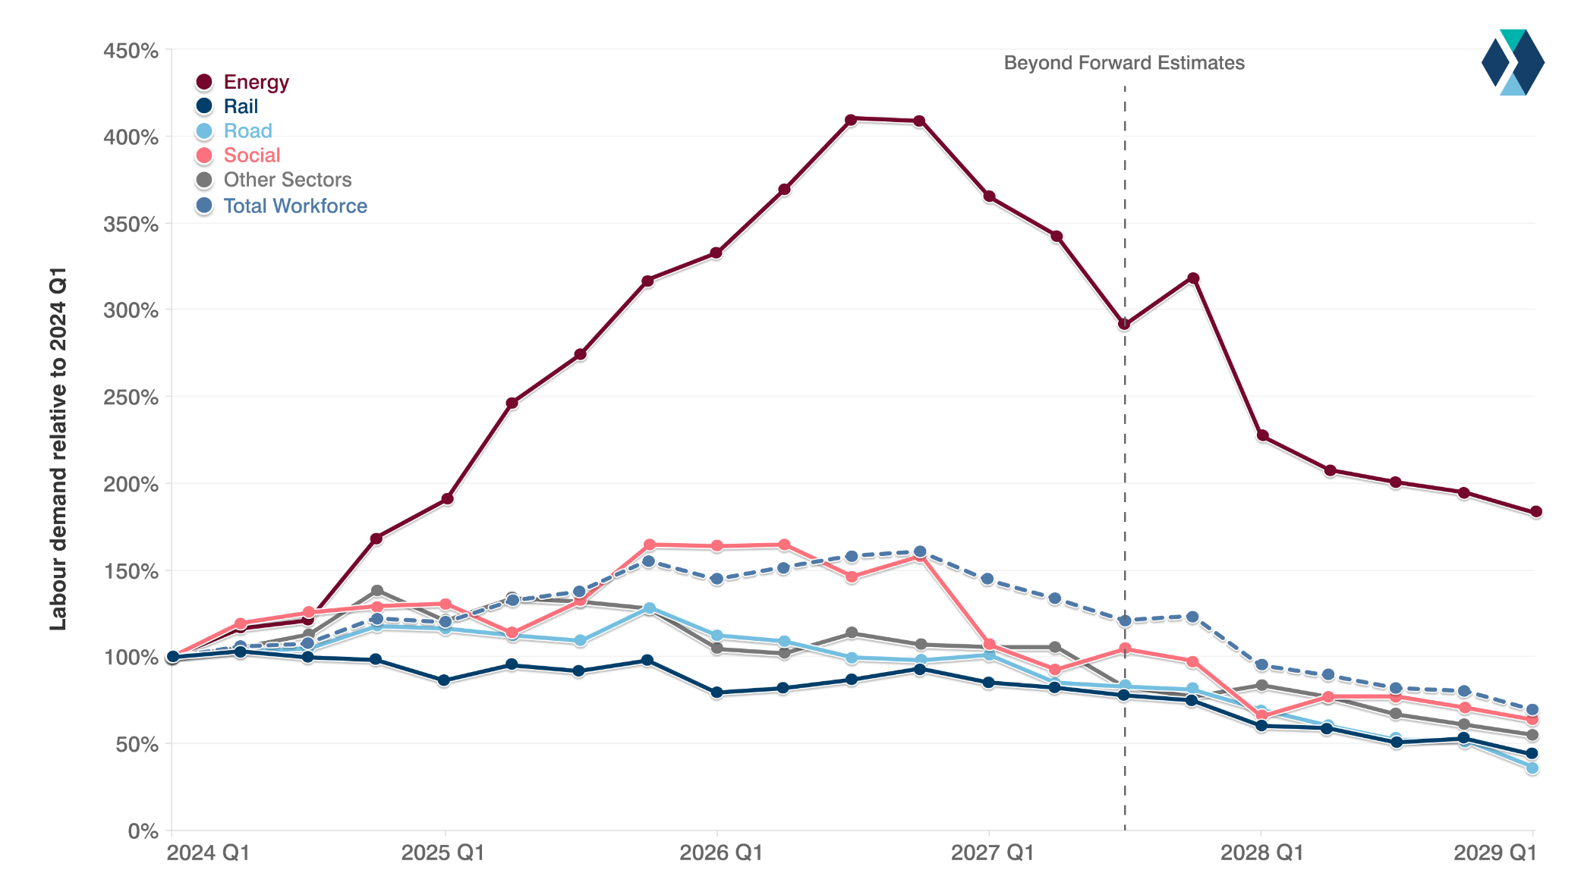
Labour Demand by Sector
Total labour demand for infrastructure forecast to peak at 160 per cent of current levels in Q4 2026
Labour demand for energy projects will peak at the same time at almost 409 per cent of current levels
Notes:
15

Slide 16


Thanks
Explore
more
Catch up on the most recent policy reports, listen to our latest podcast or to stay in contact through LinkedIn

