Slide 1
GEDSI & Digital Resilience in the Pacific
Tait Brimacombe, AIFFP GEDSI Advisor
PRIF Week 2024

Slide 2
Overview
Why use a GEDSI lens to understand digital resilience?
Framing our approach to digital resilience: 3 pillars
AIFFP’s approach:
  Regional scoping report
  Palau pilot
Key learnings so far

Slide 3
Why a GEDSI approach to digital resilience?
Digital resilience
Infrastructure approach to ‘hard infrastructure’ & cable resilience.
Pacific calls for support to manage the downstream impact of this connectivity & bolster digital resilience for users.
Gender, Disability & Social Inclusion (GEDSI)
Increasing efforts to respond to GEDSI – renewed policy focus.
Fewer project-level entry points to integrate GEDSI.
Failure to apply a GEDSI lens could mean failing to take advantage of opportunities to value add or inadvertently perpetuating/widening existing inequalities.
The bigger picture
Data poor environment & evidence gaps.
Crowded donor space, potential for duplication.
Notes:
In the infrastructure sector we often understand digital resilience in the context of hard infrastructure – resilience and redundancy cables, ensuring continuity of connectivity.
However, we’re increasingly hearing from Pacific Island counterparts that in conjunction with this cable resilience, they also need support to adequately prepare for and manage the downstream impact of this increased connectivity, particularly for users.
In parallel also exploring ways to strengthen our approach to GEDSI in our projects, particularly in the wake of DFAT’s new development policy and increasing gender and disability priorities.
At AIFFP, we have a number of ways we integrate GEDSI at a project level including mitigation and management of risks as well as identification of impact opportunities to maximise benefit in our investments. However, we were finding fewer project-level entry points to do so in our cable investments, particularly where we were financing redundancy or resilience infrastructure and had limited community and user interface at a project level.
But… failure to apply a gender lens to this kind of work could mean missing out on opportunities to value add & support digital resilience efforts alongside cable infrastructure or could result in inadvertently perpetuating inequalities because we’re not able to adequately track the long-term impacts.
At the same time, it was harder to get as clear a picture of the needs and issues – we know there are substantial data gaps in the Pacific when it comes to digital connectivity, particularly form a GEDSI perspective, including significant gaps in sex disaggregated data. This makes it difficult for us to ascertain existing gaps and entry points. We have integrate some specific country-level GEDSI analysis on these issues into some of our projects investments, but there’s a need for a bigger picture as we know many of the issues and challenge in this space are shared throughout the region… need to step back and understand the bigger picture at a sectoral level.
Also crowded donor space with varying degrees of visibility, increasing burden on small SoEs and government departments and potential for duplication
So… at AIFFP we decided to step back and take a regional and sectoral approach to better understanding digital resilience constraints and opportunities with the aim of scoping appropriate entry points for wrap around support to help value add to our cable investments.
Disclaimer – very early days.

Slide 4
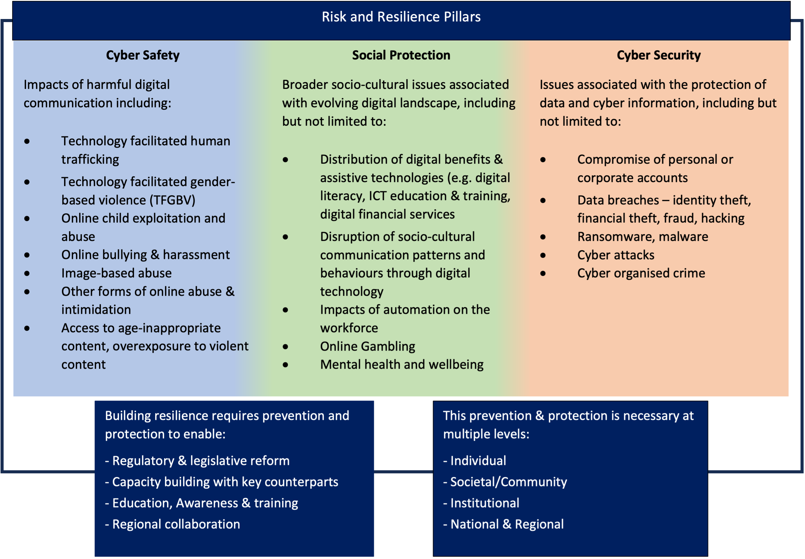
Notes:
In order to do this, we needed to clarify our understanding of digital resilience, particularly the ways it intersects with GEDSI.
Not stand-alone categories, overlap between the three
Australian context – clear distinction between cyber security and cyber safety, but increasingly seeing in Pacific understandings of cyber safety being wrapped up in cyber safety discussions, particularly as legislative and policy reform struggles to keep pace with rapid advancements … however, with a rush to respond to increasing cyber security threats, there is a risk that more individual and community level concerns over cyber safety, socio-cultural disruptions can get dismissed/ignored.
Designed to capture both risk and resilience/opportunity – the need to pay attention to the underlying impacts of those opportunities to ensure they are equitable distributed
To build digital resilience in these areas there is a need to focus prevention and protection efforts at several different sectoral levels
Regulatory and legislative reform
Capacity building (cyber maturity)
Education, awareness and training
These prevention ad protection efforts need to take place at multiple levels:
Nationally and internationally
Institutionally (within governments, private sector)
Societal and community level
Individual level.
This is the framework we’re using to underpin our conceptualization of digital resilience.

Slide 5
What we’ve done
Regional scoping report:
  Build a clearer evidence base on GEDSI & digital resilience in the region
  Begin to map the work of other donor counterparts
Whole of Aust. Govt mapping
Palau pilot to test approach
Next steps: country briefs to support dialogue & scope opportunities for value-add.

Slide 6
Key Learnings so far
Gender social norms and disability stigma drives digital gaps, inequalities and barriers
Online safety issues disproportionately impact women & are compounded by high rates of GBV (offline) & existing norms
Link between digital literacy and digital safety
Underpinning factors include: gendered social norms, exclusion & stigma, education, unemployment/poverty
Significant data gaps in the region = risk of inadvertently perpetuating gaps & challenges monitoring progress
Notes:
Women and girls with disabilities face additional, compounding challenges to accessing and using digital technologies. These gaps are exacerbated by:
Lack of accessible digital devices and services
Extra costs associated with accessibility
Low digital literacy
Living in rural and remote areas
Online safety issues disproportionately impact women and girls & are compounded by high rates of GBV offline & existing gendered norms.
For example, image-based abuse or circulation of images without consent, even in instances where this affects both male and female individuals, the socio-cultural expectations of gendered behaviour culminating with taboos on women’s sexualised behaviour mean that women disproportionately bear the community level shame and stigma associated with these instances. If a gender-lens isn’t used when undertaking legislative reform – risk of double victimising women who have had their images circulated without consent.
Conversely, there are some anecdotal indications from the region that young men and boys are more susceptible to some of the impacts of overexposure to violent content, particularly through gaming platform and the offline consequences of this.
Strong link between digital literacy and safety
The better prepared people are to navigate online worlds, the more confident they’ll be to keep themselves safe – be able to critique or verify misinformation, know to report content, set parental controls, identify suspicious online behaviour etc.
Conversely, the less confident people feel navigating technology the more likely they are to disengage – preliminary conversations with parents – inability to navigate parental controls or monitor their children’s use meant banning of devices all together rather than education approach. Depriving themselves of the benefits associated with this technology.
Underlying contributing factors:
Gendered social norms
Unemployment and poverty - Unemployment and poverty limit people with disabilities’ means to make and spend money, affordability of connectivity and devices.
Limited access to education: Women and girls with disabilities are less likely to go to school or get a higher education, factors that impact on digital literacy
Social exclusion and disability stigma: Negative and limiting beliefs about people with disabilities can create attitudinal barriers to people with disabilities accessing digital goods and services and participating in online social life.
Significant data gaps in the region = risk of inadvertently perpetuating gaps & challenges monitoring progress
women and girls with disabilities are increased risk of targeted violence, exploitation and abuse mediated by digital technologies, particularly online. This ranges from cyberbullying to human trafficking. However, evidence from the Pacific remains scarce.

Slide 7
Key Learnings cont…
Coordination is key
  Risk of duplication & overwhelm
Localisation is important for sustainability
  Bottom-up identification of priorities & needs
  Cultural relevance and salience
The interplay between cyber safety & cyber security is important
  Need to ensure communities aren’t left behind
Notes:
Coordination is key
Lack of visibility over other WoAG initiatives (including internally within DFAT), let alone broader donor community
Risk of duplication and overwhelm for small SoEs.
Significant capacity and resourcing constraints.
Fragmented advice – calls for accessible evidence to inform decision-making.
Localization is the key for sustainability
Dialogue is crucial.
Need for bottom-up identification of priorities.
Cultural relevance and salience is important (particularly when speaking about issues like image-based abuse or revenge pornography). Cultural disruption of technology looks very different in different contexts (e.g. Palau context, cultural protocol for notifying community of a death including a clear hierarchy and order for notification, increasing use of social media is significant disrupting these processes and causing tension).
Overlap between cyber security & cyber safety is important
Rush to respond to cybersecurity threats, communities feeling left behind and don’t’ have the tools to manage their own safety/opportunities. For example, hear from key stakeholder dialogue in Palau – there are a number of different (many) pieces of legislation waiting to pass through congress in attempts to respond to cybersecurity threats. However, community feeling left behind and lacking the skills they need to protect themselves at an individual and community level – in many instances don’t need to wait for legislative reform to happen before progressing these objectives.

Slide 8
Thank you!
Tait Brimacombe, AIFFP GEDSI Advisor
taitbrimacombe@aiffp.com.au

