Slide 1
Supporting connectivity in the Pacific and Timor-Leste
Overview of Australian Infrastructure Financing Facility for the Pacific’s (AIFFP) Submarine Cable Investments

Slide 2
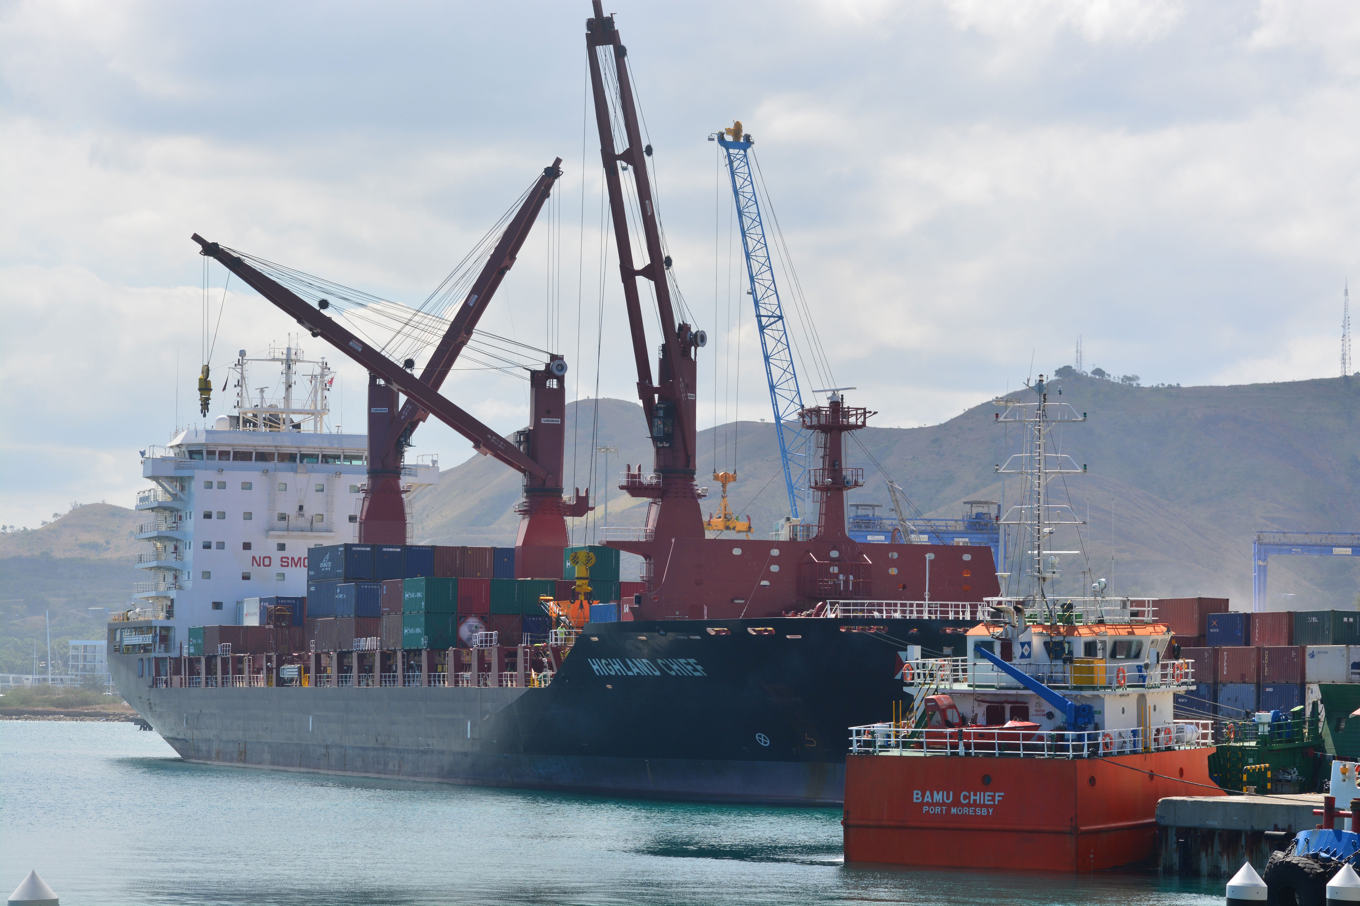
What is the AIFFP?
As a member of the Pacific family, Australia is committed to the region’s stability, security and prosperity
Enables development of climate resilient, quality infrastructure in the Pacific and Timor-Leste
Prioritises projects that contribute to economic and social transformational change, investing in energy, transport, water and telecommunications
Provides lending to Governments and private sector partners
Grants to countries at debt risk or to enable more concessional sovereign loan financing
aiffp.gov.au

Slide 3
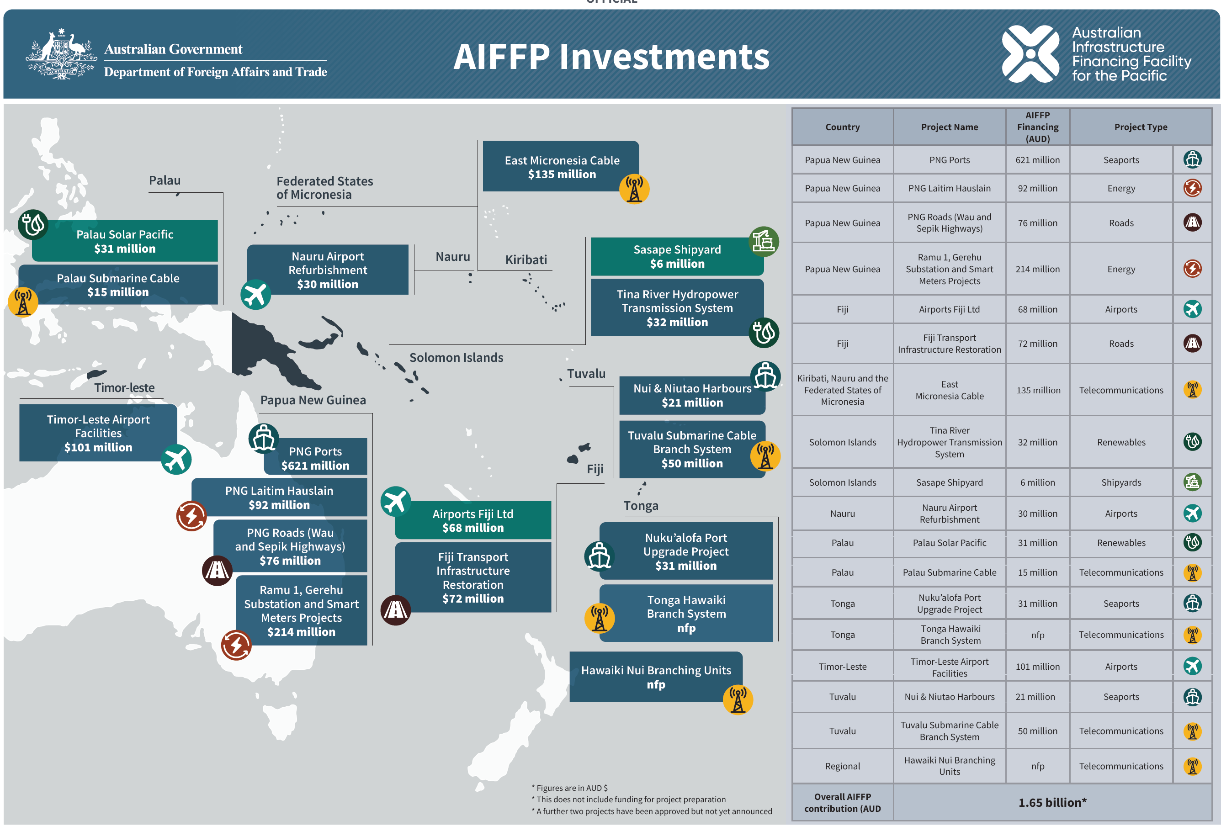

Slide 4
AIFFP objectives: submarine cable infrastructure
All Pacific island countries to achieve primary undersea cable connectivity, plus expand critical redundancy in the region.
Reliable and secure connectivity key to levelling up the disadvantages Pacific communities and economies face with distance from markets and services – a priority of Pacific governments.
Support build out of cable infrastructure in the region, including through enabling medium to long term branch system options.
Coordinate with Australia's broader connectivity agenda, including infrastructure and telecommunications networks, regulatory support (e.g. Cables Centre), cyber security and digital literacy.
Coordinate closely with other development partners and leverage commercial investments to maximise development and strategic benefits.

Slide 5
Australia’s record of investments
Project | Country | Project Value | Funding Partners | RFS | Australia’s Specific Input
Coral Sea Cable Project | Papua New Guinea Solomon Islands | AUD 200.0m | Co-contributions to be made by partner countries | 2019 | Funding marine, terrestrial and implementation support
Palau ECHO Submarine Branch System | Palau | USD 30.75m | Australia (USD 10.95m: of which USD8.85m is loan) USA (USD 11.8m) Japan (USD 8.0m) | 2024 | Funding multiple components of the branch system
East Micronesia Cable | Federated States of Micronesia Kiribati Nauru | AUD 135.0m | Australia USA Japan | 2025 | Funding marine, terrestrial and implementation support
Timor-Leste South Submarine Cable | Timor-Leste | AUD 7.2m | NB: Government of Timor-Leste funded all capex costs | 2024/25 | Advisory support to the Government of Timor-Leste
Tonga Hawaiki Branch System | Tonga | AUD 49.0m | Australia (AUD 30m) NZ (AUD 19m) | 2025 | Branch system and implementation support
Tuvalu | Tuvalu | USD 50m | Australia (AUD 50m) Likeminded-partners contributions (TBC) | 2025 | Principal contribution to branch system
Branching units (Hawaiki Nui, Google) | Pacific Island countries | USD 65m | Australia (USD 50m) USA (USD 15m) | n/a | Branching Units

Slide 6
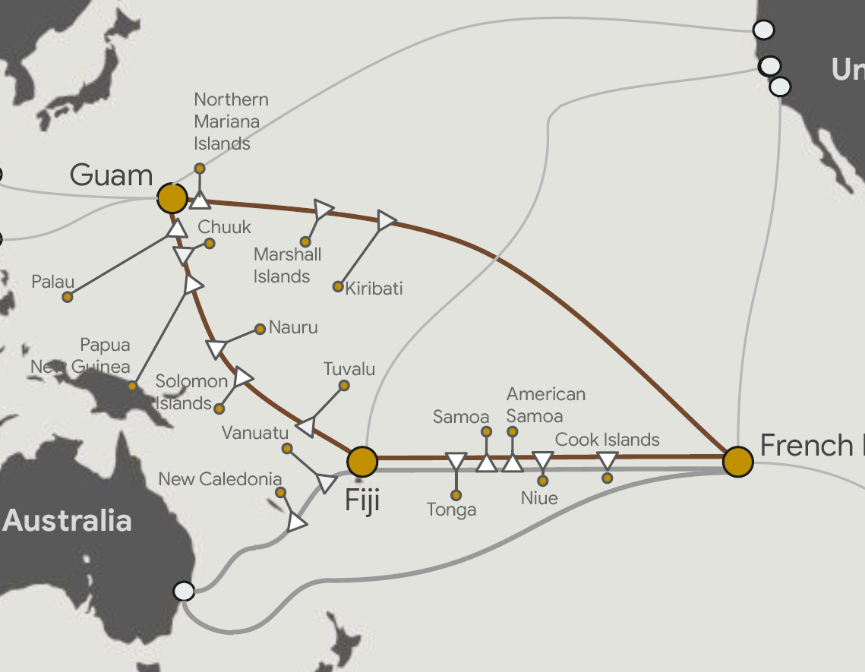
Current priorities
Leverage recent cable industry developments (e.g. Hawaiki Nui, Google Pacific Connect) to achieve objectives.
Work with Pacific governments and partners to structure options for provision of one or more potential cable components:
branching unit
capacity/ data
branch systems.
For example, current priority is delivery of branch system off Google trunk to Tuvalu given no primary connection.

Slide 7

Cable Connectivity and Resilience Centre
Helping ensure undersea cable networks in the Indo-Pacific are resilient and all countries can benefit from reliable connectivity and the growth of the digital economy.
Australia will invest $18 million over the next four years in the Centre.
Working with governments, business and academia to:
  commission joint research and facilitate dialogue
  develop best practice regulatory and policy recommendations
  support countries with technical assistance and advice
  encourage cable investment.
  undersea.cables@dfat.gov.au

