Slide 1

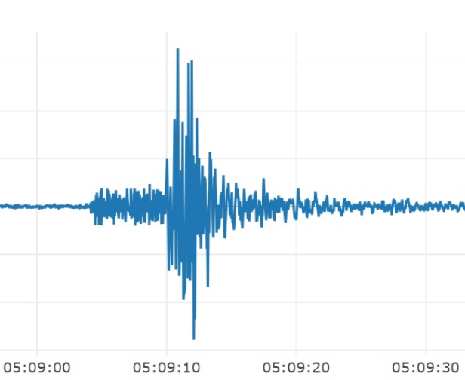
Session 2: Promoting resilience through building codes – Legislation, Compliance and Costs
Resilience to Earthquakes
Richard Sharpe, Earthquake Engineer, Beca, Wellington

Slide 2
Three Aspects:
A New structures
B Existing structures
C Assessing earthquake damage

Slide 3
New Structures:
Building Codes
For what size earthquakes are we designing?
The choice is yours depending on your priorities
There is no international code
The common level of design is quite arbitrary with respect to other life-safety risks
We know how to achieve life safety, but limiting damage is much harder and more expensive

Slide 4


Slide 5
Existing Structures:
A consistent assessment approach required across all structure types and materials
Significant experience required – New Zealand guidelines more than 1000 pages long.
Your nation needs to decide on what is a minimum acceptable level of resilience compared to a new building, and what should happen to unacceptable structures.

Slide 6
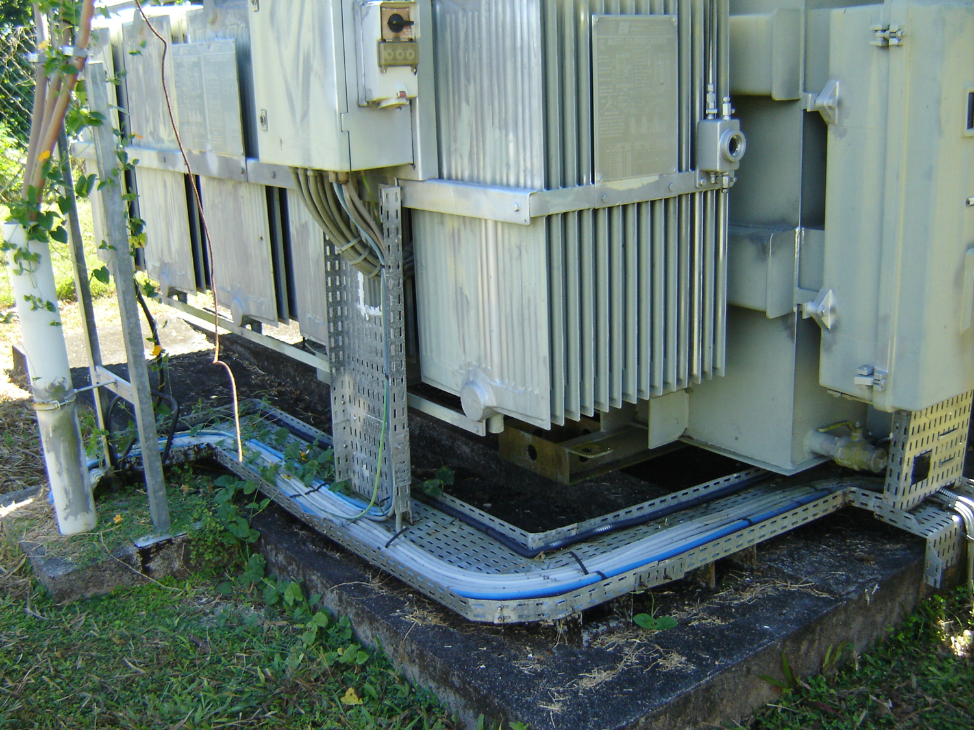
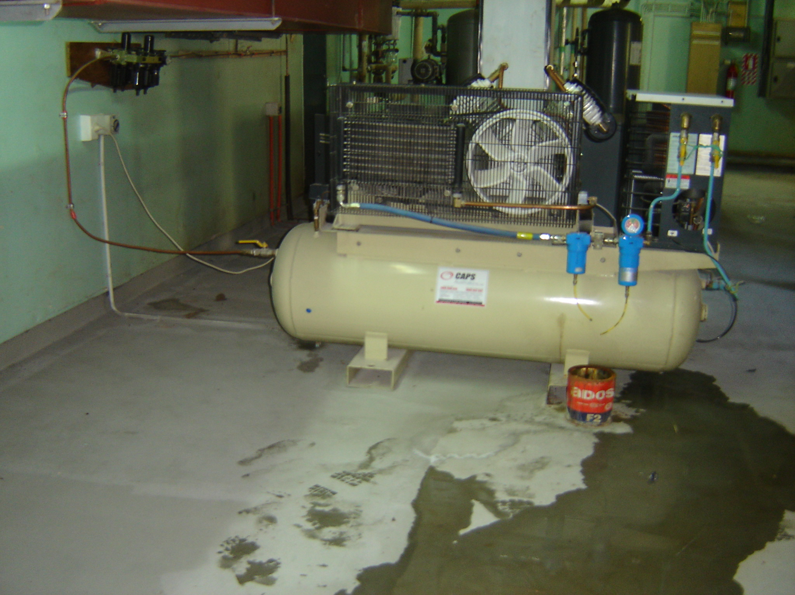
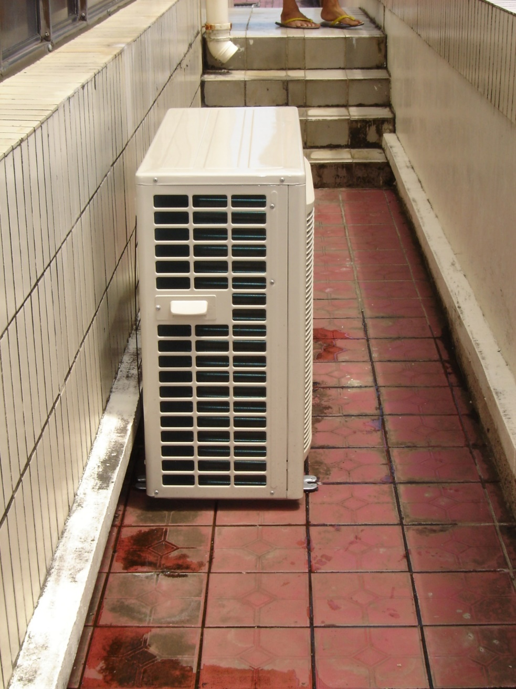
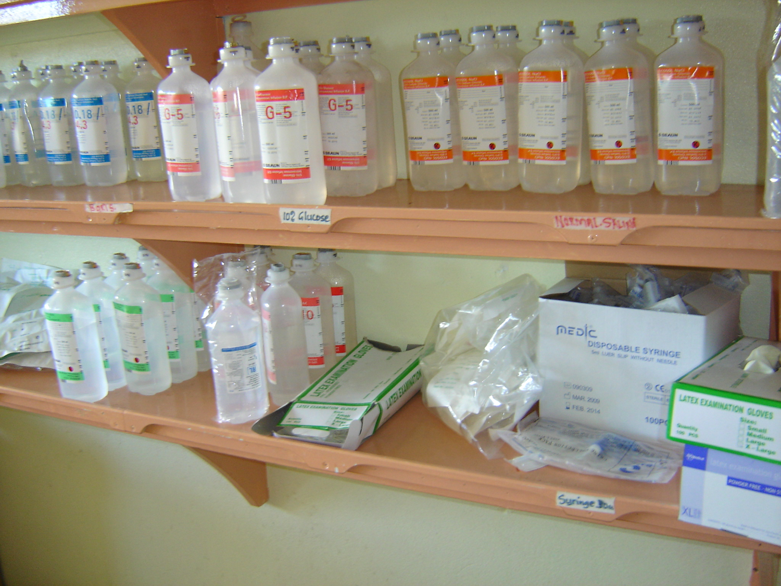

Slide 7
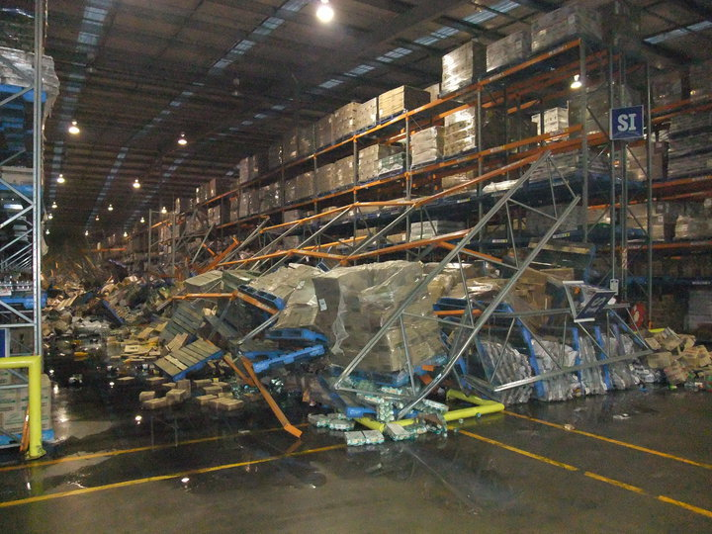

Slide 8
Assessing Earthquake Damage:
A consistent approach gives public confidence
Guidelines, checklists, placards and training available
Same approach applicable to flooding and cyclone damage
Ideally, each country would have a group of trained assessors

Slide 9
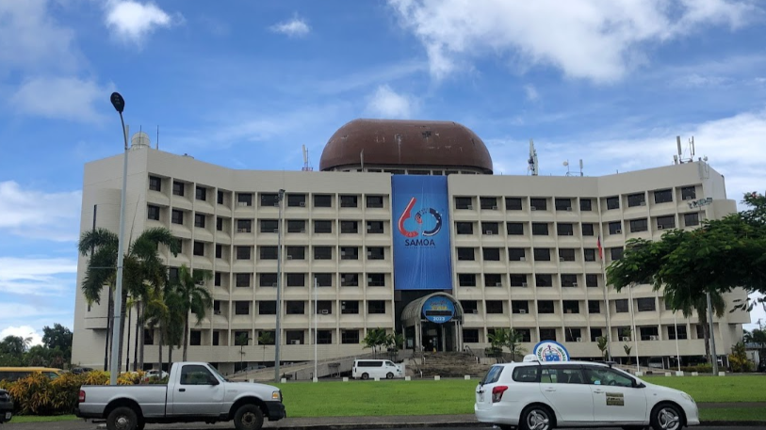

Slide 10
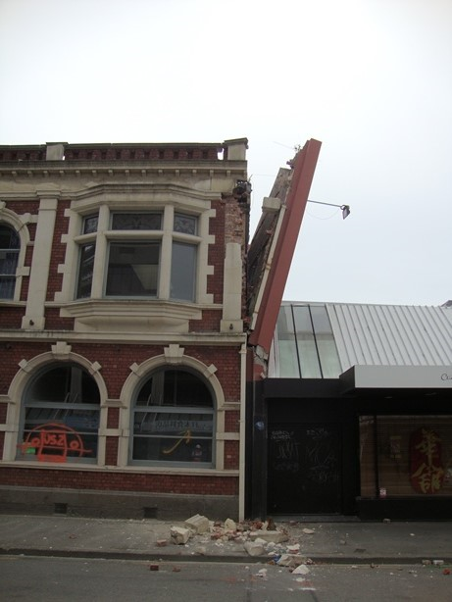

Slide 11
Recommendations
Decide on your country’s tolerance of risk of earthquake damage.
Keep sophisticated earthquake design code requirements for your most important buildings and infrastructure.
Expand the “Home Building Manual” approach with more pragmatic details for making the most common residential types of building and their contents resilient to cyclones and earthquakes (similar objectives).
Know the fragility of your existing infrastructure.
Seek training on damage assessment.

