Slide 1



WE

Slide 2
Services NZ councils provide
Regional councils are primarily responsible for environmental management including flood control, air and water quality, biodiversity and pest control, coastal management
Territorial authorities (district and city councils) are responsible for:
infrastructure services such as roading, water supply, wastewater and stormwater services
waste collection and disposal and recycling services
community facilities such as parks, reserves, libraries, swimming pools and community centres, public toilets
Planning, urban design, public transport, and bylaws for public health and safety.
Regulatory compliance for building control, food safety and environmental health

Slide 3
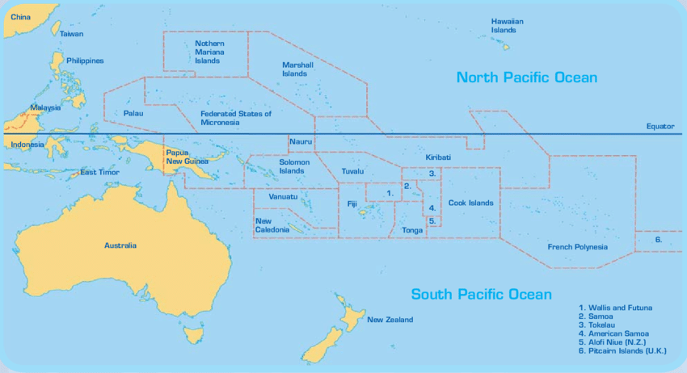
Map Pacific with partner countries identified
Diagram from notebook if doable
Notes:
Under the contract the NZ International development programme with we can work with any country within this area outlined in black - with the exception of Wallis and Futuna and American Samoa
Its probably worth mentioning now that the programme has been running for 11 years with 4 more years to go before another discussion with the development programme about renewing the contract.

Slide 4
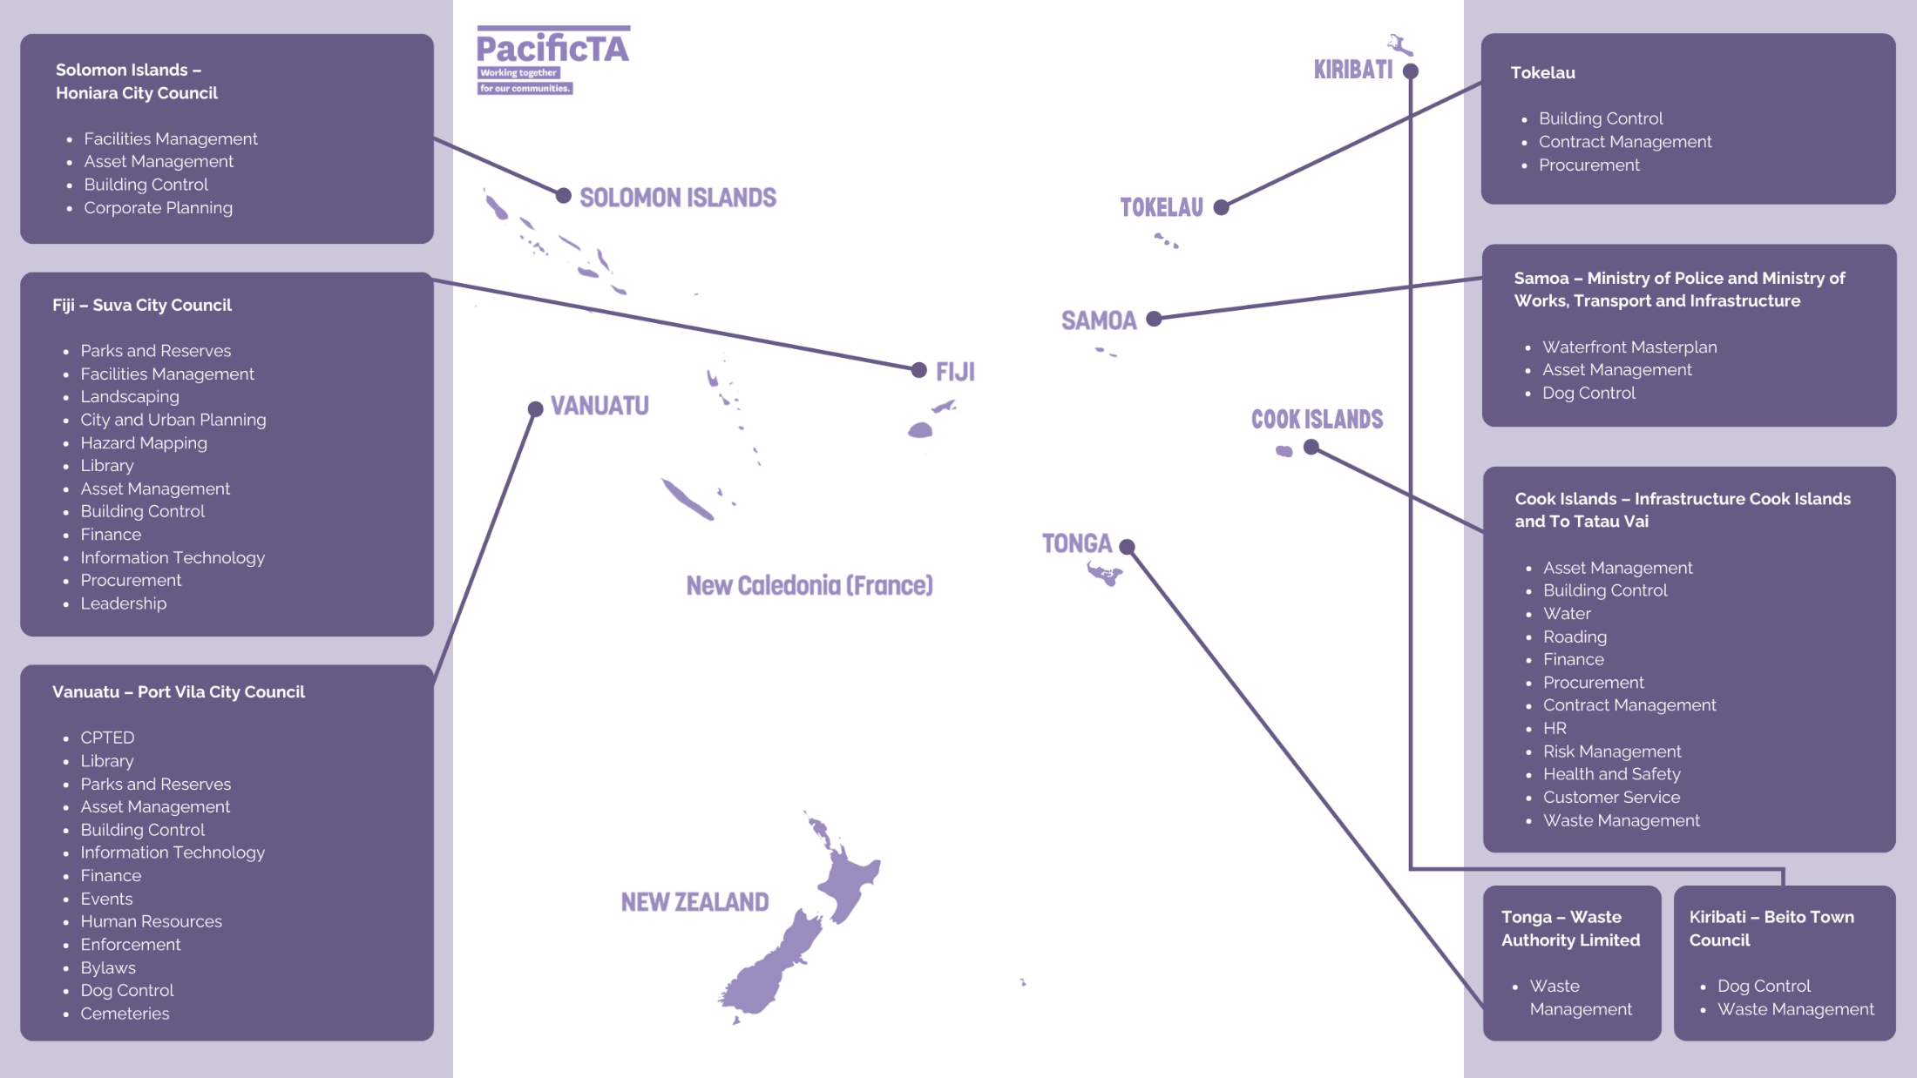
PacificTA activity / work
“Work with rather than do”
Knowledge and awareness + enabling environment + imperative

Slide 5
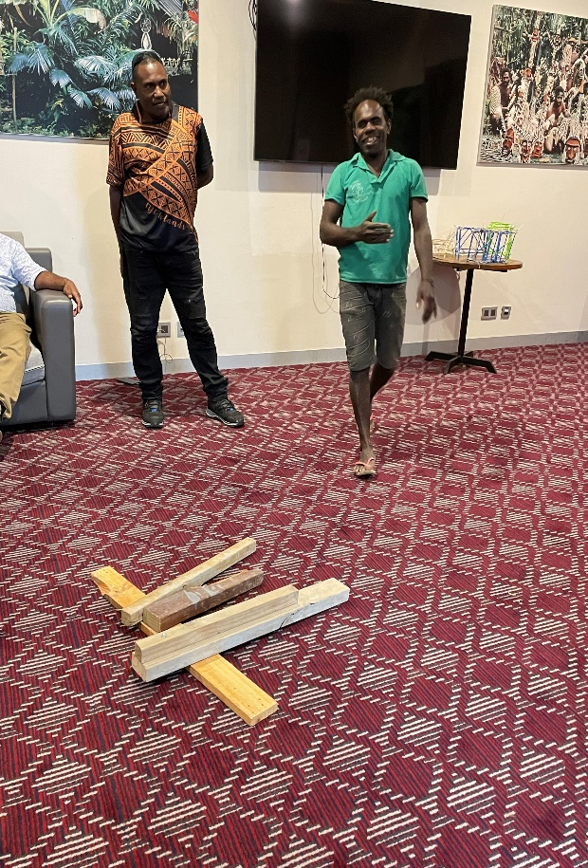
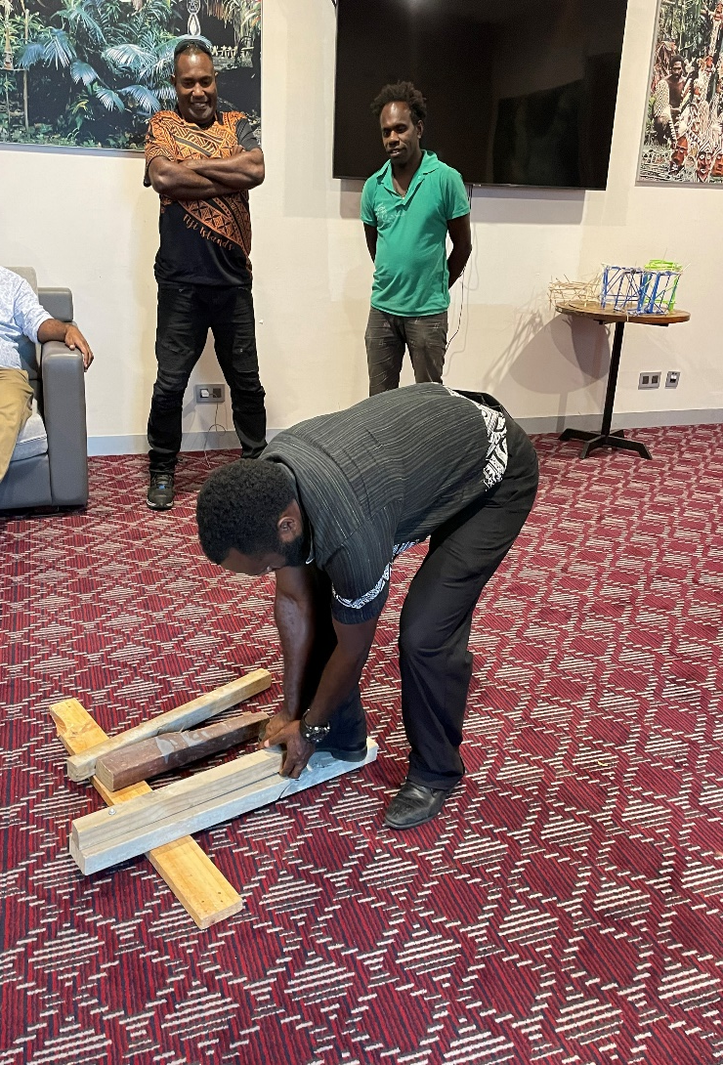

Slide 6
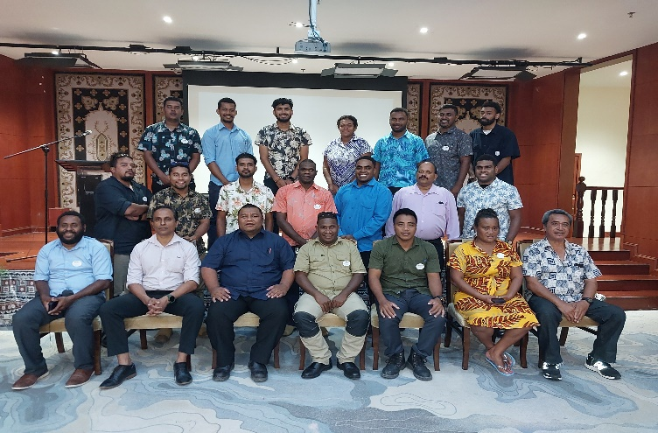
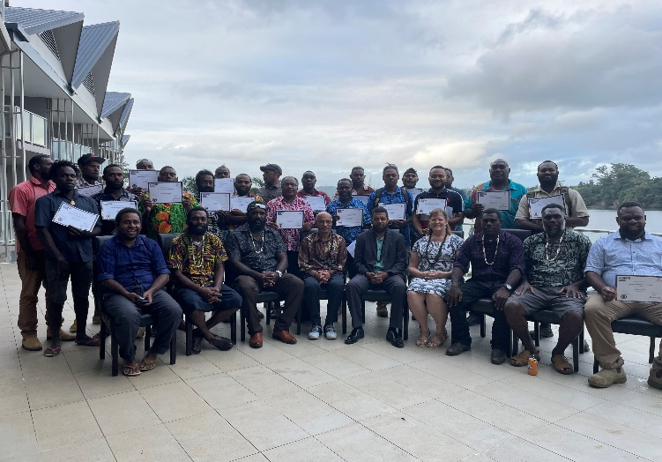
Training
Suva November 2023: Implementing the Building Code – the Performance of Primary and Secondary Elements
Port Vila May 2024 Durability and Structural performance.
Suva 2024 Basic Plumbing – building inspectors
Honiara August 2024 Building Code Implementation Structural performance

Slide 7
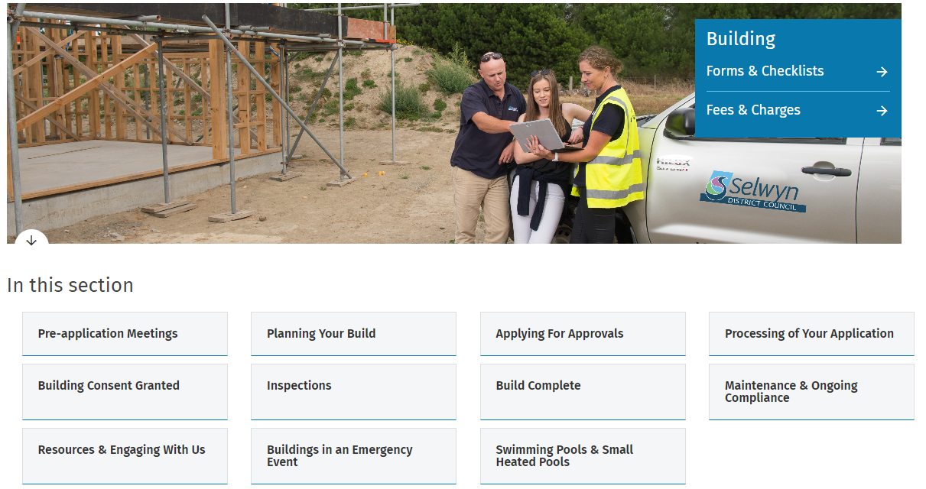
https://www.aucklandcouncil.govt.nz/building-and-consents/building-consents/Pages/apply-for-building-consent.aspx
https://www.selwyn.govt.nz/property-And-building/building
onlinelibrary@standards.govt.nz

Slide 8

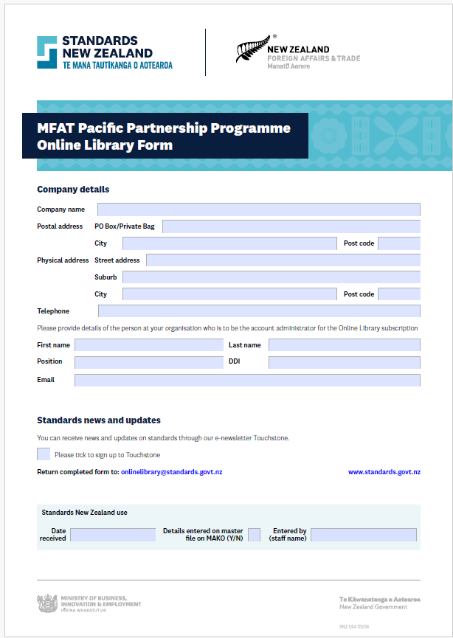
https://www.branz.co.nz/shop/catalogue/good-practice-guide-concrete-masonry-2nd-edition_83/
onlinelibrary@standards.govt.nz

