Slide 1

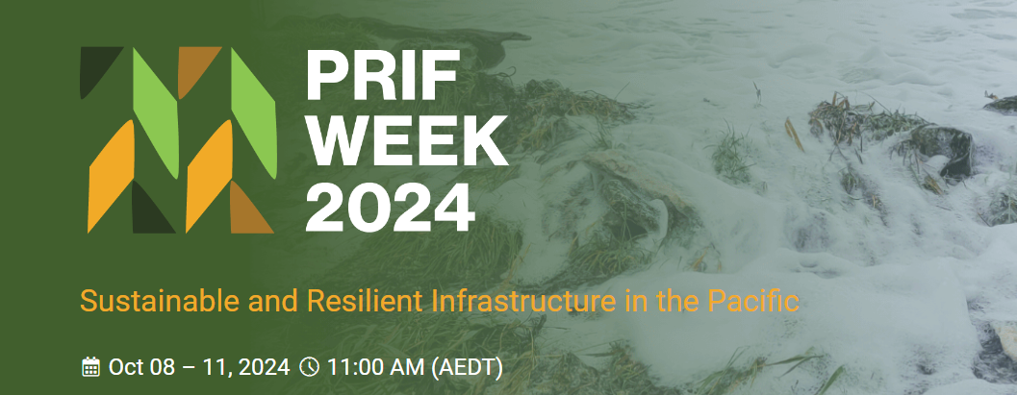
Vanuatu Road Design Guide
increasing climate resilience across Vanuatu
Raviky Talae – Infrastructure Sector Coordinator (PWD/Van-KIRAP Project)
Link: https://library.sprep.org/sites/default/files/2023-09/Vanuatu-Road-Design-Guide.pdf

Slide 2
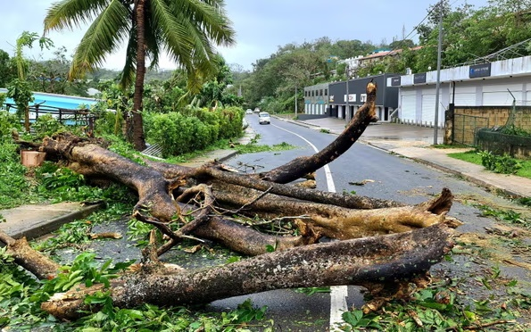
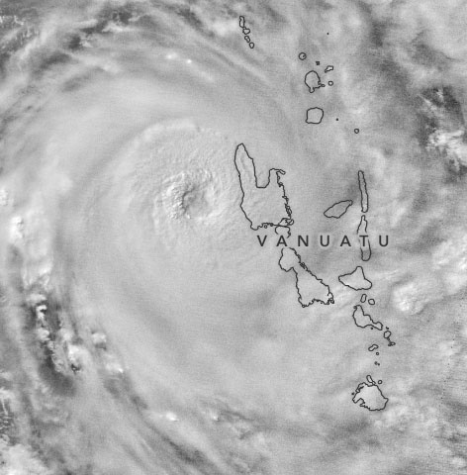
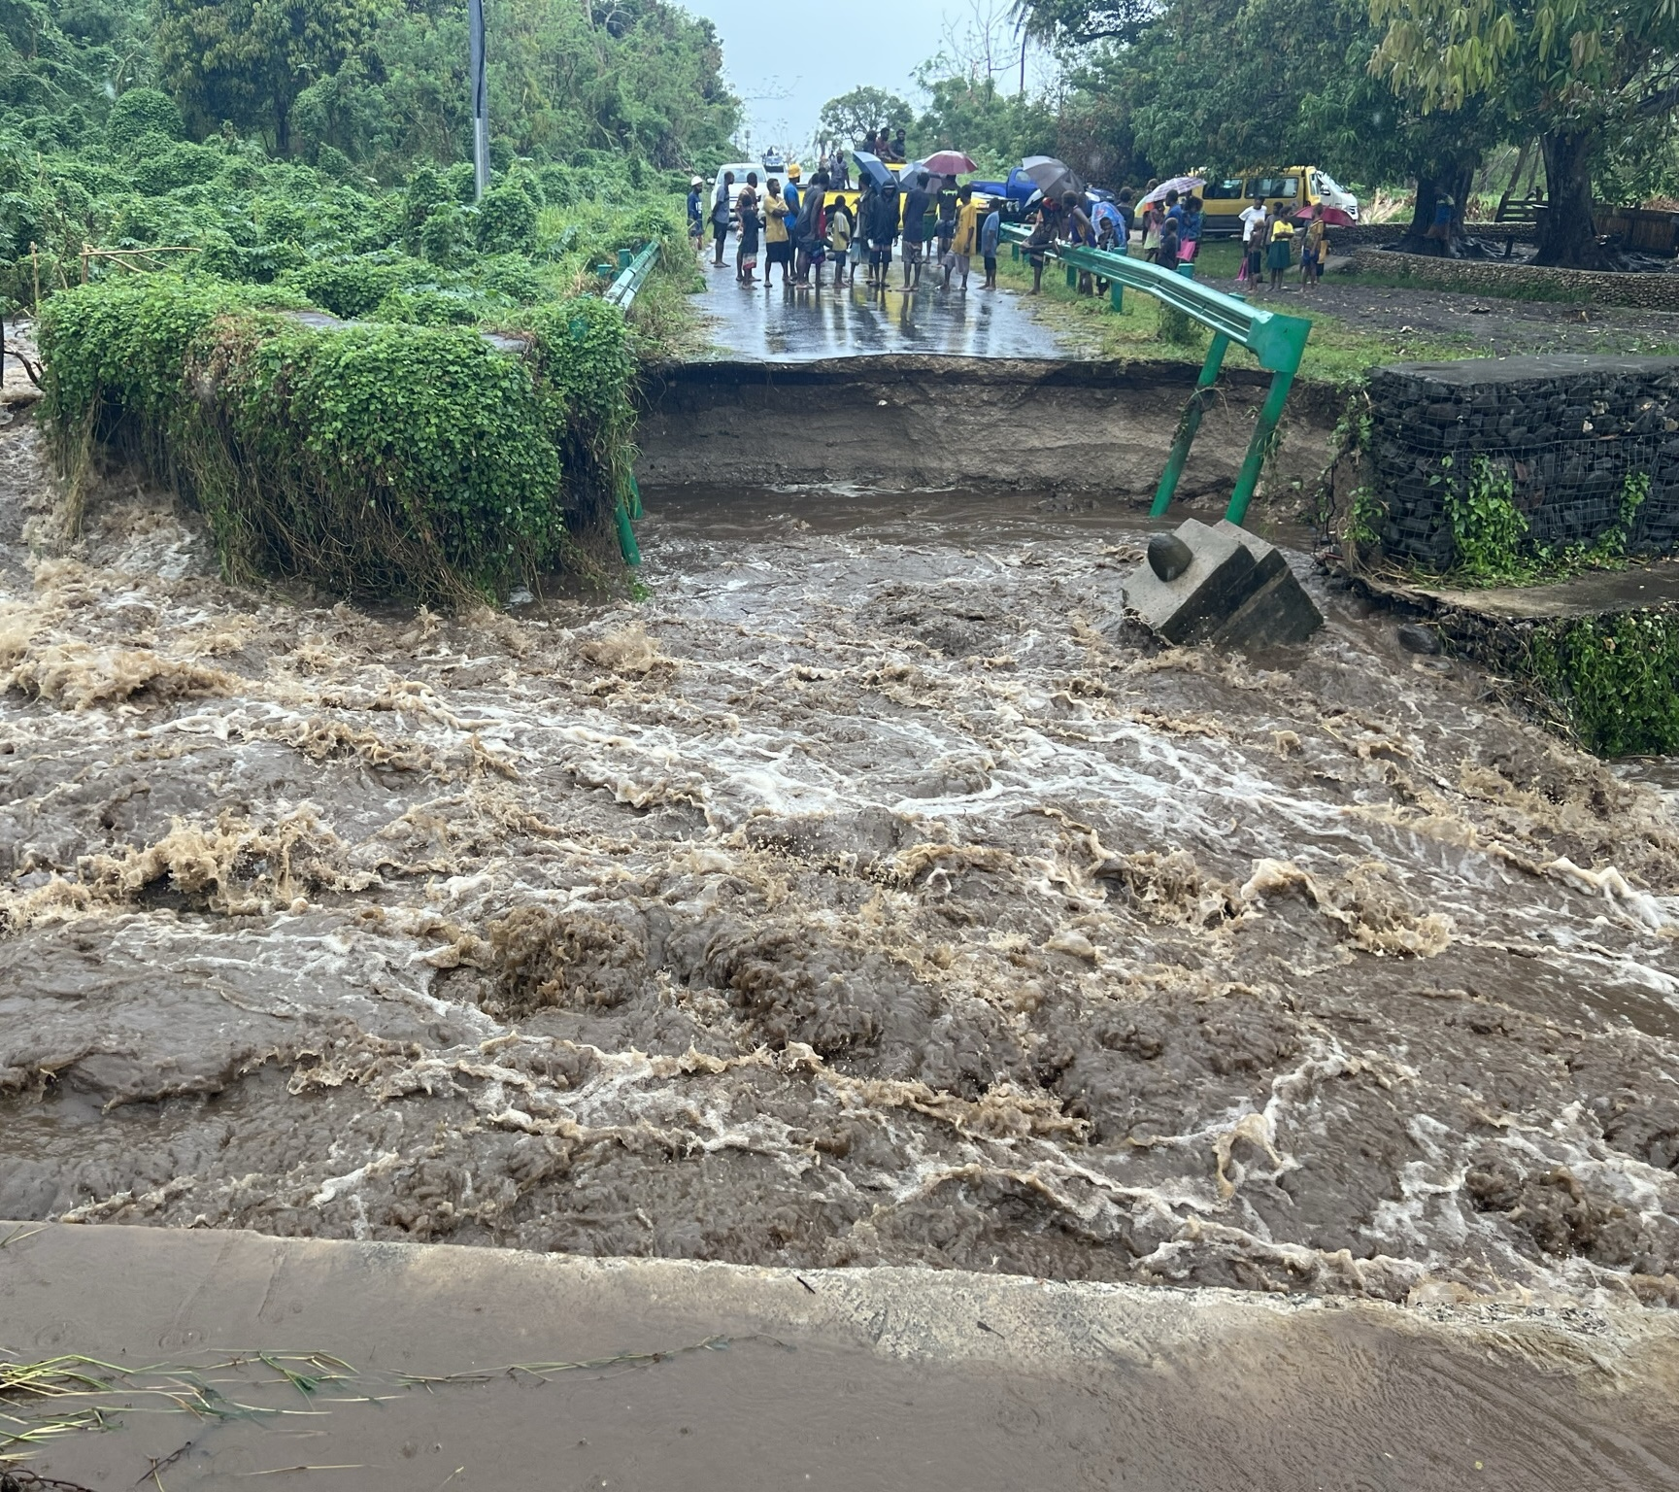
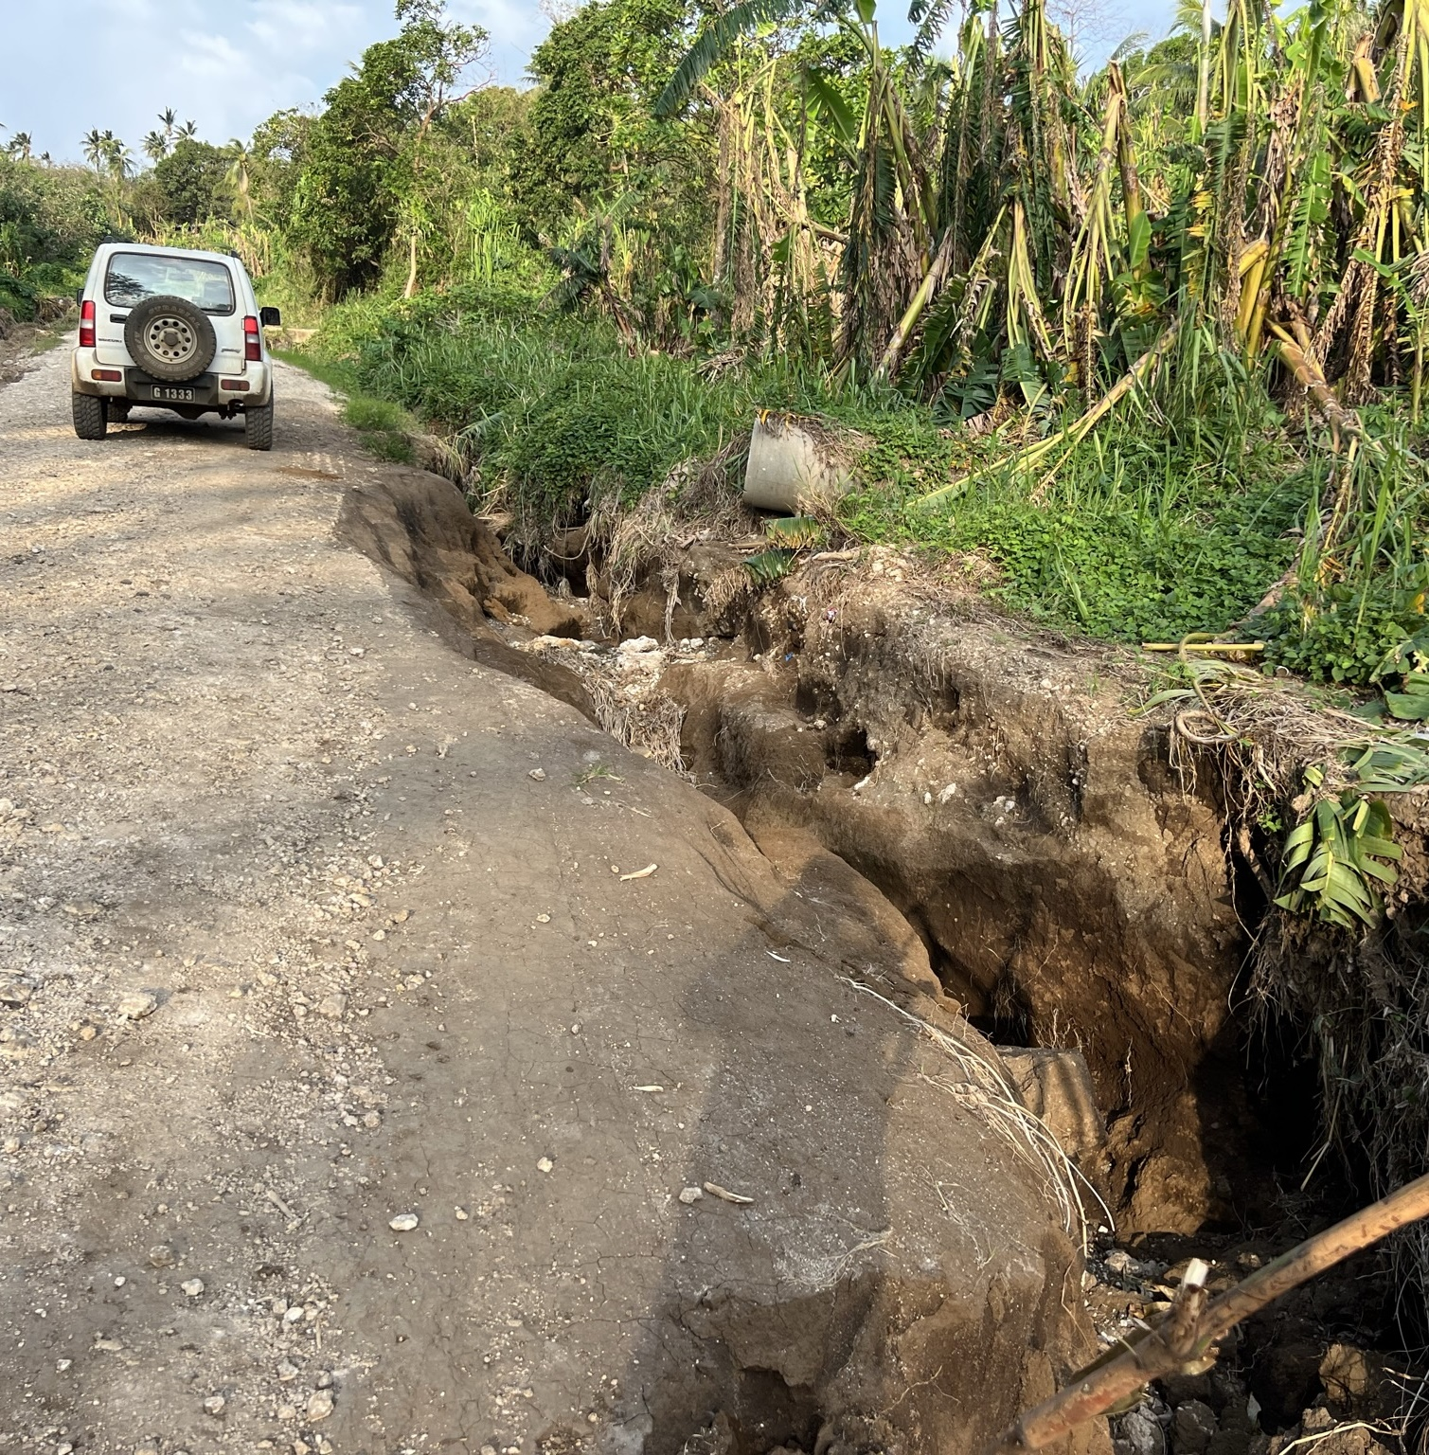
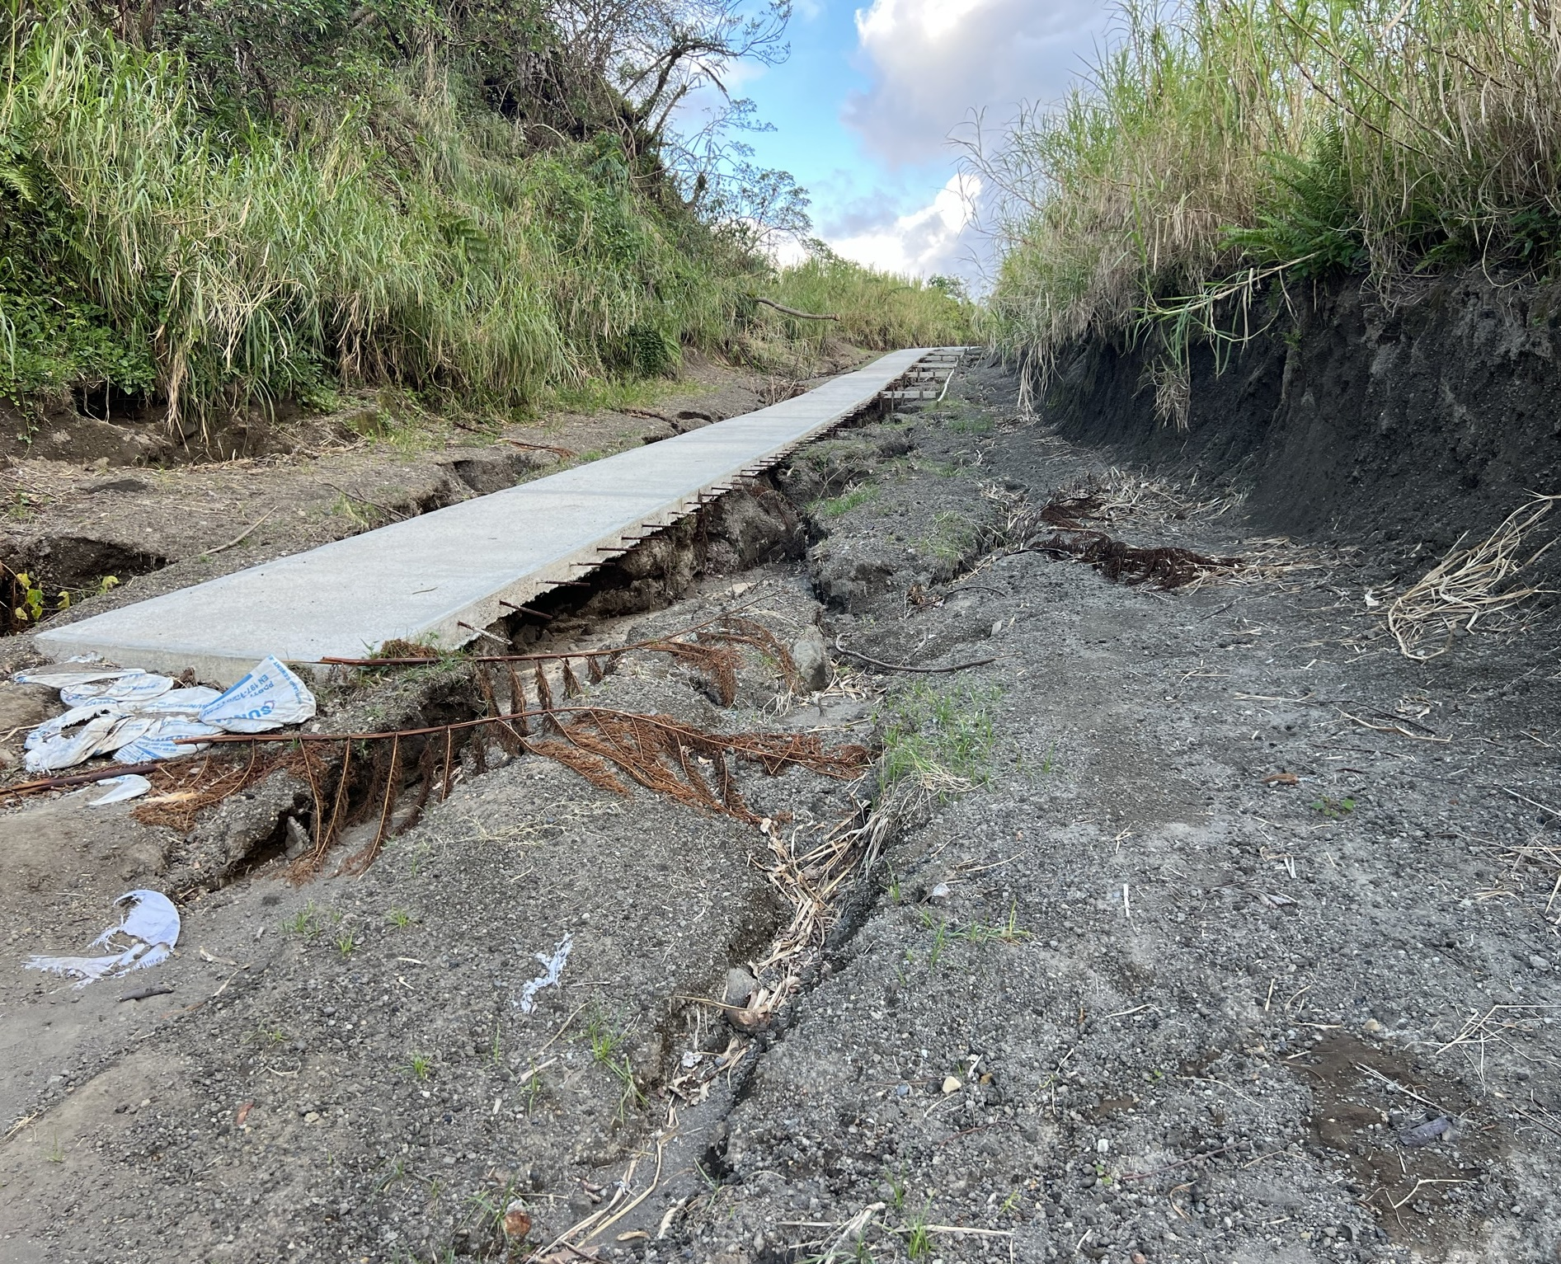
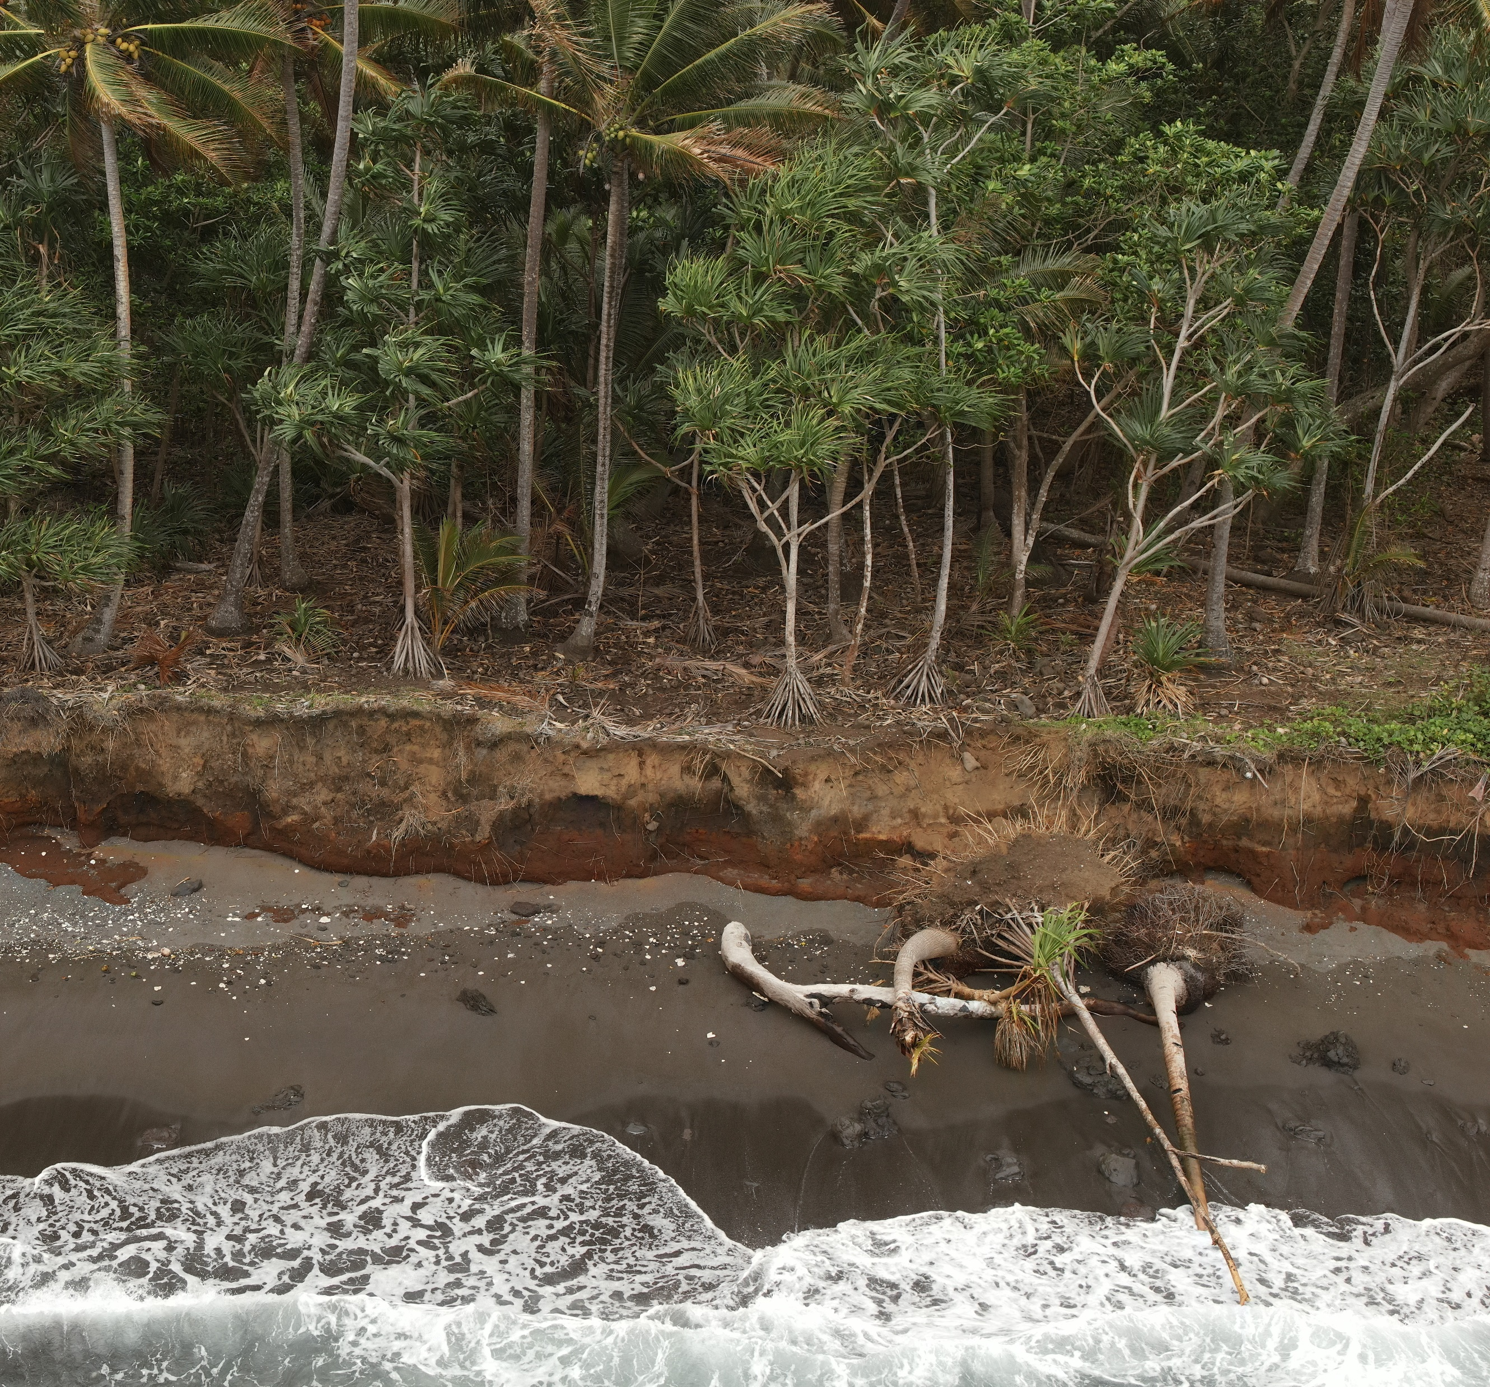
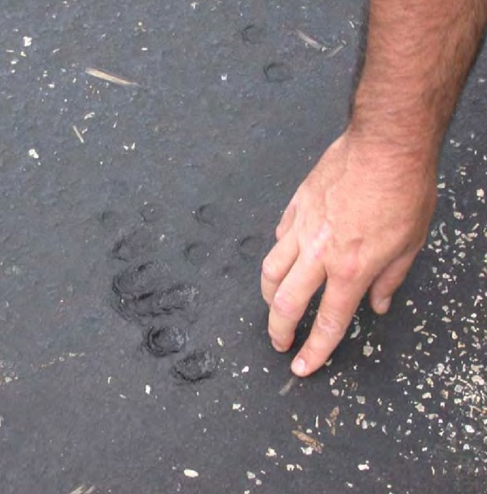
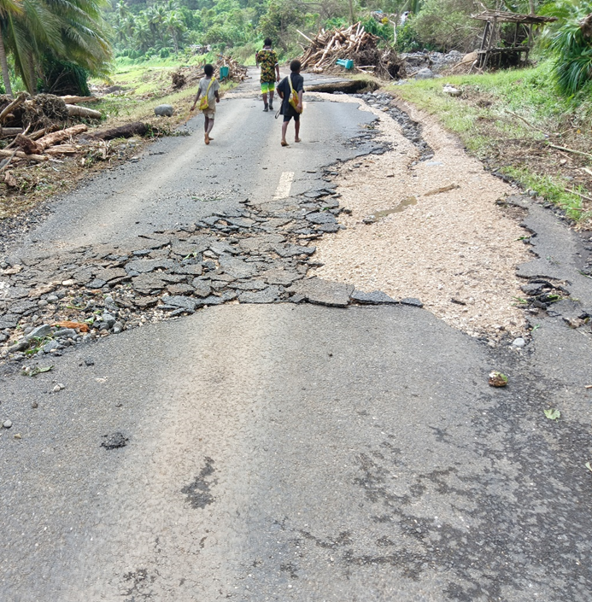
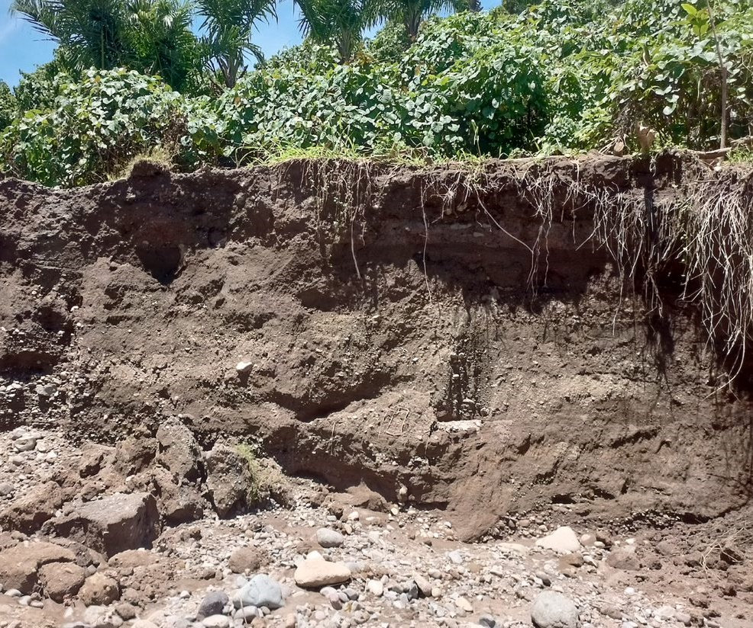
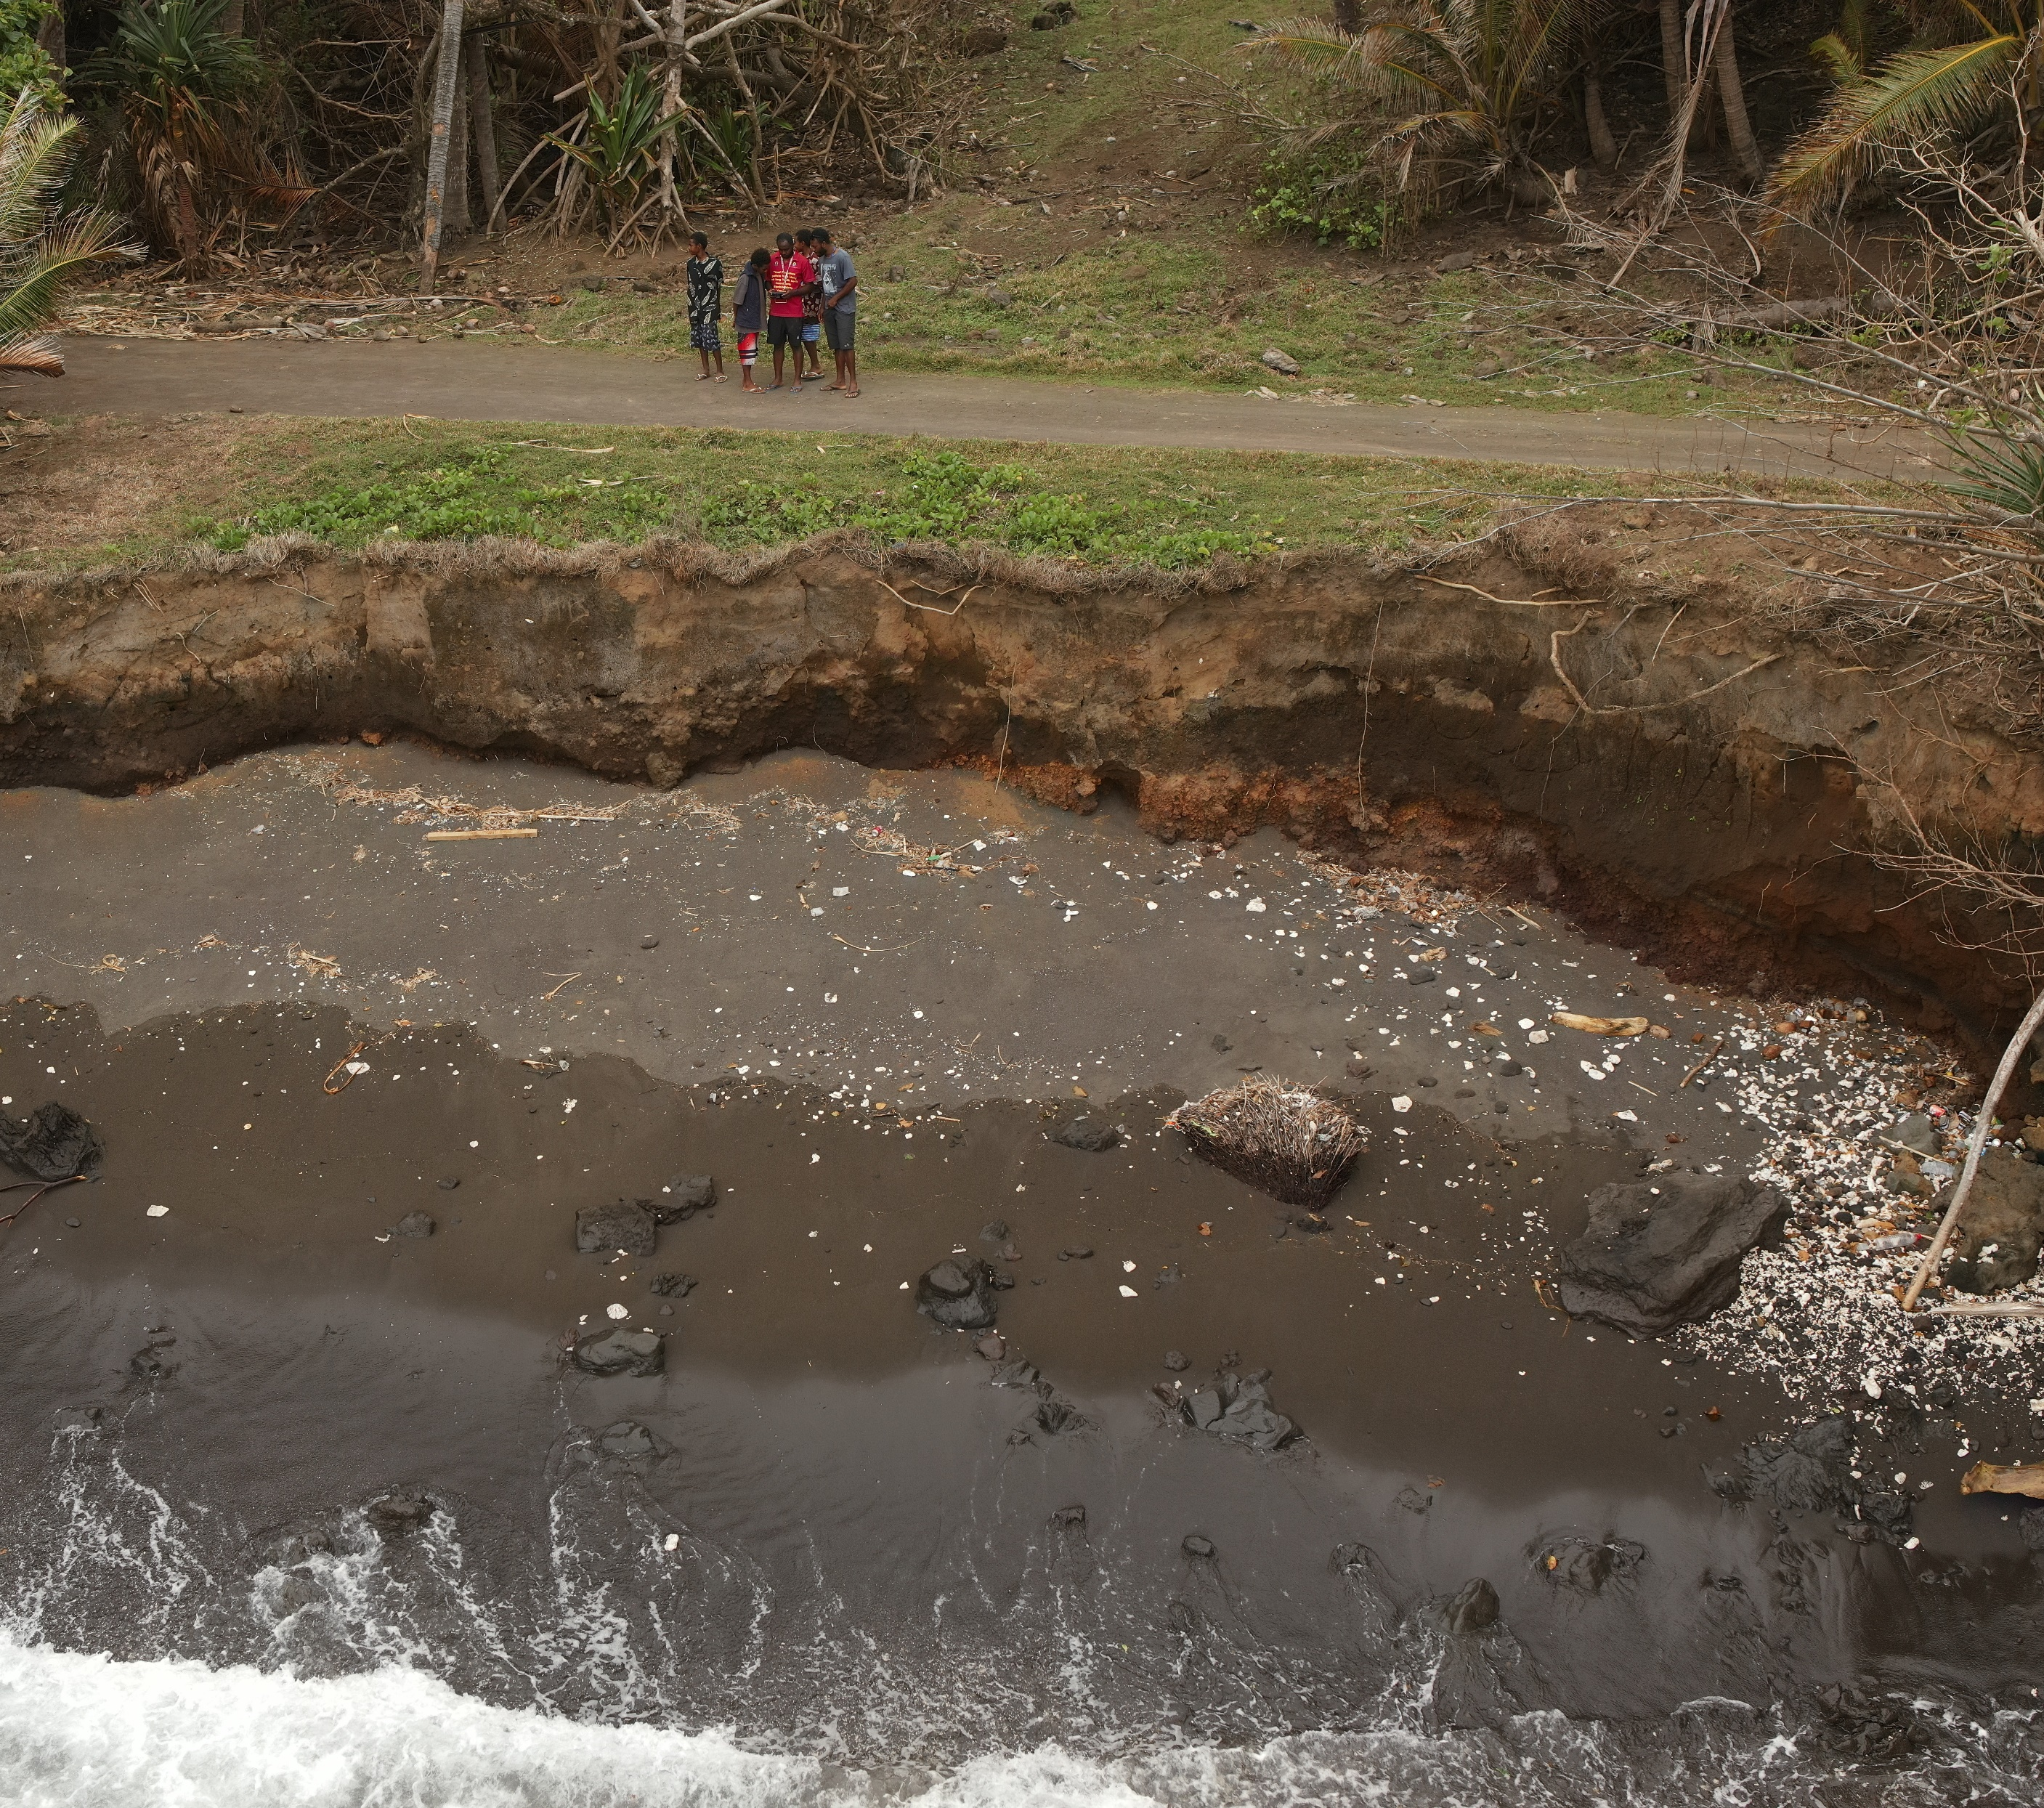
Climate Change Impacts on Roads in Vanuatu
Overview of Climate Change in Vanuatu:
Vanuatu is among the most vulnerable countries on earth to the increasing impacts of climate change, including climate related natural disasters and the effects of slow-onset events such as the sea-level rise and ocean acidification.
Key Impacts on Roads:
Erosion and Flooding: Increased rainfall leads to soil erosion and flooding, damaging road surfaces and foundations.
Landslides: More intense storms can trigger landslides, obstructing routes and increasing maintenance costs.
Temperature Variability: Rising temperatures can cause material degradation, affecting road longevity and safety.

Slide 3
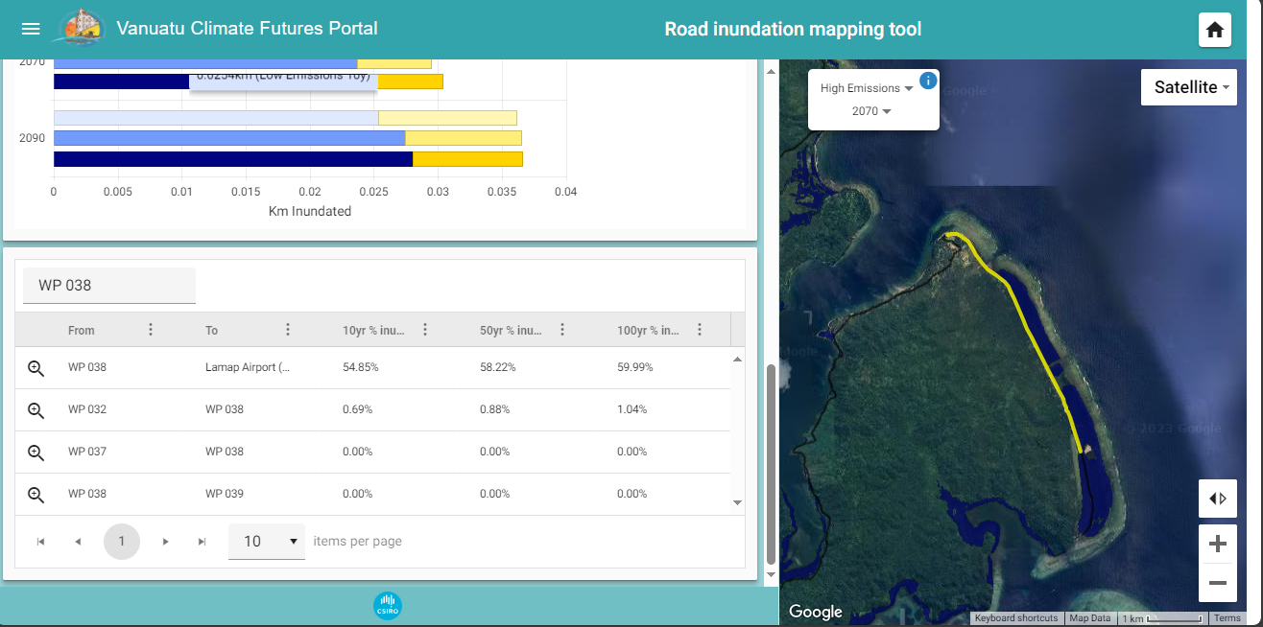
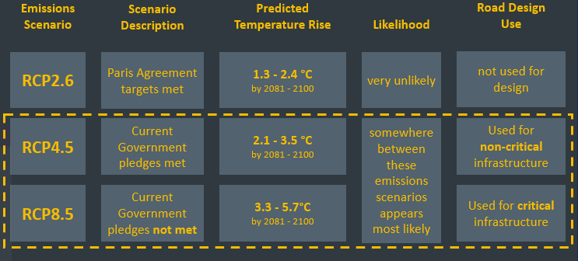
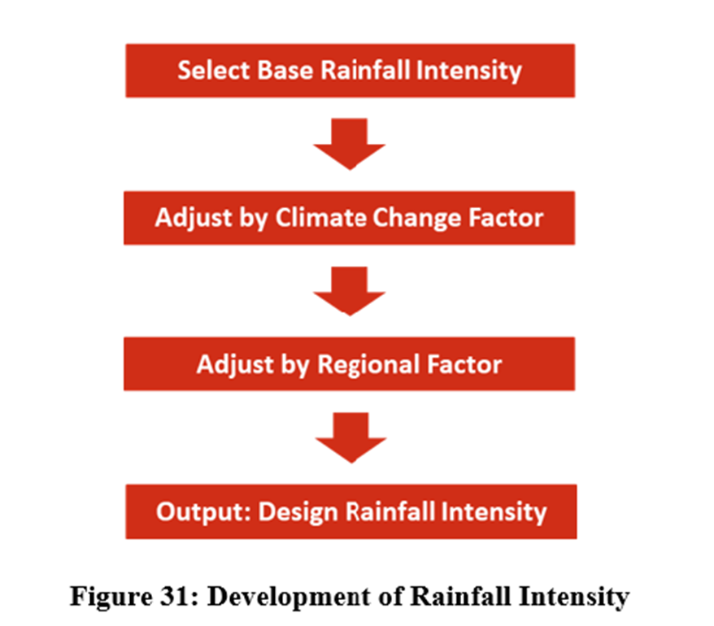
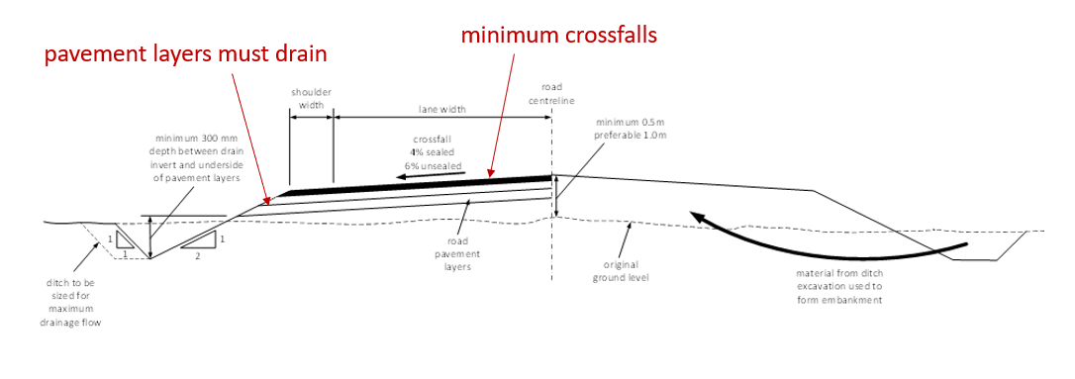
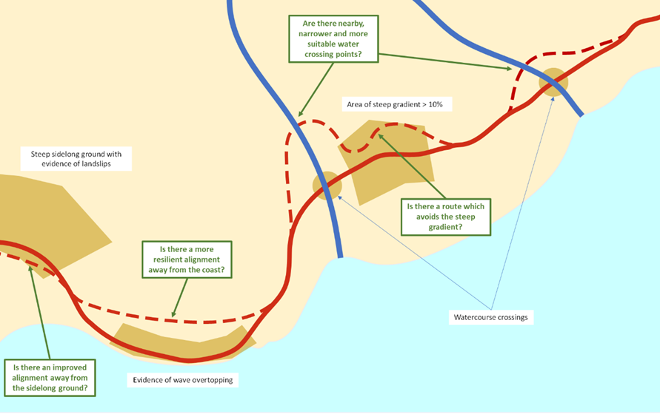
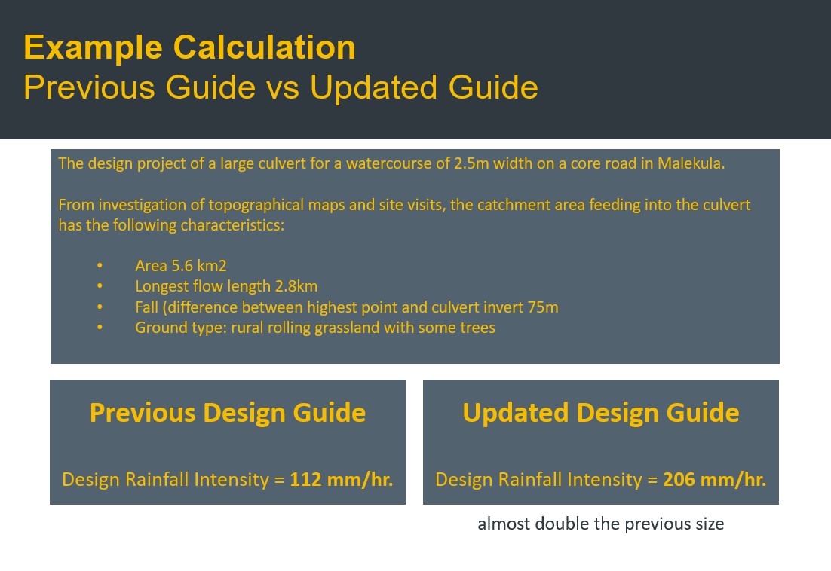
Addressing Climate Challenges in the Updated Vanuatu Road Design Guide 2023
Vanuatu Road Sector Challenges:
Geography: made up of many dispersed islands making the logistics of road construction and maintenance difficult, slow and costly
Climate: heavy rains and cyclones during the rainy season cause significant damage to our roads every year
Materials: the local coronous gravels available for road construction in Vanuatu are not ideal road-building materials compared to many countries and only few islands have the coronous gravels
Capacity: we are a small population with very few civil engineering graduates available to build up a competent professional road sector
Funding: the typical annual roads budget is insufficient to maintain the existing 3,000km road network effectively
Design Approach:
Emissions Scenarios used to develop updated Road Design Guide: Core Roads are to be designed for higher emissions scenario (RCP8.5) and Non-Core Roads are to be designed for lower emissions scenario (RCP4.5).
Drainage Design Approach: Critical to our revised design approach is to base drainage designs on predicted design year rainfall intensity for each catchment and drainage element.
Constraint Mapping using the Vanuatu Climate Futures Portal
Topographical Surveys
Focus on Defining Catchment Areas for Each Drainage Element
Cross-Sectional Design for Resilience
Drainage Design Approach Corridor Selection using Constraints Mapping

Slide 4








Tankyu Tumas!

