Slide 1


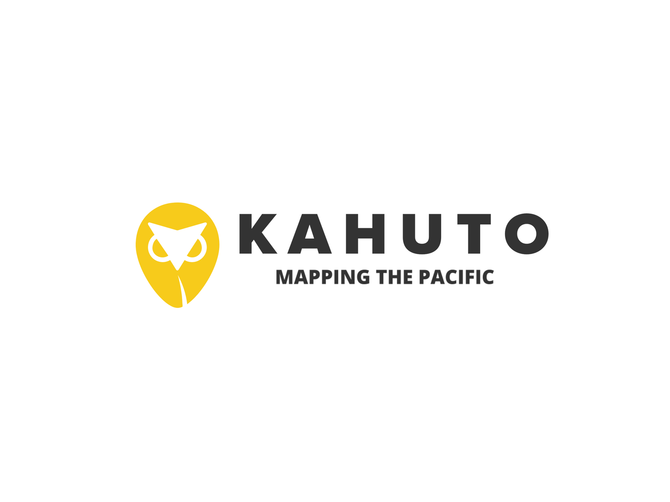
Driving more informed Decisions with Data
Filling the gaps - Data and expertise for risk informed planning

Slide 2
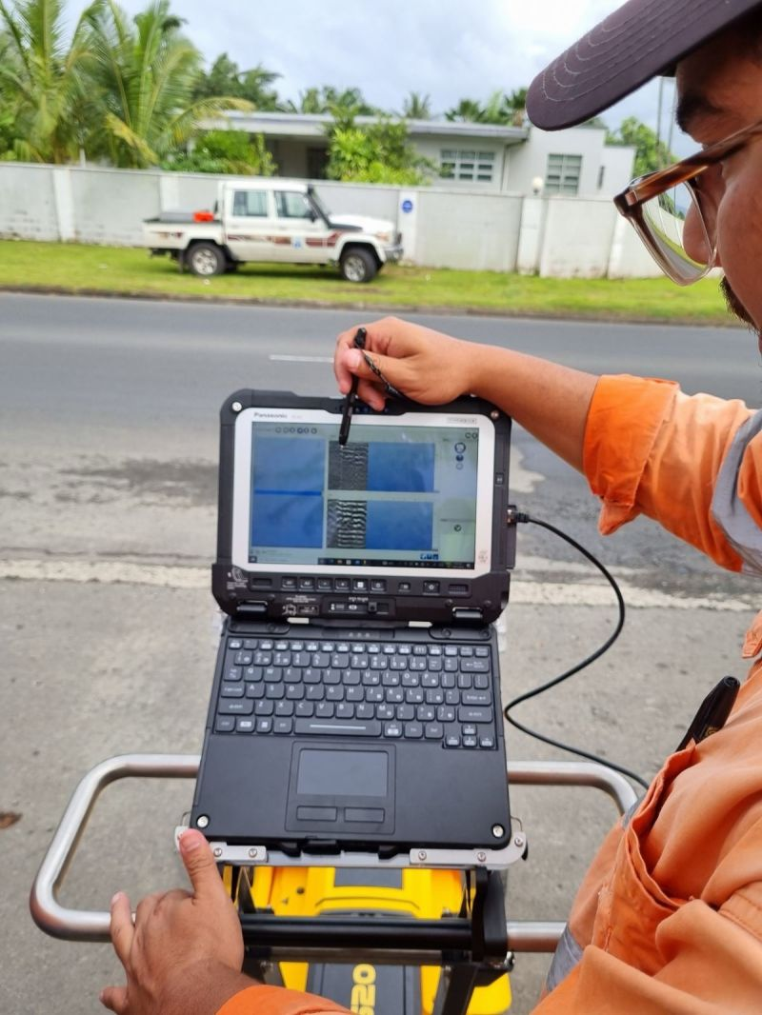
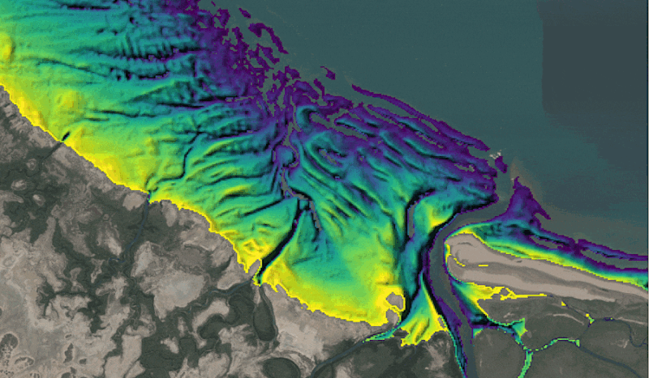
The Pacific has a data problem
The Blue Continent (Pacific Islands) lacks good quality survey and geospatial data
Without this data decision makers/policy makers cannot make informed decisions around planning and infrastructure.
Huge shortages in skilled Suveryors, Geotech Engineers and other critical professions.

Slide 3
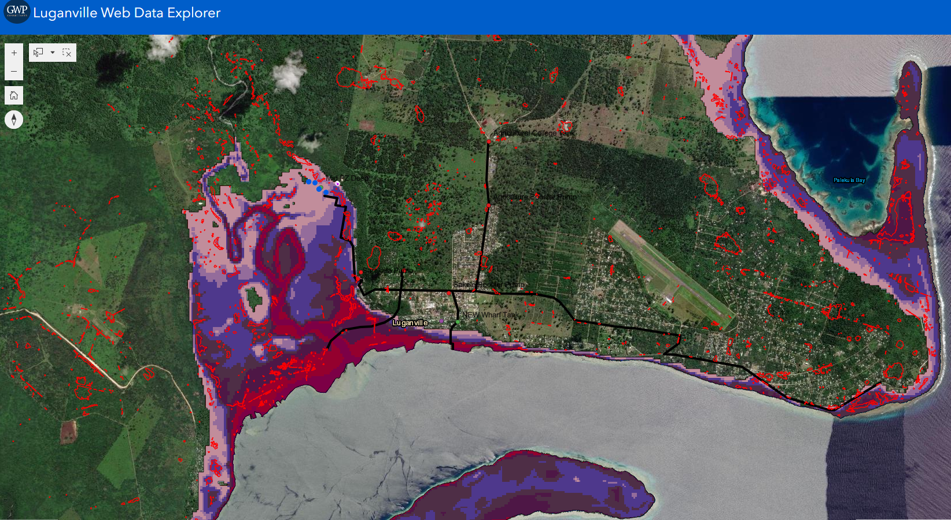

Why is it important
Infrastructure Risk Exposure Mapping - Vanuatu
Tsunami and Sinkhole proximity to water supply system

Slide 4
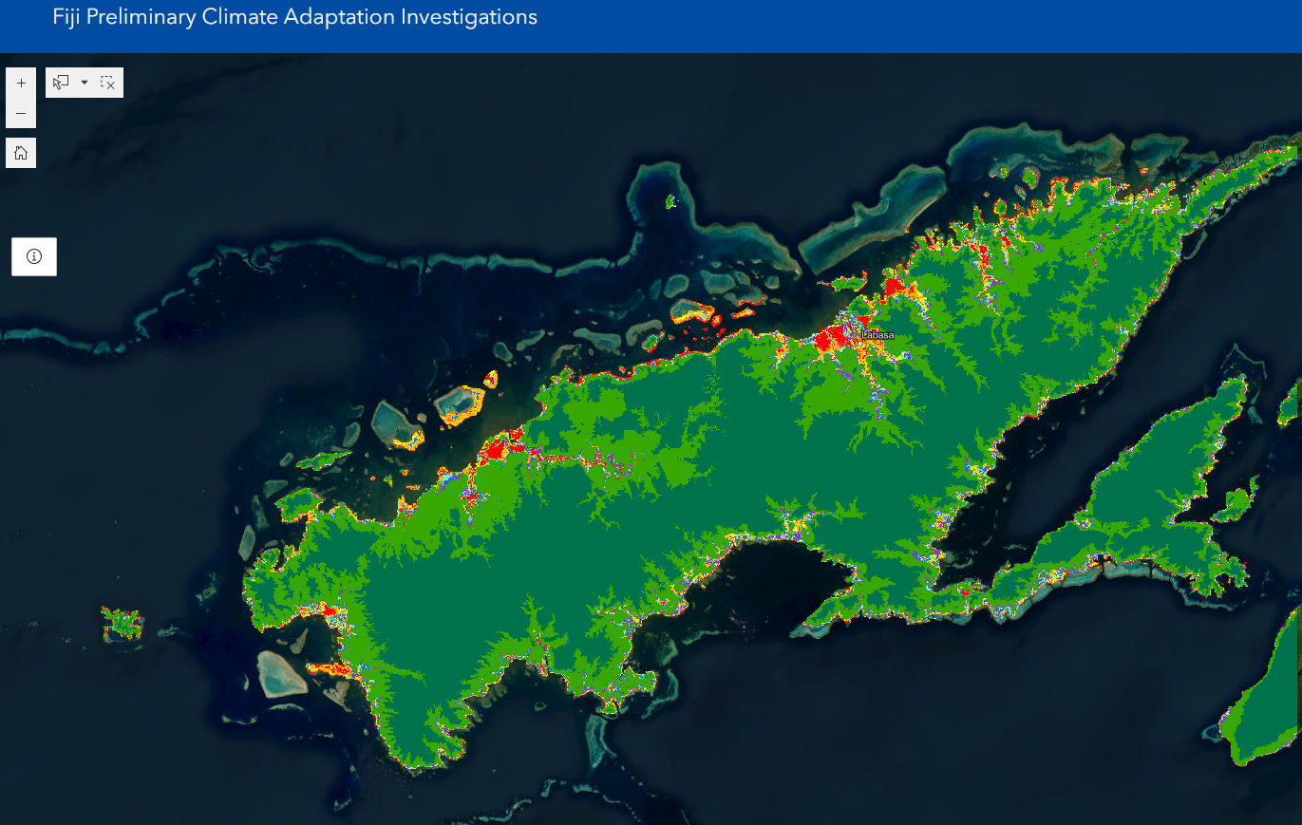
Remote sensing digital terrain model analysis – Vanua Levu
Colour elevation banding – as proxy to coastal surge and tsunami inundation risk

Slide 5
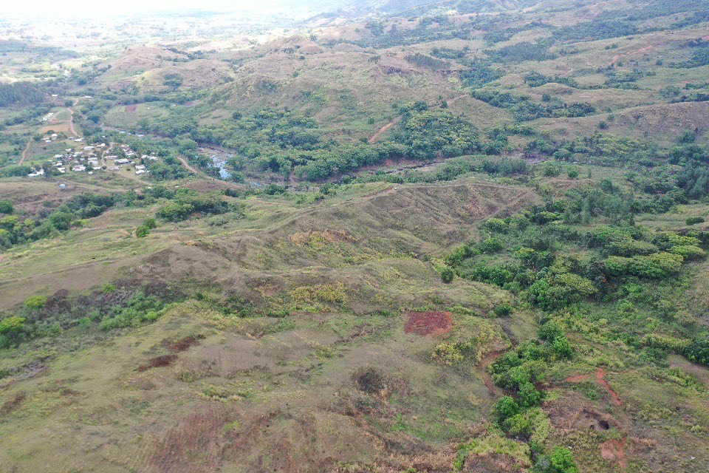
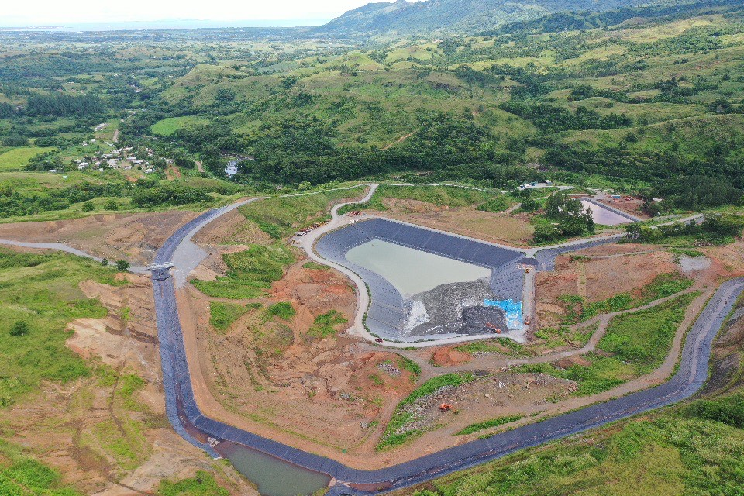
Lion One metals required an aerial LiDAR survey to inform dam failure modeling for Tailings Dam in close proximity to Korebebe Village
Survey was required urgently and traditional survey methods would have been time costly and also hazardous for surveyors working across steep and dangerous terrain

Slide 6
Data in Design
National Building Codes and Standards provide the guidance and some of the design data (loading) necessary for application in infrastructure design.
These codes guide the application of data (say wind speed m/s) based on importance of infrastructure and the probability of occurrence and exceedance (frequency, intensity, duration).
Design consultants apply the guidance of these standards and captured data to produce risk-informed and risk-responsive designs.
The better the Data = the better the Design response

Slide 7
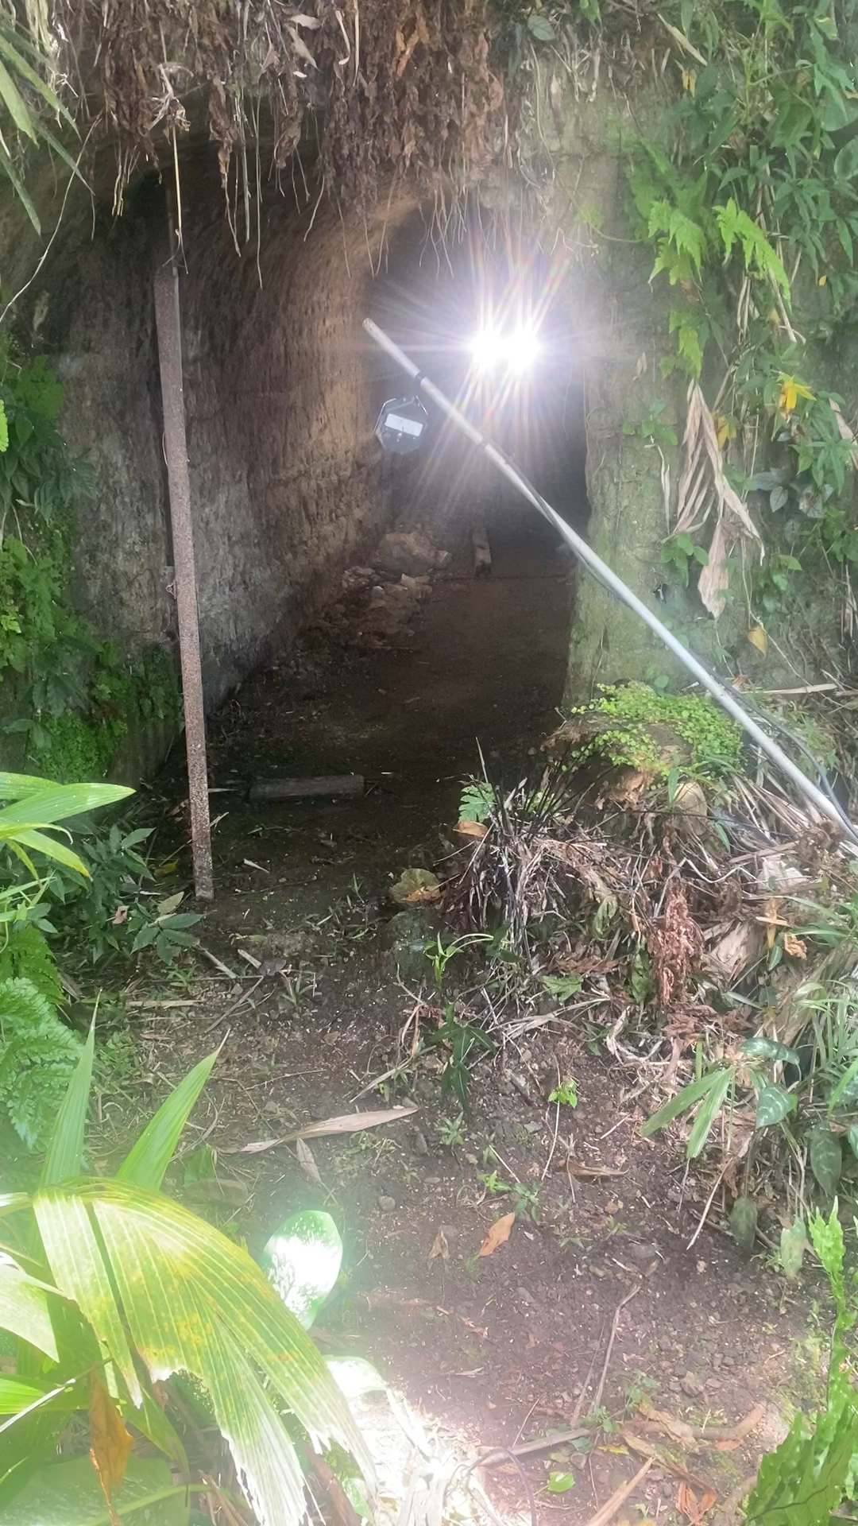
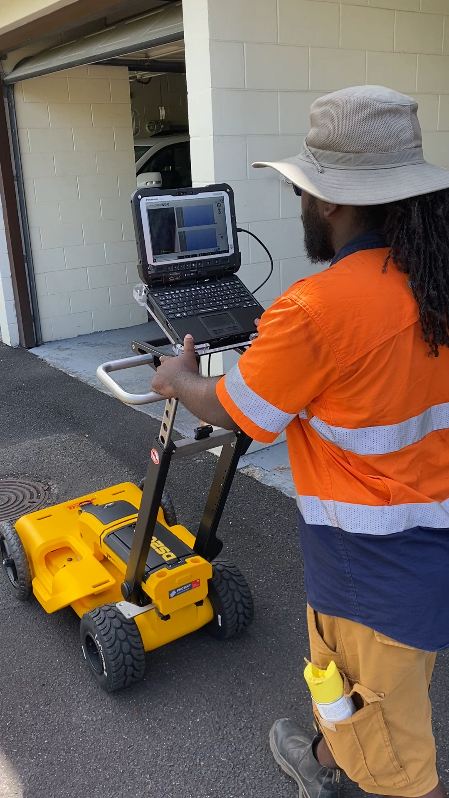

Slide 8
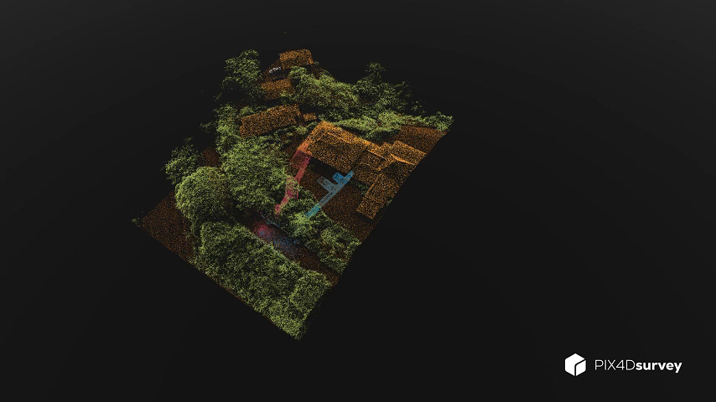

Slide 9
Examples
Flood modelling projections from the collapse of a tailings dam.
Mangrove mapping and the impact of mangroves on coastal protection through erosion control.
In-ground services and utility mapping to ensure accurate capture of sub surface obstructions.
Rainwater surface runoff for stormwater design and management.
Sea-level rise and coastal inundation mapping.

Slide 10
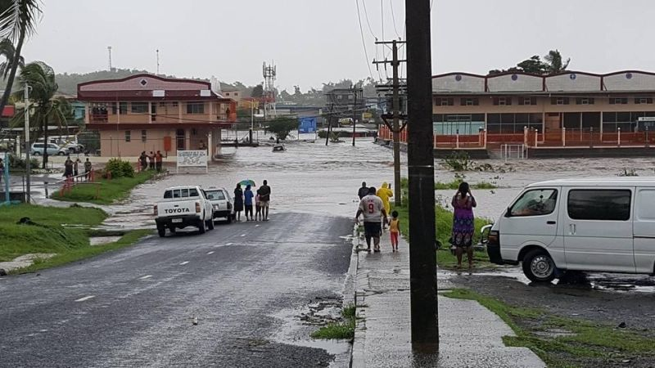
Suggestions
The are clear benefits to the SIDS for having a central repository for data storage
The ability to manage risk can be vastly improved through regular capture of spatial data to understand changes in the natural and urban environments.
Open access to data.
Cost and time savings to development funded project and programs would be significant.

