Slide 1
Climate and Disaster Risk Assessment
ADB’s approach in the Pacific
Overview presentation

Slide 2


Context
Growing impact of climate change and disasters on Pacific communities, infrastructure and economies
ADB commitment to significantly scale up standalone and embedded investments in climate adaptation and disaster risk management
Increased availability of concessional finance for climate adaptation and disaster risk reduction
Need to shift risk assessment further upstream (from project to national/sectoral level) to inform long-term investment planning decision-making
Need for enhanced risk information to inform disaster risk financing arrangements

Slide 3
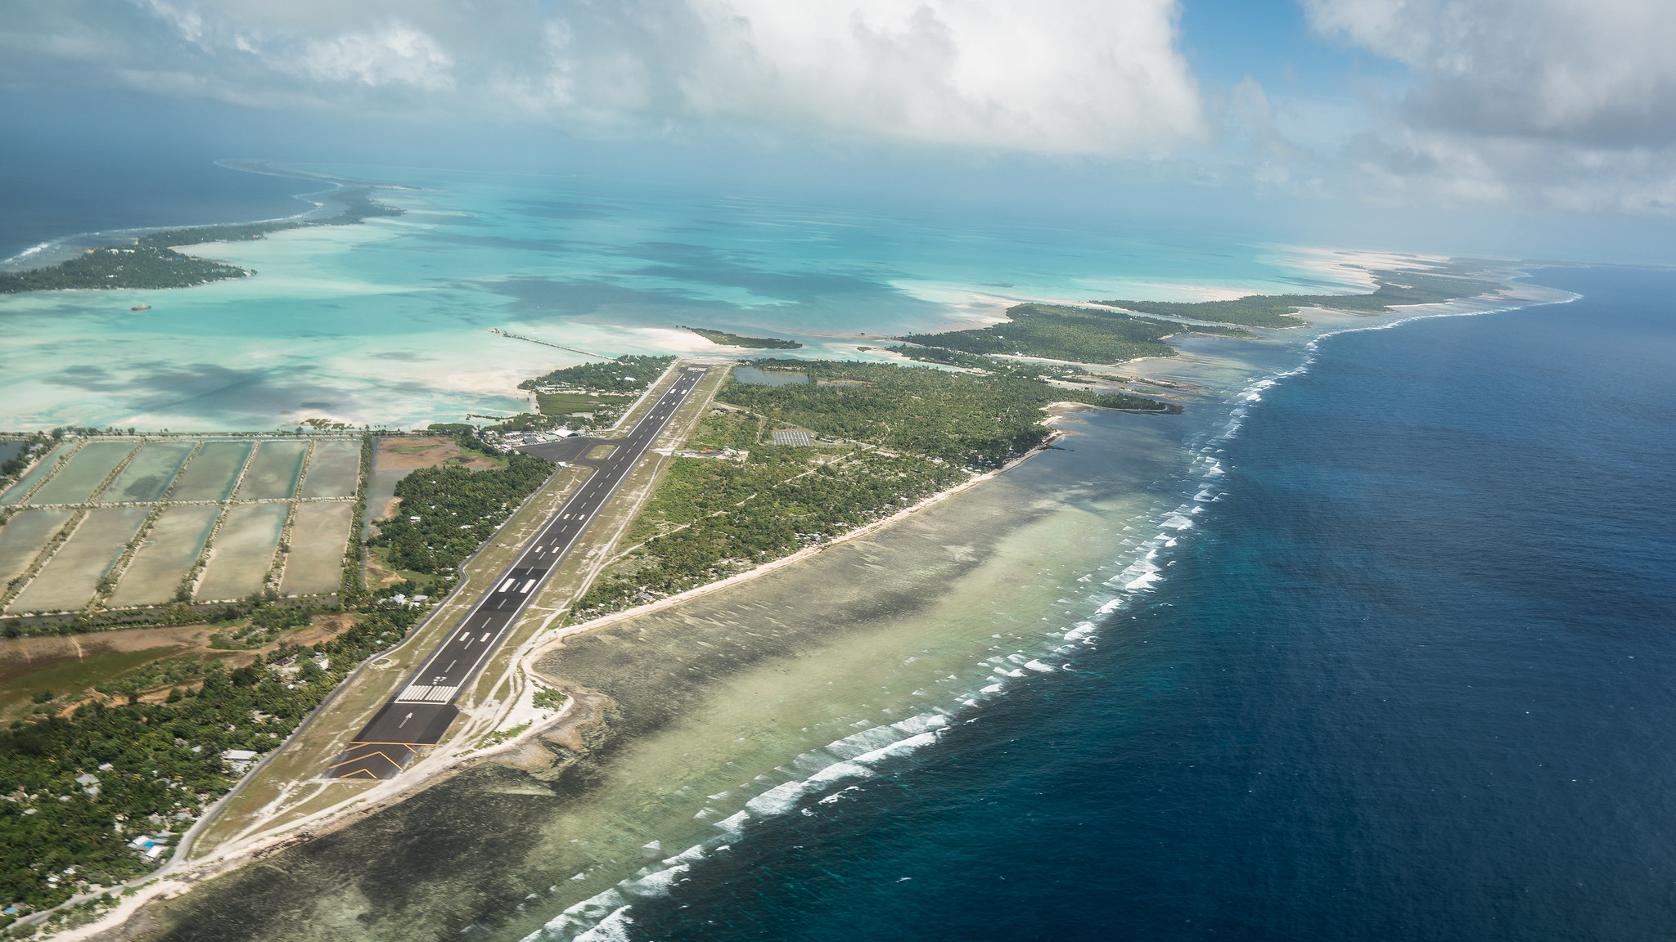

Shifting upstream:
risk & resilience-based investment planning
Pacific context: unique opportunity in SIDS to assess risk across an entire economic, social and infrastructure system and inform island-level masterplans/ spatial plans

Slide 4
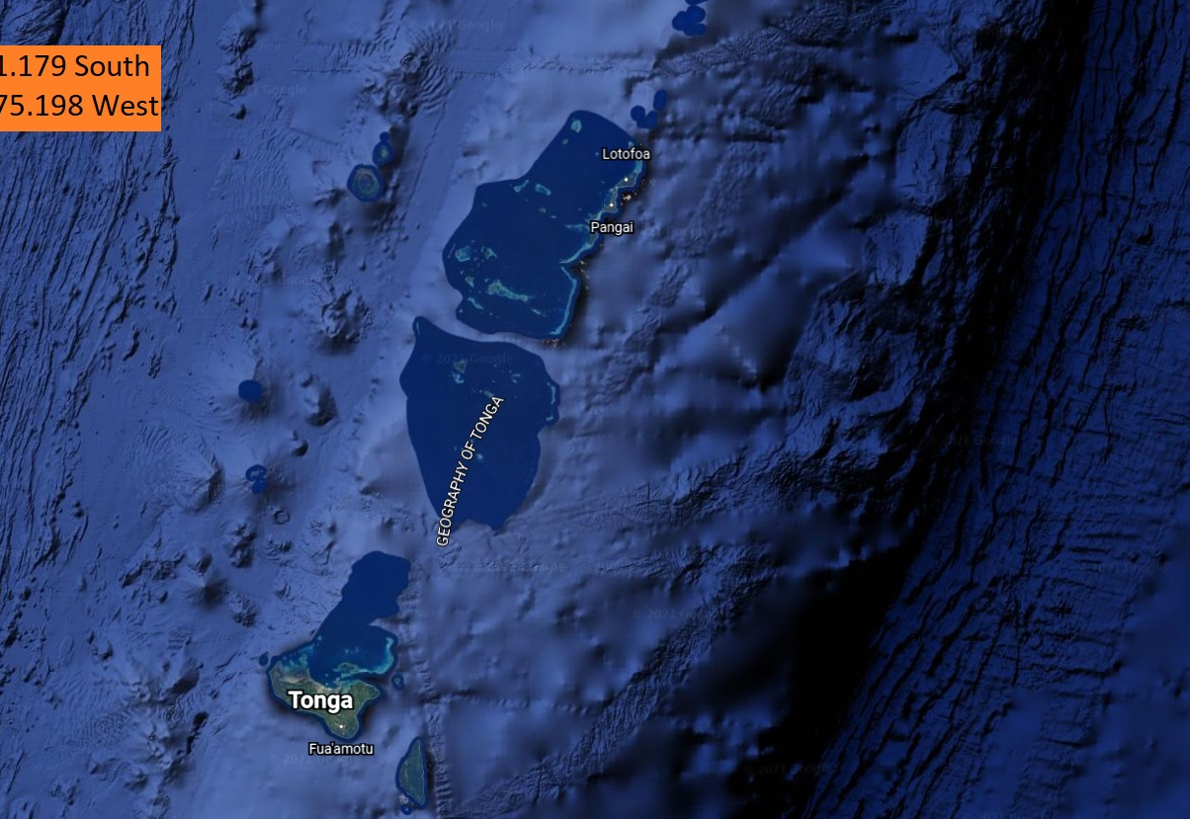
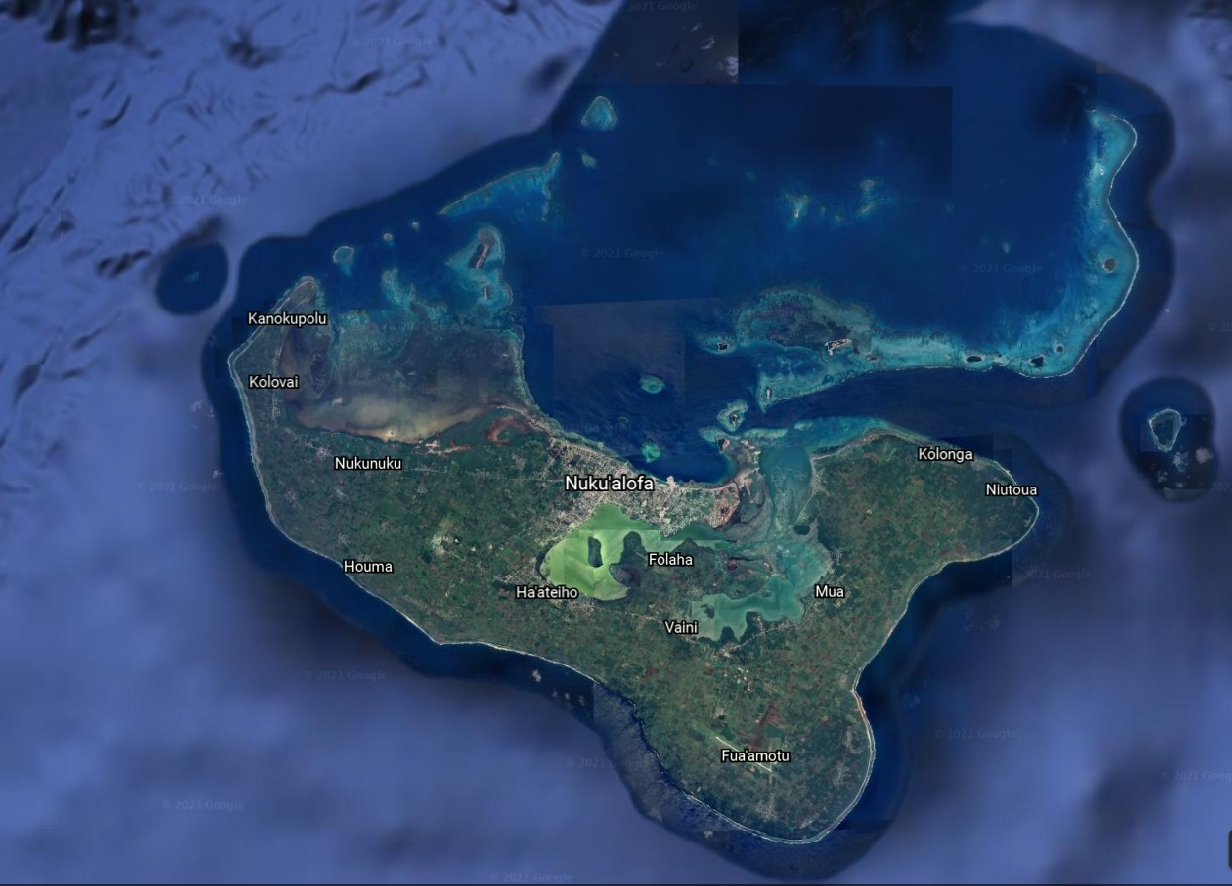

Case Study: Multi-hazard Disaster Risk Assessment for Tongatapu, Tonga
170 Islands 21° South of the Equator in the South Pacific
Home to approximately 105,000 people
Focusing on Tongatapu and Capital City Nuku’alofa
Home to 75,000 – more than 70% of the population

Slide 5
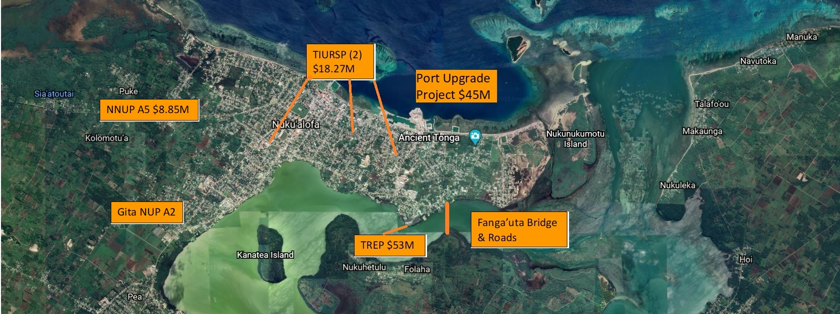
Nuku’alofa & GoT/ADB Investments
Tonga Integrated Urban Resilience Sector Project: Feasibility Study found that urban flood risk in the capital could not be managed through infrastructure measures
Heightened interested in understanding the risk to Nuku’alofa because of a concentration of ADB investments in the city and need for long term adaptation pathway

Slide 6
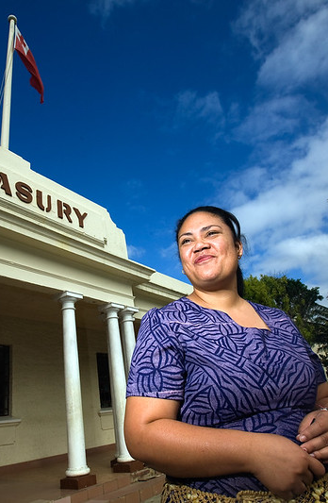
Government of Tonga ownership
Multi-agency ownership: governance group included at least 3 of the CEOs in the GoT and SOE representatives
Inception phase: involved a number of workshops with different ministries.
Throughout the project: multiple workshops were held to gather and share information
End of project: presentations for each phase of the project to share results and a workshop to handover the deliverables and database to GIS agency in Ministry of Lands
Notes:
Due to COVID, meetings held remotely

Slide 7
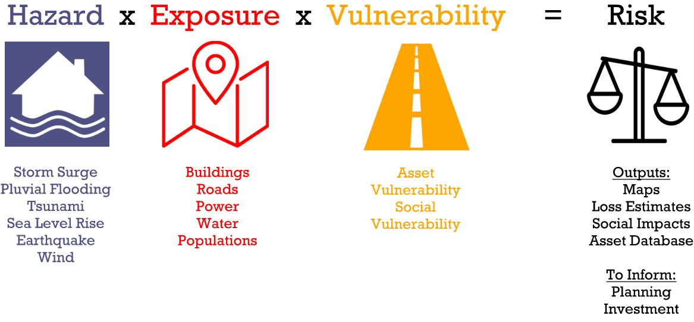
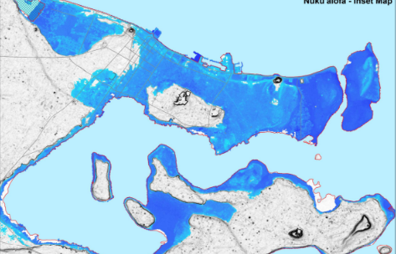
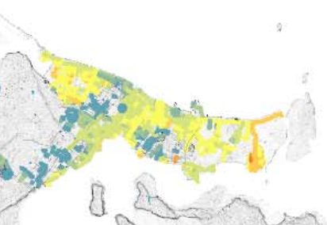
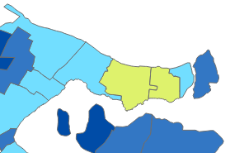
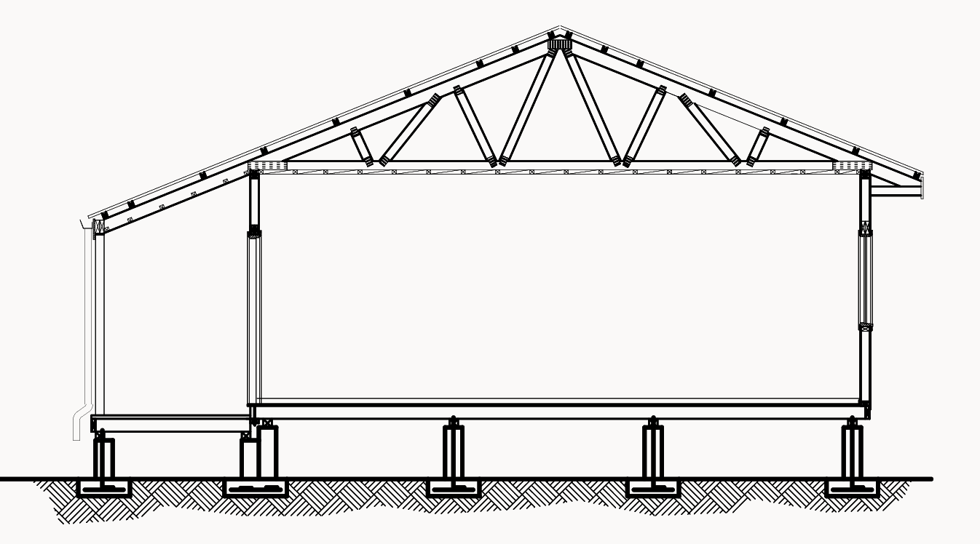
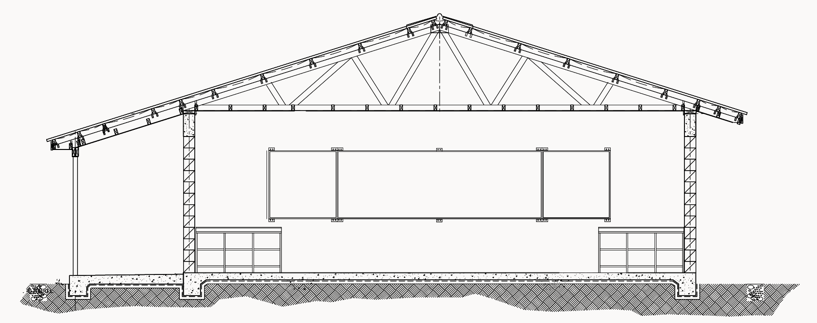
Risk Assessment Approach
AAL: the expected financial loss per year, averaged over many years and modeled events.

Slide 8
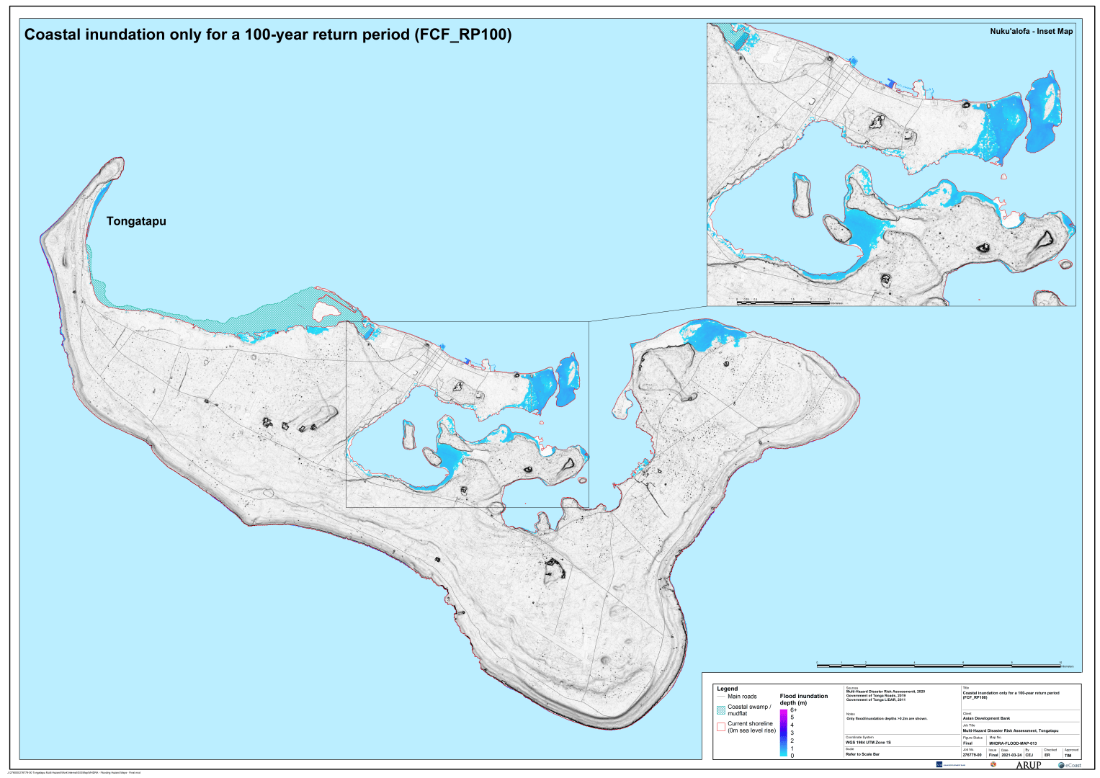
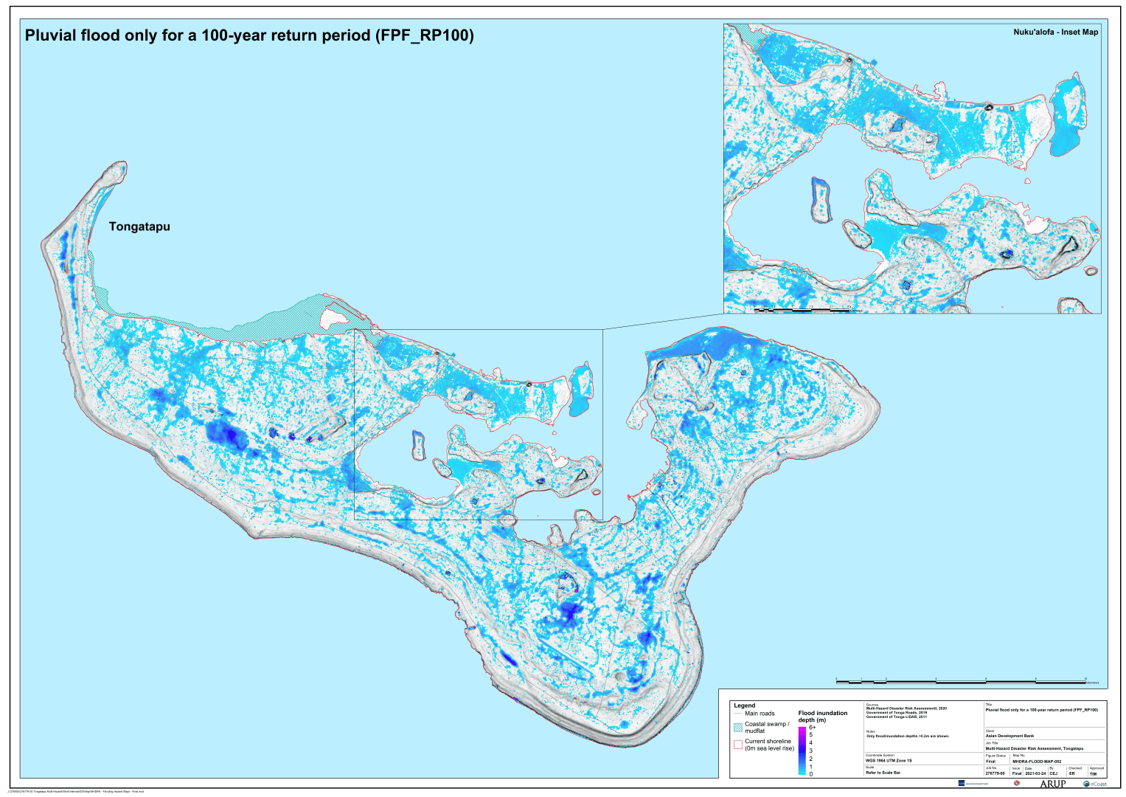
Inundation Hazard
Sea level rise + climate change impacts
Coastal inundation, 100-yr RP
Pluvial flooding, 100-yr RP
Notes:
Pluvial, coastal and combined pluvial + coastal inundation
Intensity metric: flood depth
Return periods: 10, 50, 100, 200-yr
Pluvial flooding was most significant inundation hazard
Sea level rise was considered independently + in combination with coastal inundation and pluvial flooding.
Deterministic SLR scenarios: 0.5m, 1.0m, 2.0m, 4.0m and 6.0m
Scenarios selected due to uncertainty in climate models – allowing decisions makers to consider latest science, planning horizons and appetite for risk.
For pluvial flooding, precipitation was scaled to account for climate change impacts

Slide 9
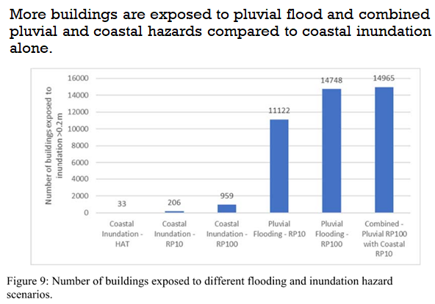
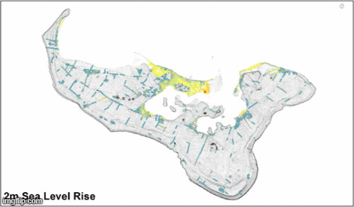

Exposure Assessment: Inundation
Roads exposed to inundation vs Sea Level Rise Scenarios.
Notes:
Exposure:
Assets
Buildings ~28,000
Roads ~1,200 km
Power assets ~26,000 items
Water assets ~500 items
Environmental / agricultural lands 212km²

Slide 10
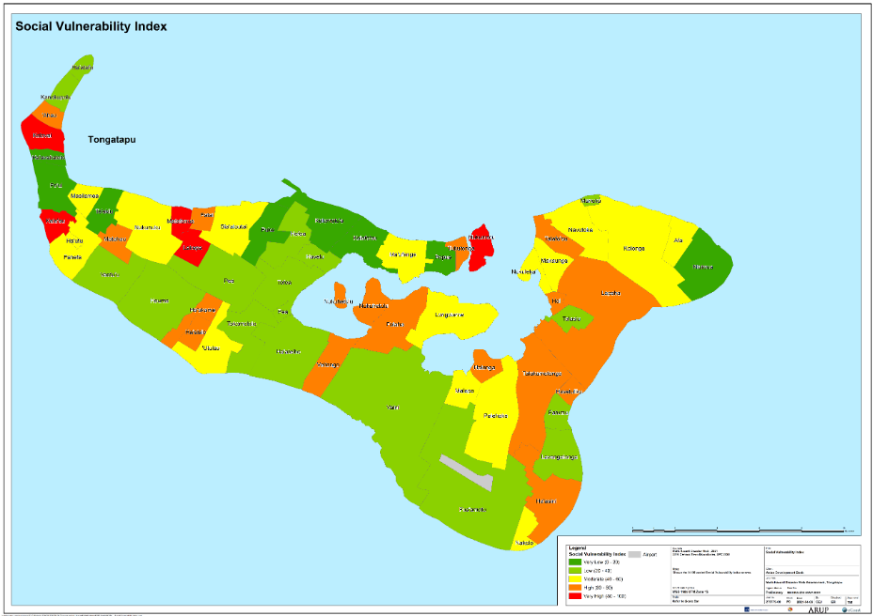
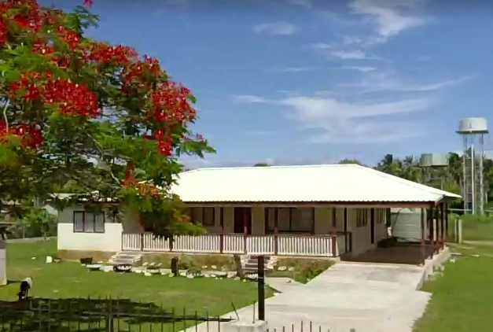
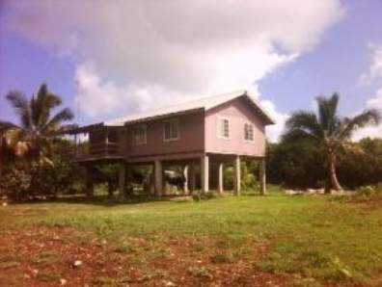
Vulnerability
Social Vulnerability
Physical Vulnerability
Building typology A
Building typology B

Slide 11
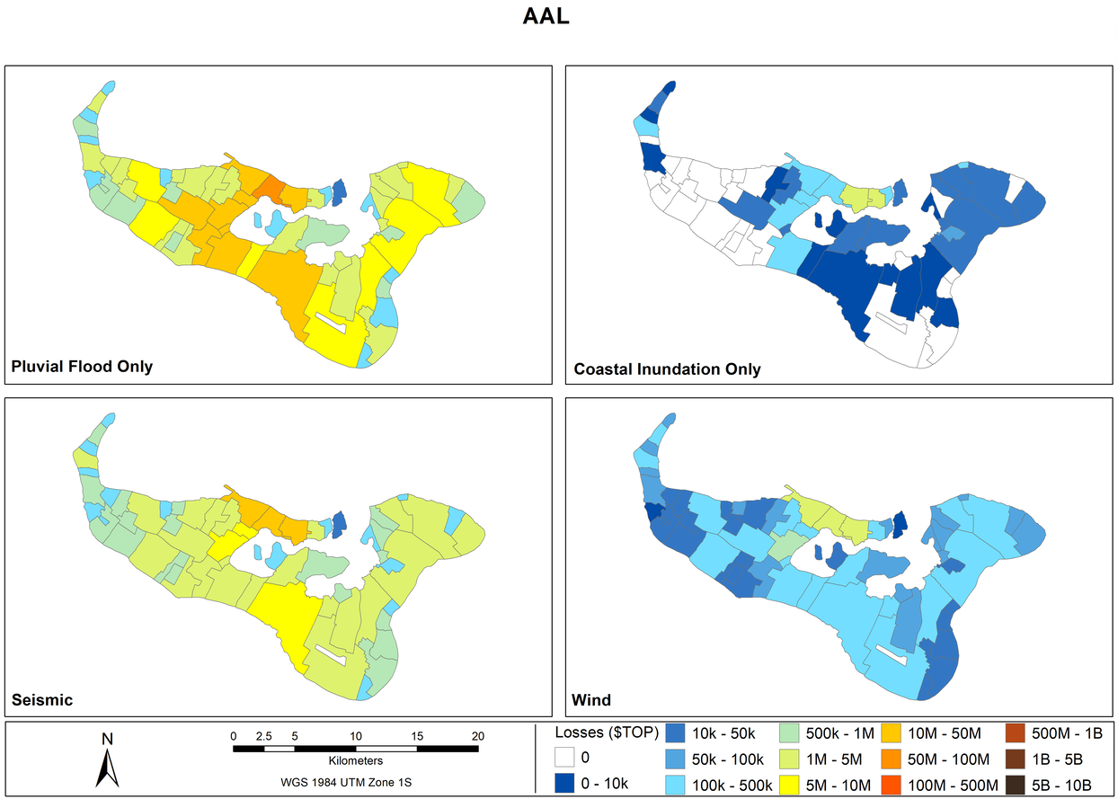
Risk findings: comparison of hazards
Pluvial is most impactful for AAL and at shorter return periods
At the longer return periods seismic and TC/wind events become more impactful
Average annual loss (AAL)
$310M
$6.4M
Pluvial
Coastal
$134M
$10M
Seismic
Wind

Slide 12
Key findings
Assets:
Buildings are a key driver for loss due to having the greatest volume of assets
While losses due to damage to water and power are comparatively smaller, the impacts of disruption to service may be significant
Sea level rise:
Permanent losses under sea level rise are significant
0.5m SLR losses ($756M) are approximately equal to 50-yr pluvial losses ($752M)
1m SLR losses ($3.3B) are greater than the 200-yr seismic losses ($2.5B)
1m SLR losses are more than 10x the modelled losses for TC Gita ($300M)

Slide 13
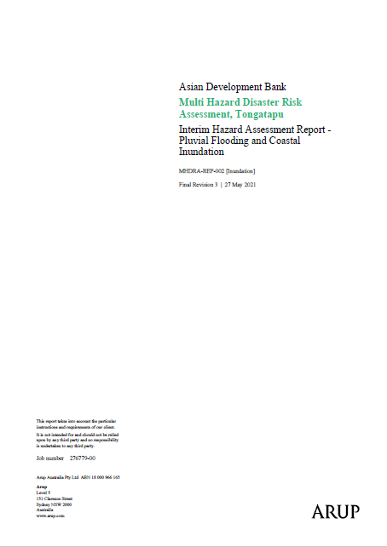
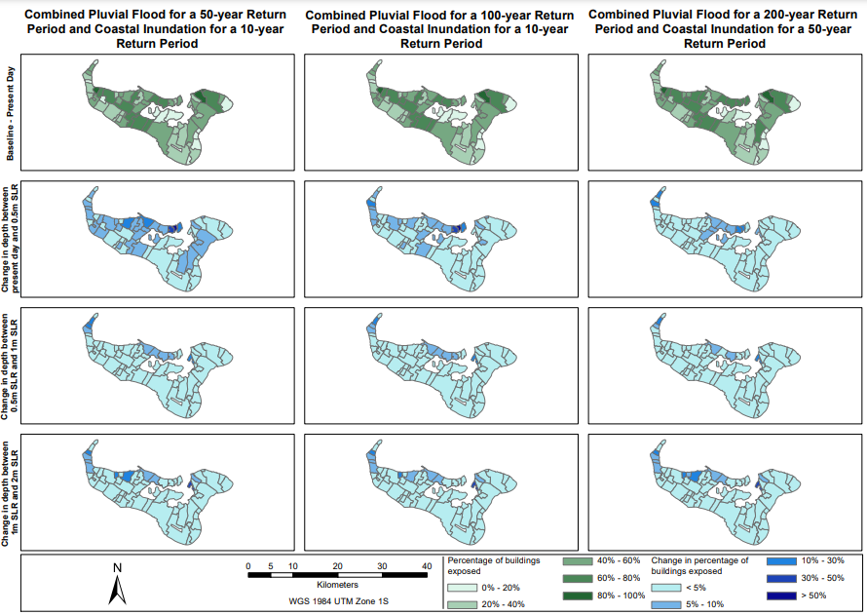
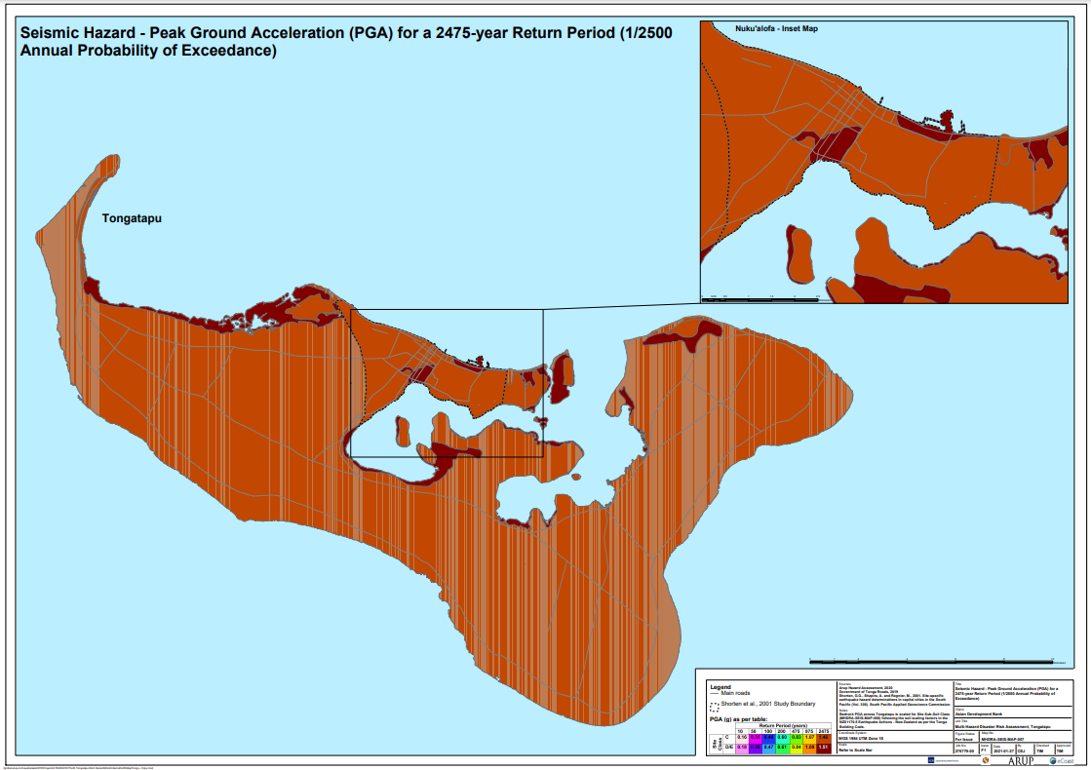
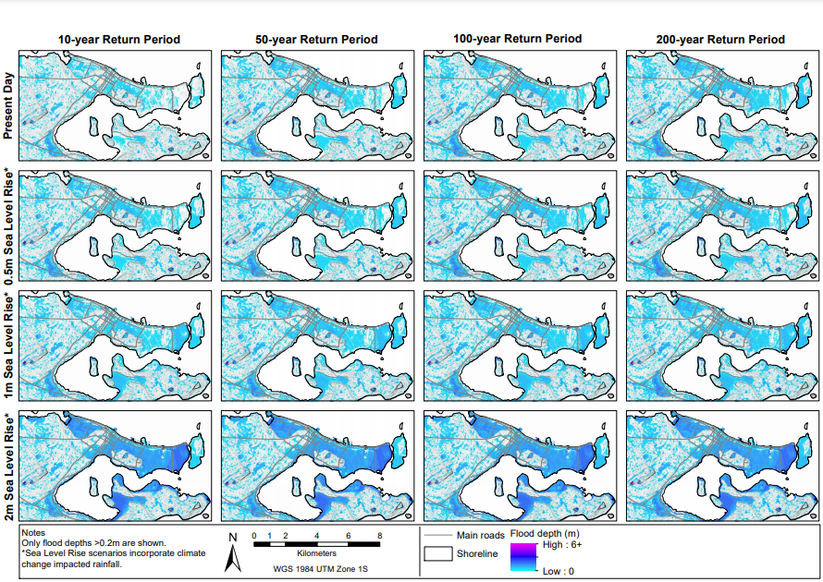
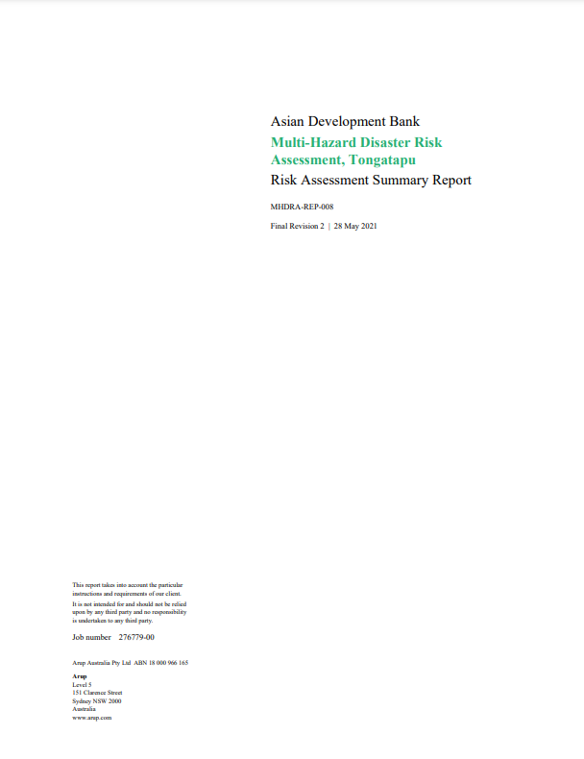
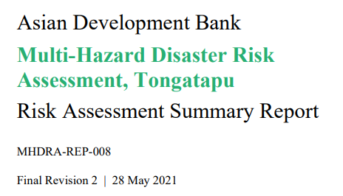
Outputs
GBs of data
7 technical reports and 1 project summary report
100s of hazard, exposure and risk maps

Slide 14
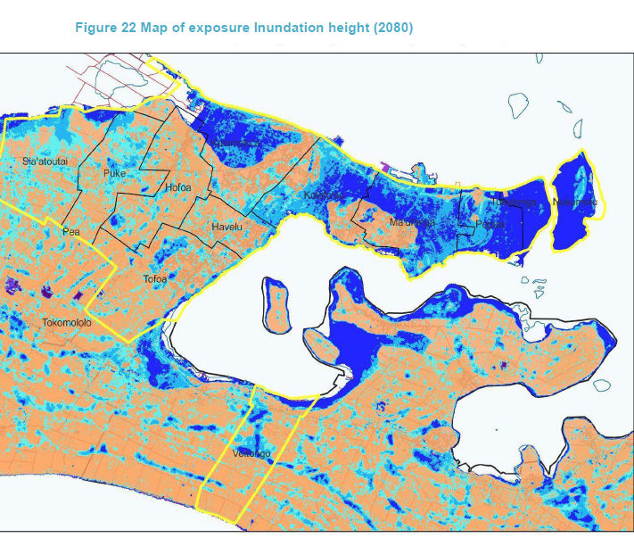

Applying findings to investment decision-making
ADB and the government of Tonga are developing a climate and disaster resilient urban strategy and investment plan for greater Nuku’alofa.
Based on the findings of the risk assessment, the plan provides revised zoning to reduce disaster impacts, especially inundation and sea level rise.
Climate adaptation actions are identified for relevant authorities and agencies.
It provides an investment plan to build resilience, e.g., emergency shelters and municipal GIS system.

Slide 15
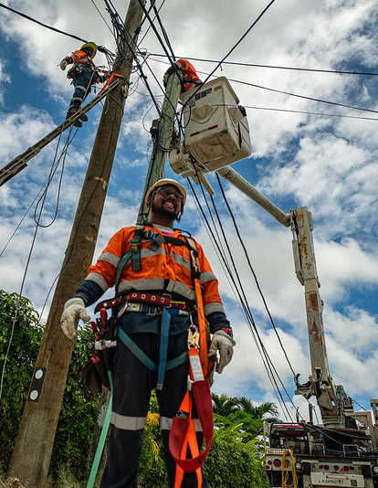
Ongoing initiatives
Vanuatu: multi-hazard DRA for Greater Luganville area nearly complete.
Cook Islands: coastal hazard risk assessment of critical public infrastructure systems and identification of risk reduction and adaptation options to reduce direct and indirect losses.
Sectorial risk assessments
Sectoral climate and disaster risk assessment for Samoa and Cook Islands to inform power sector master planning.

Slide 16
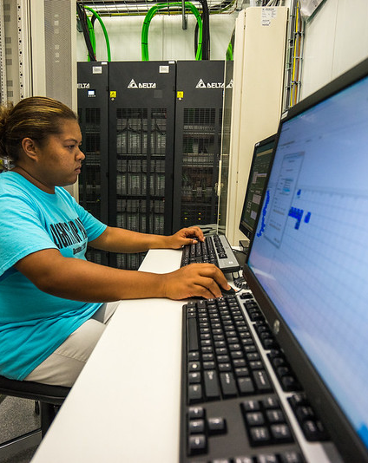
Remaining challenges and priorities
Lack of baseline data especially DEM, social and physical exposure data remains a major barrier to widescale rollout
Gaps in global climate models (but rapidly improving)
Lack of technical capacity, data standards, hardware and software at a national level to institutionalize data
Data governance issues are widespread, challenges to making data truly open source
Close involvement of national stakeholders in risk assessment processes and investment prioritization key to ensuring buy-in and understanding
Need for regional coordination

Slide 17
Thank you
Belinda Hewitt, Senior Disaster Risk Management Specialist
bhewitt@adb.org

