Slide 1
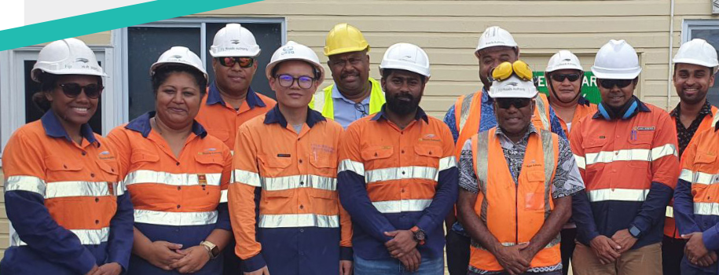
Local content in infrastructure
Achieving value for money through local content and industry participation

Slide 2
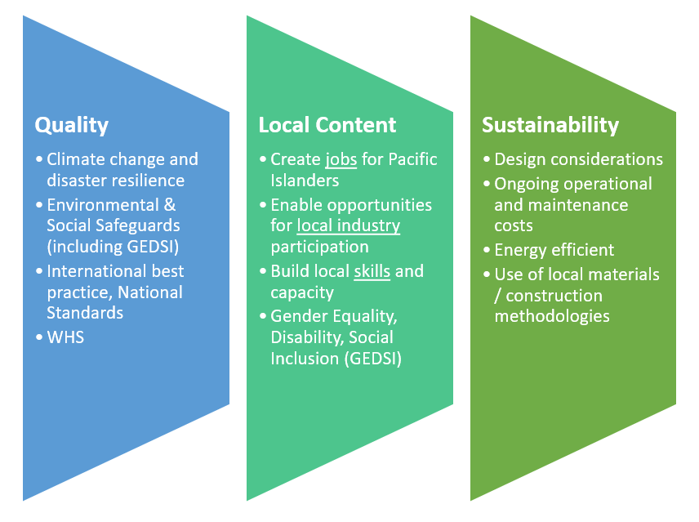
AIFFP Social Procurement Policy

Slide 3
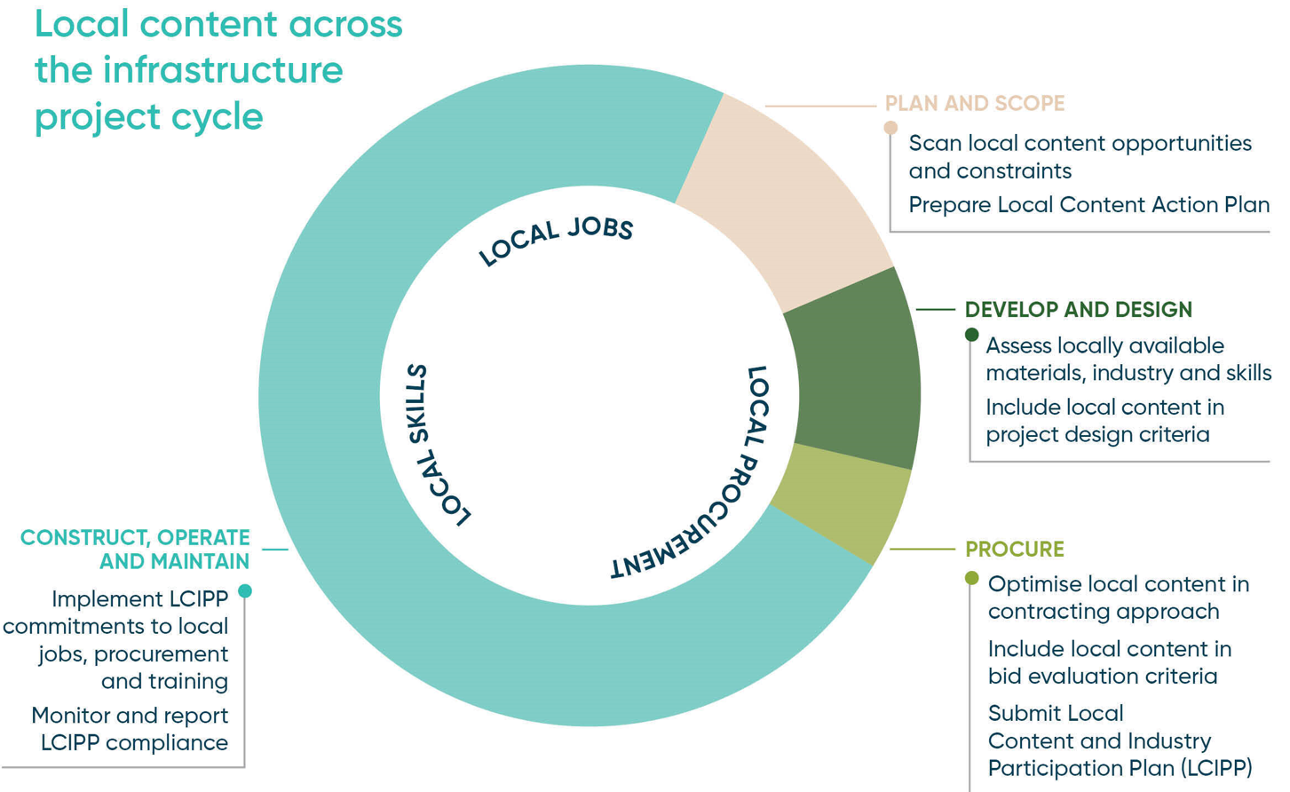

Slide 4
AIFFP Project Guide:
Local content checklist

Slide 5
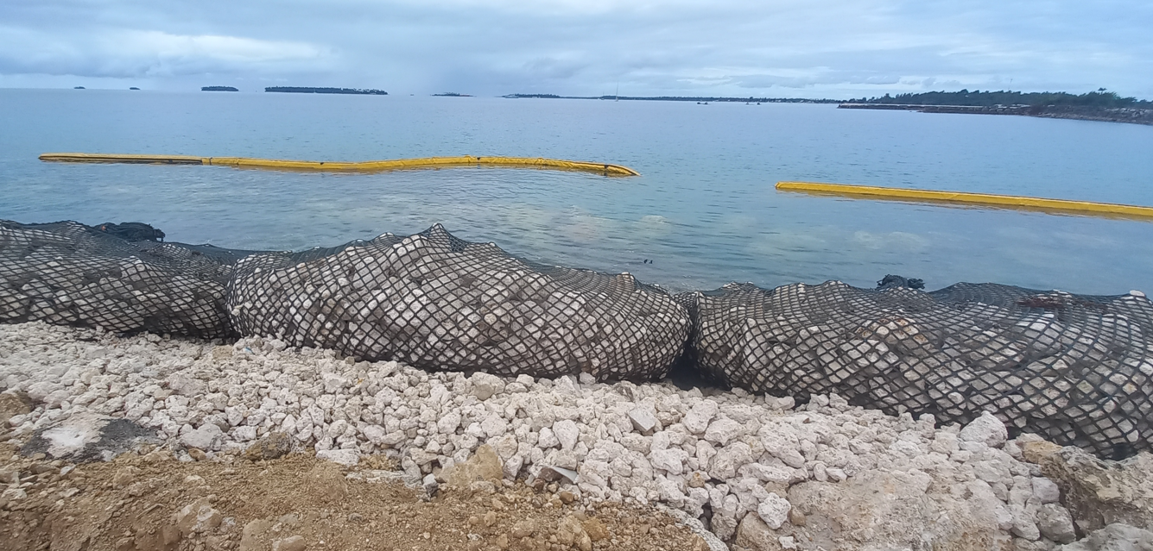
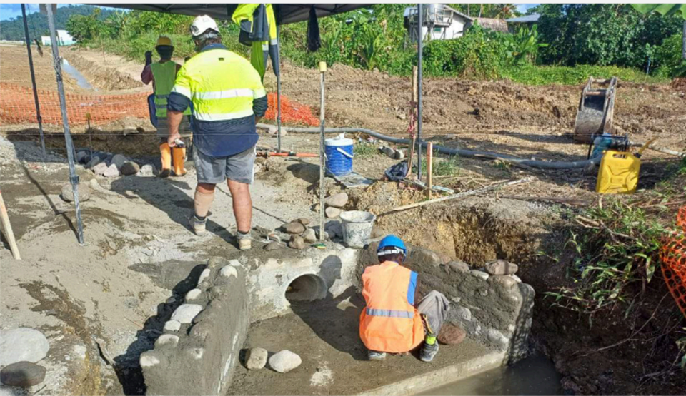
Locally Informed Design – import substitution
Substituting imported rockarmour for shore revetment with rockbags using rock waste from the dredging works
The use of appropriate forms of construction can enable the use of local skills and materials at substantial cost savings
Substituting stone masonry for precast concrete stormwater features

Slide 6
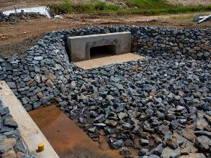
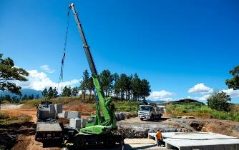
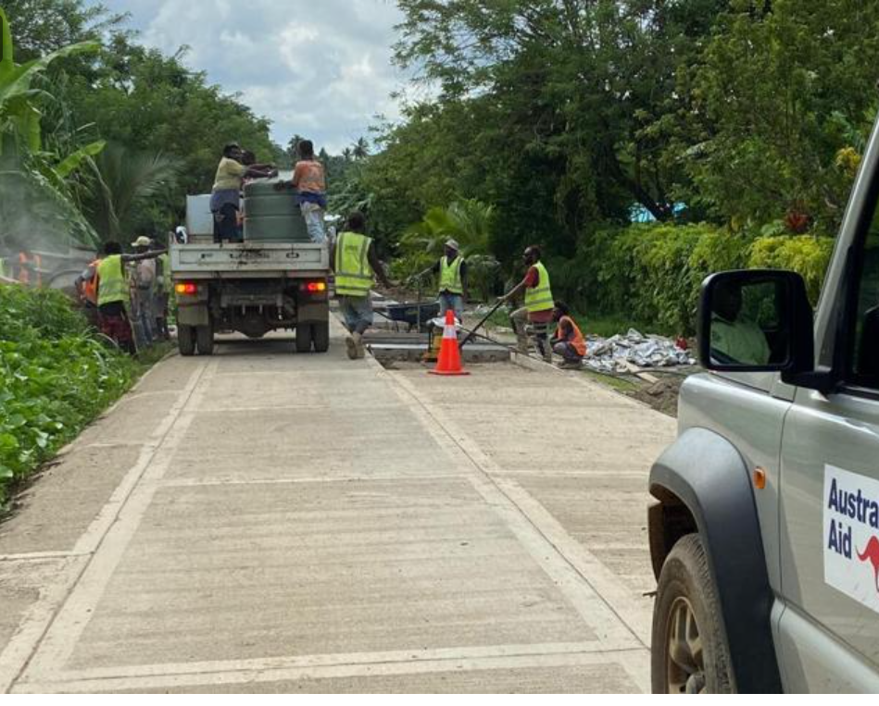
Industry Development
Import substitution strategies developing new local industries for long-term economic benefits and use on future projects
Creating new local supplier capabilities to manufacture concrete culverts in Fiji
Creating new industry of small scale roads contractors in Vanuatu with a fibre reinforced concrete surface

Slide 7
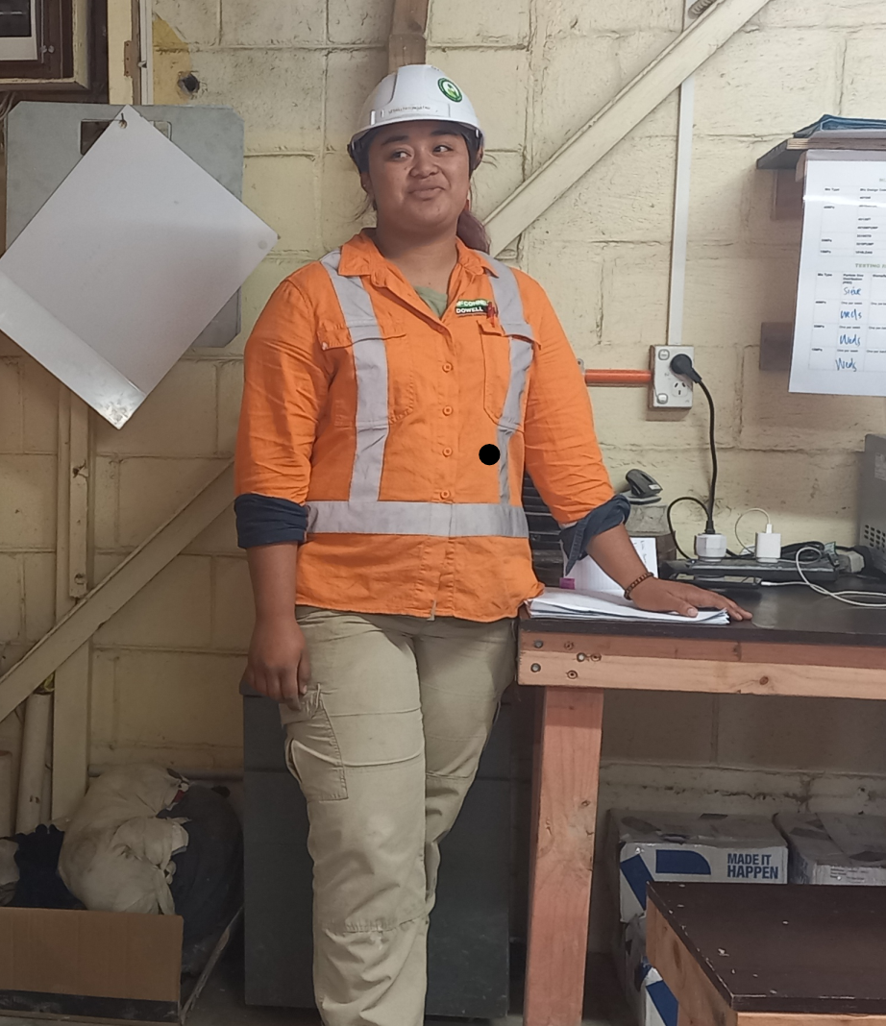
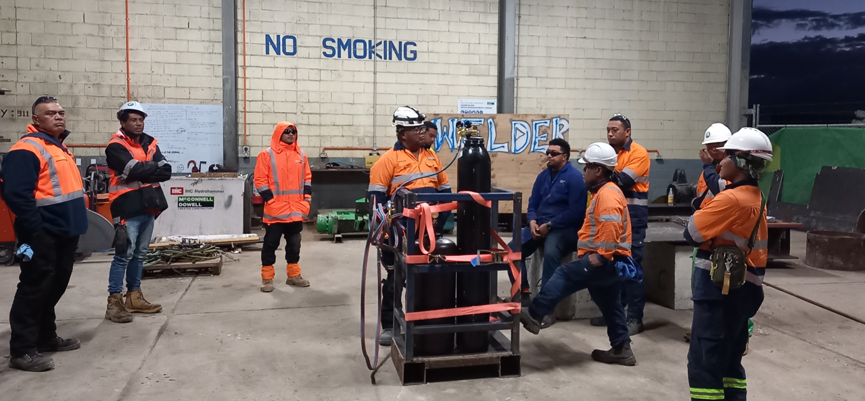
Local content optimisation
Labour market imbalances driving local content investments
Oxywelding demonstration delivered by Tongan diaspora to local workforce
Quality control of marine grade concrete supply managed entirely by local team, headed by recent graduate engineer
Optimising the quality of materials and workforce capacity is a critical enabler of local content

Slide 8
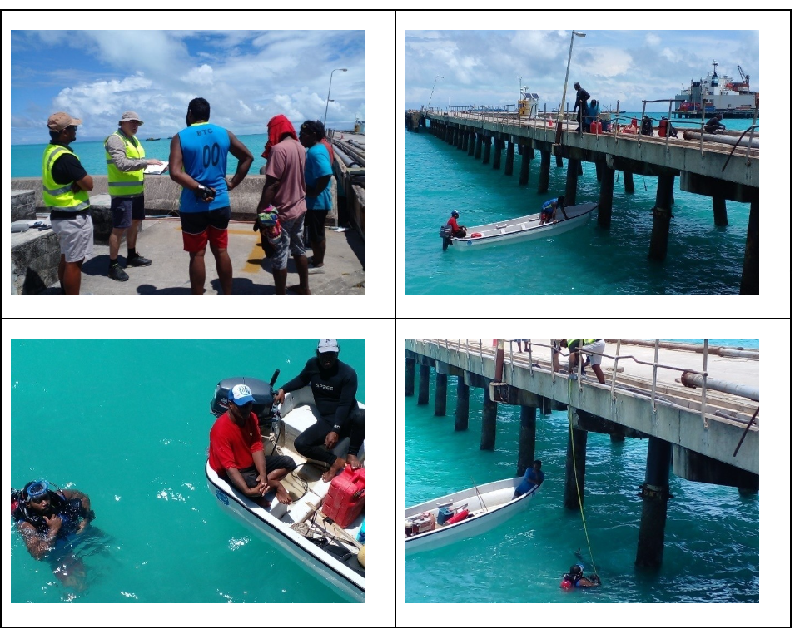

Capacity Development
Leveraging project sites as learning sites to gain industry experience and equitably grow the next generation of skilled workers
Graduates from the SIIP / APTC Construction Skills Cert II course in Solomon Islands, with solar PV module
Kiribati divers and local graduate engineer supporting site condition assessment of steel piles at Charlie Wharf

Slide 9
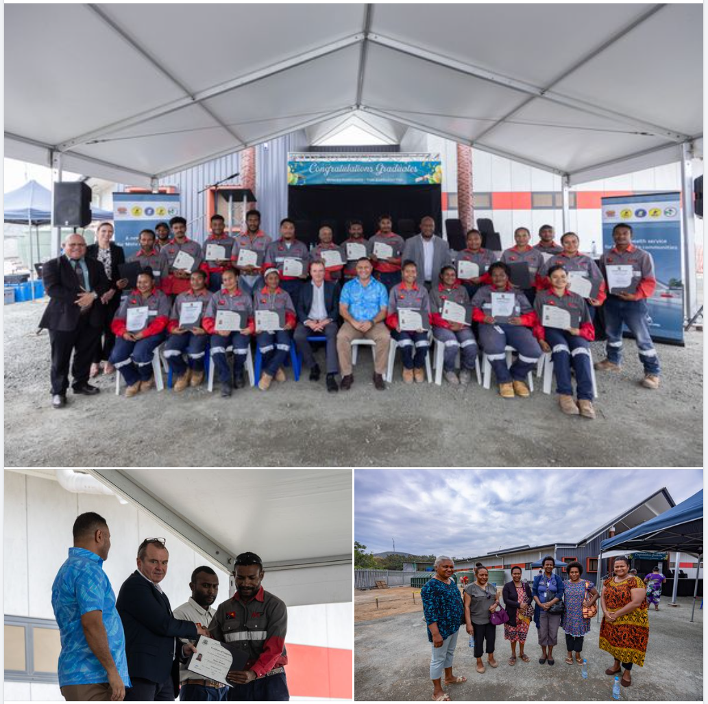
Capacity Development
Projects providing pathways to formalise on-the-job skills and attain trade qualifications
21 participants (more than 50% women) successfully complete Certificate I in carpentry, plumbing, electrical and mechanical trades through industry-led, workplace-based training at the Australian-funded construction project to build Metoreia Health Centre, Hanuabada, National Capital District, PNG.

Slide 10
Questions
Feedback
Sharing of local content experience
Thank you!

