Slide 1
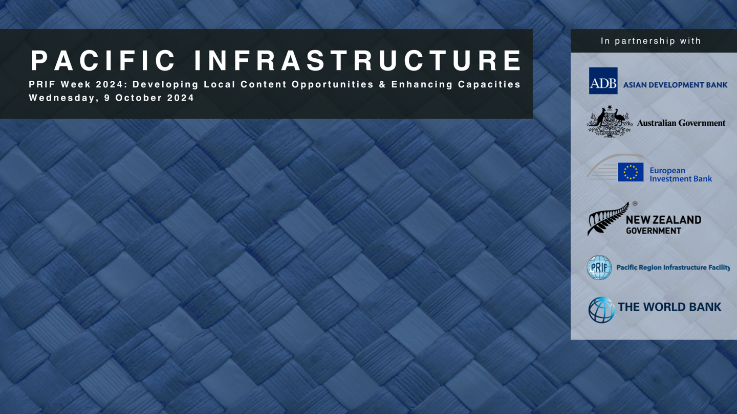
Development Partner Initiatives to increase participation in Pacific Infrastructure Projects
Amin Sakai – World Bank
Jenny Yan Yee Chu – Asian Development Bank
Tim Houghton – Austrade
Benoit Cambier- European Investment Bank

Slide 2

Following the Industry Feedback received at Pacific Regional Infrastructure BOS 2024
Review suggestions against policy framework to increase flexibility and fit for regional context
Tailored actions for different players
Market feedback welcomed on the actions being considered

Slide 3
Theme 1 – Consider VfM and Sustainability in Qualification and Evaluation Approach
Rated Criteria/ Merit Point Criteria – increasingly made mandatory/ promoted/ defaulted by development partners
Regional Procurement
Pre-Qualification allowed
Promote use of O&M model

Slide 4
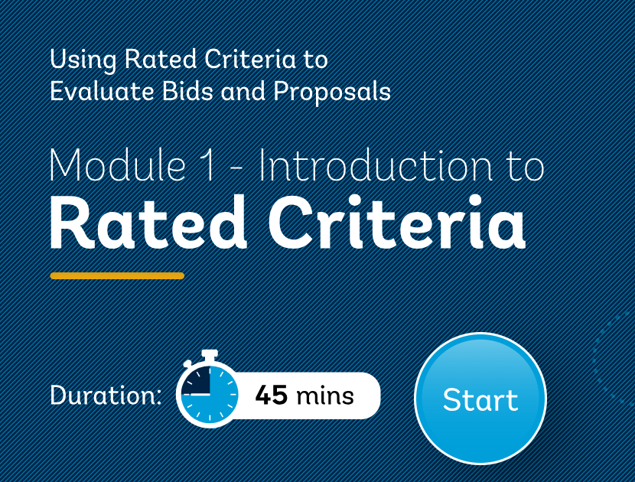
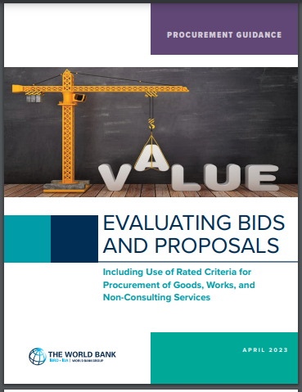
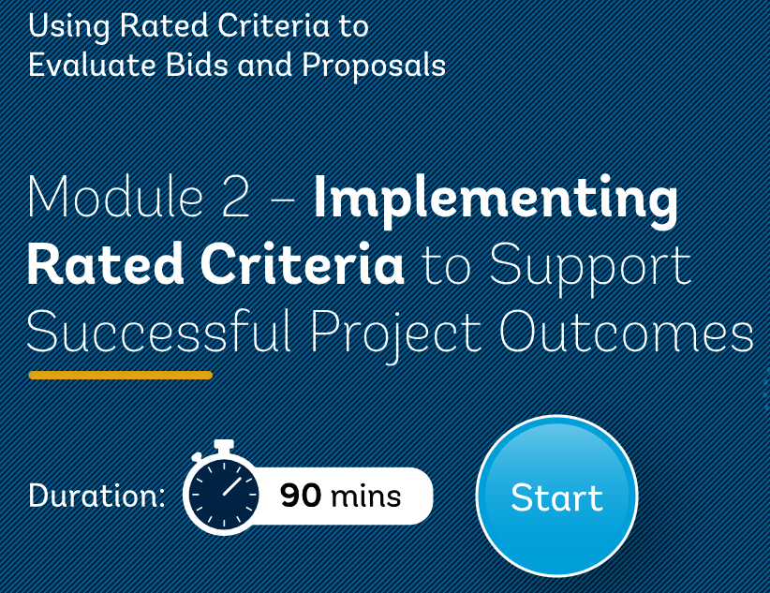
Theme 1 – Consider VfM and Sustainability in Qualification and Evaluation Approach
Value for Money (VfM) balances cost, quality, and impact, focusing on achieving the best overall outcome rather than just the lowest price.
Rated Criteria (WB) / Merit Point Criteria (ADB)
      WB example
      All new International Procurements advertised or invited on or after September 1, 2023, using a Bank Standard Procurement Document must use Rated Criteria.
                Pacific 100% compliant.
                Weighted and Scored: 60-40 or 70-30

Slide 5
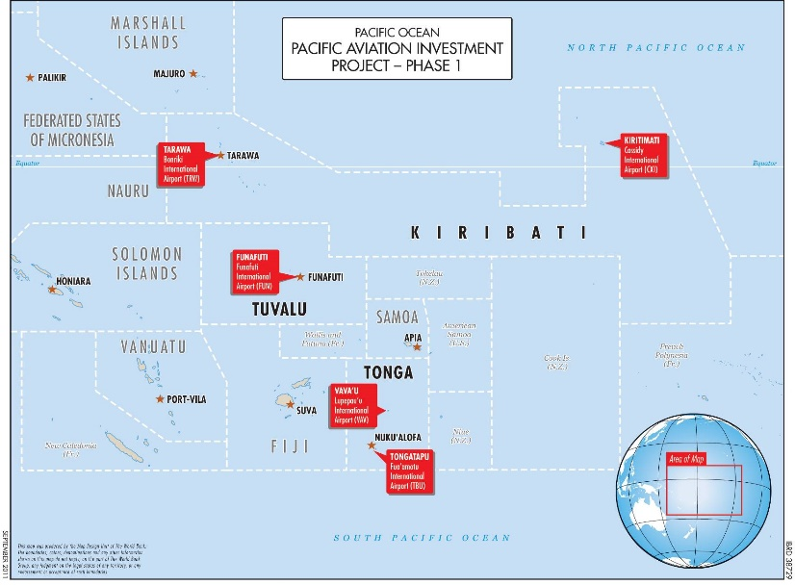
Theme 1 – Consider VfM and Sustainability in Qualification and Evaluation Approach
Regional Procurement
Pacific Aviation Investment Program To improve operational safety and oversight of key air transport infrastructure - WB
Design, Supply, Install, Test, Commission, Operate & Maintain Floating Solar PV Generation, Grid Infrastructure and other items in Kiribati and Tuvalu – ADB
Opportunities:
Increase appeal to market by bundling
Address remote supply chain issues
Enhance procurement transaction efforts
Challenges:
Coordination Among Stakeholders
Differing priorities and objectives among stakeholders
can hinder collaborative procurement initiatives.

Slide 6

Theme 1 – Consider VfM and Sustainability in Qualification and Evaluation Approach
Pre-Qualification allowed
  Ensure capability
  Streamline Bidding
Risk Reduction
Applicability: Project Type + Complexity

Slide 7

Theme 1 – Consider VfM and Sustainability in Qualification and Evaluation Approach
Incorporating O&M in Contracts: The O&M model can be integrated into procurement contracts, particularly for complex infrastructure and facilities. In design-build-operate (DBO) or design-build-operate-maintain (DBOM) contracts, contractors are responsible for not only constructing but also operating and maintaining the infrastructure over a defined period.
The Operations and Maintenance (O&M) model is commonly integrated into energy projects, such as solar panels and power plants, where ongoing maintenance is essential after contract award to ensure efficient operation. However, borrowing countries often avoid borrowing funds specifically for O&M activities, focusing instead on capital expenditure for project implementation rather than the long-term costs associated with maintaining these assets.
Other Example: Fiji Non-Revenue Water Loss Reduction (ADB)

Slide 8

Theme 2 – Enable Innovation through Early Market Engagement
Market Sounding during procurement planning stage – e.g. Workshop
Increasingly using collaborative steps (e.g. two stage procurement) to incorporate industry feedback on requirements, risk sharing and contract models, etc. for works procurements.
Increase awareness and application of Alternative Proposal

Slide 9

Theme 3 – Support Local Participation and SME Capacity Building
Common approach to Local Participation/ Local Content e.g. traineeship, materials, sub-contracting
Increase Visibility of Pipelines and Procurement Opportunities
  BOS, Roadshow, Centralised Info Platform
Local Contractor Database
Knowledge Resources and Training Pathway to help SME participate
Business Admin, Insurance, Bidding, Contract
PRIF webinar series
Strengthen enabling environment

Slide 10

Theme 4 – Performance Management
Contract Management training
Framework Agreement for Design/ Construction Supervision
Explore use of Performance Based Contract Model
Explore use of National Performance System

Slide 11

THANK YOU
See you in the next Pacific Infrastructure
Event

