Slide 1
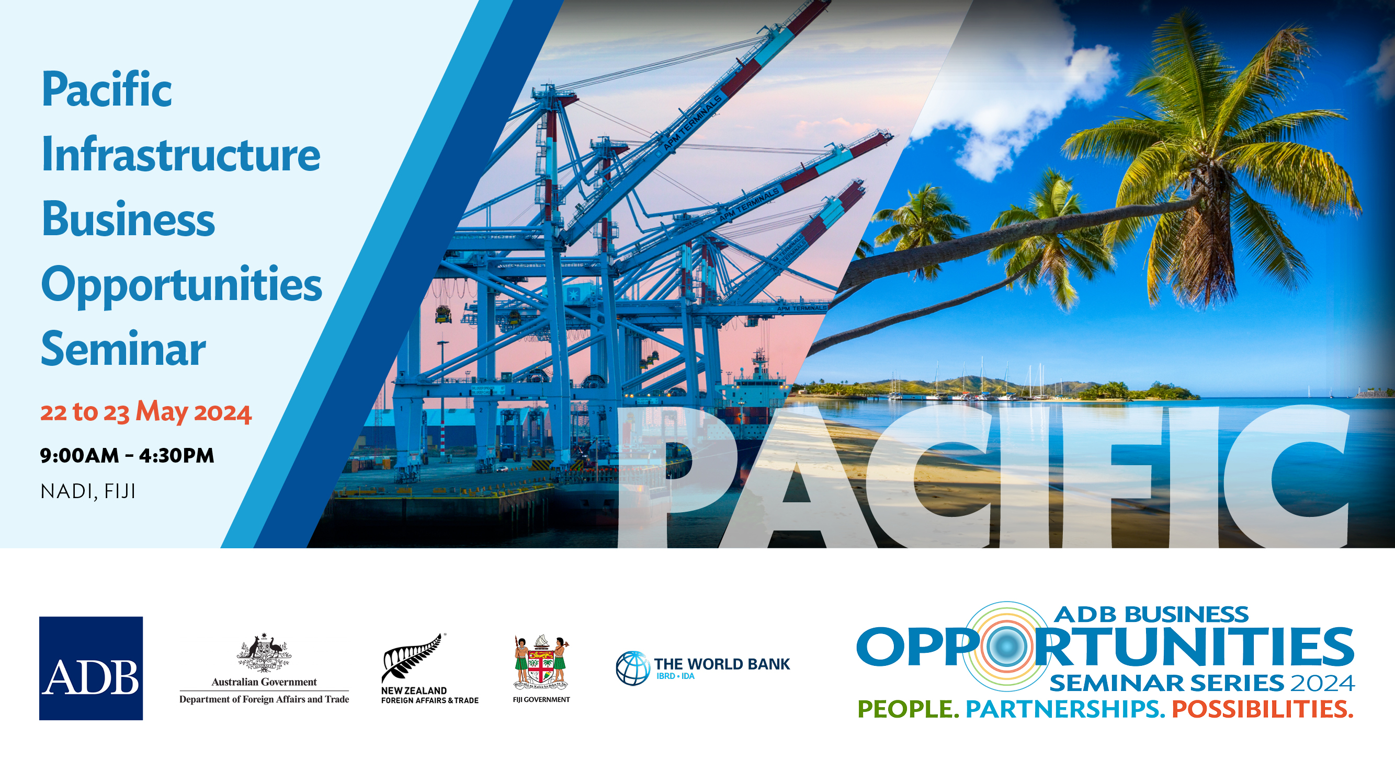
Development Partner Initiatives to increase participation in Pacific Infrastructure Projects
PRIF WEEK 2024
9 Oct 2024
Amin Sakai – World Bank
Jenny Yan Yee Chu – ADB
Tim Houghton – Austrade
Benoit Cambier- EIB

Slide 2
Following the Industry Feedback received at Pacific BOS 2024
Review suggestions against policy framework to increase flexibility and fit for regional context
Tailored actions for different players
Market feedback welcomed on the actions being considered
Pacific Infrastructure Business Opportunities Seminar | 22-23 MAY 2024 | NADI, FIJI

Slide 3
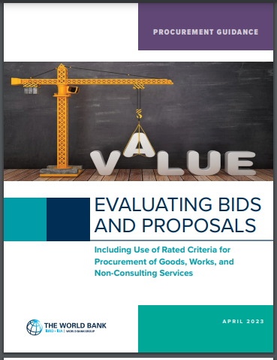
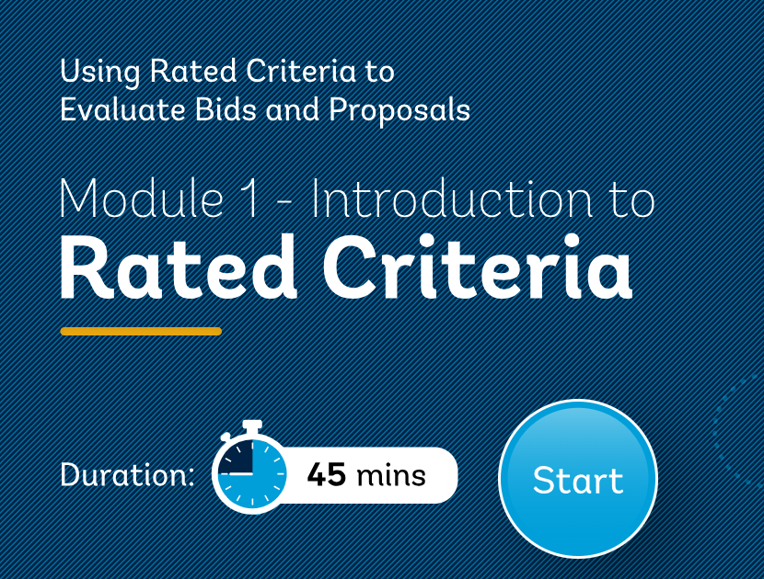
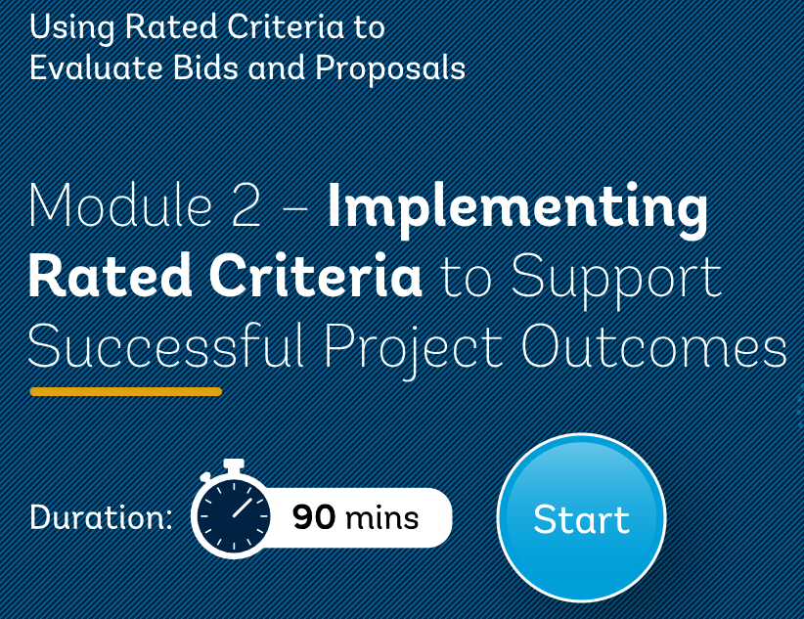
Theme 1 – Consider VfM and Sustainability in Qualification and Evaluation Approach
Value for Money (VfM) balances cost, quality, and impact, focusing on achieving the best overall outcome rather than just the lowest price.
Rated Criteria/ Merit Point Criteria – All new International Procurements advertised or invited on or after September 1, 2023, using a Bank Standard Procurement Document must use Rated Criteria.
                Pacific 100% compliant.
                Weighted and Scored: 60-40 or 70-30
Pacific Infrastructure Business Opportunities Seminar | 22-23 MAY 2024 | NADI, FIJI

Slide 4
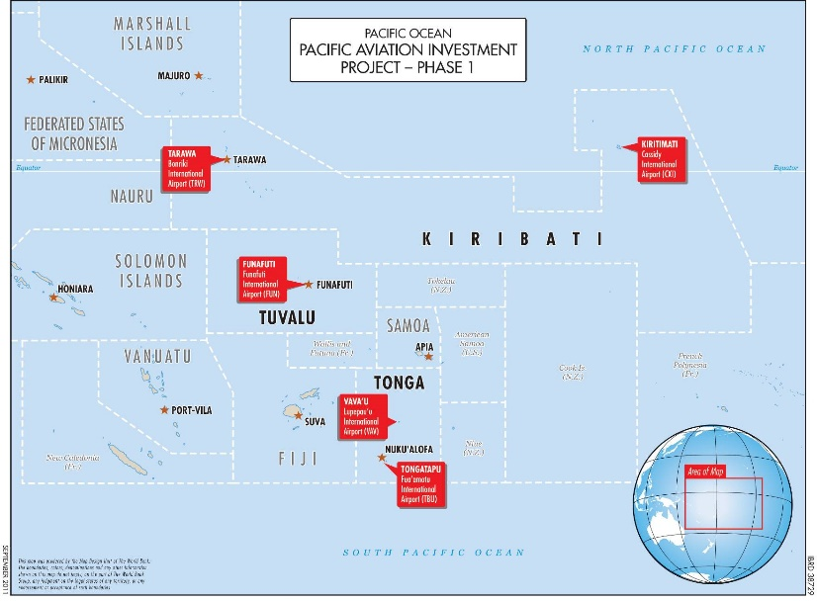
Regional Procurement
Regional Procurement
Pacific Aviation Investment Program
Project Development Objective: To improve operational safety and oversight of key air transport infrastructure.
US$ 125 Million Equivalent
Challenges:
Coordination Among Stakeholders
Differing priorities and objectives among stakeholders
can hinder collaborative procurement initiatives.
Pacific Infrastructure Business Opportunities Seminar | 22-23 MAY 2024 | NADI, FIJI

Slide 5

Pre-Qualification
Pre-Qualification allowed
  Ensure capability
  Streamline Bidding
Risk Reduction
Applicability: Project Type + Complexity
Pacific Infrastructure Business Opportunities Seminar | 22-23 MAY 2024 | NADI, FIJI

Slide 6

Promote use of O&M Model
Incorporating O&M in Contracts: The O&M model can be integrated into procurement contracts, particularly for complex infrastructure and facilities. In design-build-operate (DBO) or design-build-operate-maintain (DBOM) contracts, contractors are responsible for not only constructing but also operating and maintaining the infrastructure over a defined period.
The Operations and Maintenance (O&M) model is commonly integrated into energy projects, such as solar panels and power plants, where ongoing maintenance is essential after contract award to ensure efficient operation. However, borrowing countries often avoid borrowing funds specifically for O&M activities, focusing instead on capital expenditure for project implementation rather than the long-term costs associated with maintaining these assets.
Pacific Infrastructure Business Opportunities Seminar | 22-23 MAY 2024 | NADI, FIJI

Slide 7

THANK YOU
See you in Pacific Infrastructure BOS 2025

