Slide 1


Pacific Region Infrastructure Facility
The Pacific Infrastructure Market and Pipeline
Jim Binney (PRIF)

Slide 2
Overview
Setting the scene (Pacific Quality Infrastructure Principles and the infrastructure project cycle).
The infrastructure market (The scale, scope and location of potential investments. Can we absorb the projects? Are the opportunities getting greater or smaller?).
A Pacific Procurement Opportunities and Project Pipeline (Making infrastructure markets more efficient – the role of the Pipeline. Pipeline and interactive design session).

Slide 3
Setting the scene

Slide 4



Pacific Quality Infrastructure Principles
Local Content. Use local labour, develop local talent, support local businesses.
Value for Money. Generate positive social and economic values.
Climate Resilience. Build resilience to future impacts of climate change.
Notes:
In recent years there has been a greater recognition that addressing infrastructure requirements in the Pacific requires a more nuanced approach recognizing the scale, scope and diversity of circumstances and challenges.
Challenges like CDR and the need for better environmental and social safeguards are becoming more prominent
Pacific Islands Forum endorsed the Pacific Quality Infrastructure Principles (PQIPS) in November 2023.
PQIPs provide guiding principles for future development and management in infrastructure in the Pacific.

Slide 5




Pacific Quality Infrastructure Principles
Responsible Borrowing and Governance. Borrow sustainably, spend transparently and accountably
Social and Environmental. Safeguards protect the environment, people and livelihoods.
Inclusivity. Infrastructure for all, inclusively developed.
Private Sector Investment. Incentivise private sector to finance and develop infrastructure.

Slide 6
The infrastructure project cycle & PQIPs
Private sector opportunities differ along project cycle. PQIPs should enhance opportunities & outcomes along cycle.
Service need
Feasibility, assessment, design
Procurement
Establishment
O&M
Good ongoing information on the infrastructure market is required throughout cycle to inform investment and capacity development by private sector.
Notes:
Macro factors, governance, NIIPs, NAPs, sectoral plan and strategies, policies and regulations etc. all establish the underpinning of infrastructure development to respond to service needs.
Ongoing information on the infrastructure market is required by governments, development partners, financiers and private sector to better plan and invest. This is particularly important to the private sector as it underpins an understudying of market opportunities and the benefits and risks of market participation and growing their business.
This is where pipelines come in! Better market information for all.

Slide 7
The infrastructure market

Slide 8
The scale and scope of the infrastructure market
Data sourced from multiple sources.
Short-term / certain procurement + long-term / less certain.
Data cleansed, but still not perfect.
Provides indication of scale, scope and location of market.
Think of this as the demand for inputs and opportunities for local content.
NIIP priority projects (development partner and self-funded)
PRIF
Pipeline (development partner funded)
Higher Certainty Lower
PIC GOC, Gov’t and development partner procurement
Shorter Timeline Longer
Notes:
First step was to pull together data along the project cycle for key packages and projects from multiple sources and undertook some cleansing activities (e.g. removing duplicates), noting that there are inconsistences across datasets and care should be taken when .
Procurement data of development partners (the work led by Austrade for the BOS). This is all approved and is either in the market or about to go to the market. Even this provides more information that is typically in the public arena.
We added in some known and approved procurement activities from GOCs and PICs (where data was provided).
Jointly,1 & 2 provide a short-term picture of the work coming to market in the next 12-18 months (with exceptions). This things will almost certainly happen. Given that our approach only puck up on a subset of projects in the procurement system, this is an underestimate.
Then we added in the PRIF pipeline. These are projects that are still in the concept and early development stage and are often not yet funded or approved.
Then we added in the priority projects from the NIIPs (typically 20-40 projects per NIIP). These projects are effectively endorsed by PIC governments but may be at different stages of development (from concept notes through to nearing approval and financing agreements). Only a subset of these are picked up in the PRIF pipeline and procurement due to funding availability and eligibility. In addition, many projects in the NIIPs will be self-funded by PICs.
Jointly 5 & 6 provide a longer-term view of projects that may eventually come to the market (a look over the horizon). Not all will as there is greater uncertainty. This is effectively an overestimate of total emerging projects. This overestimate is tempered by the fact the data does not include proposed projects from all investors or sectors.

Slide 9
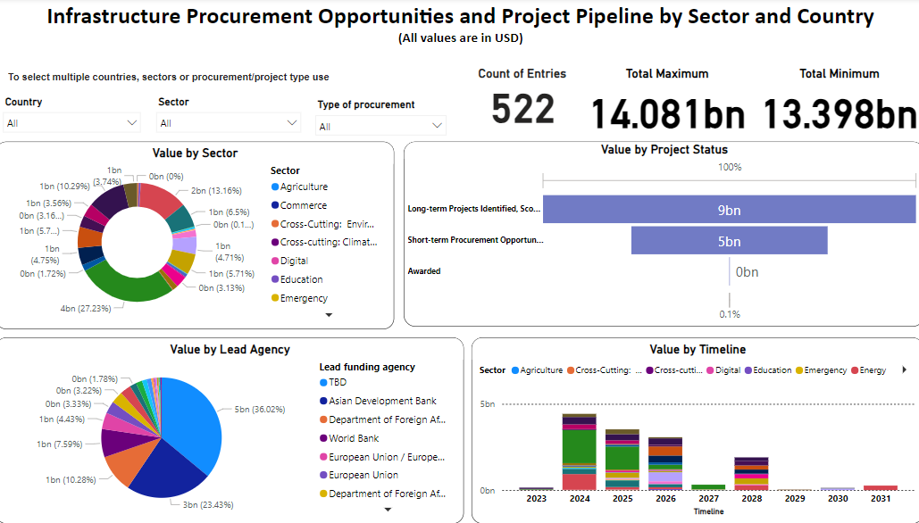
What did we find?

Slide 10
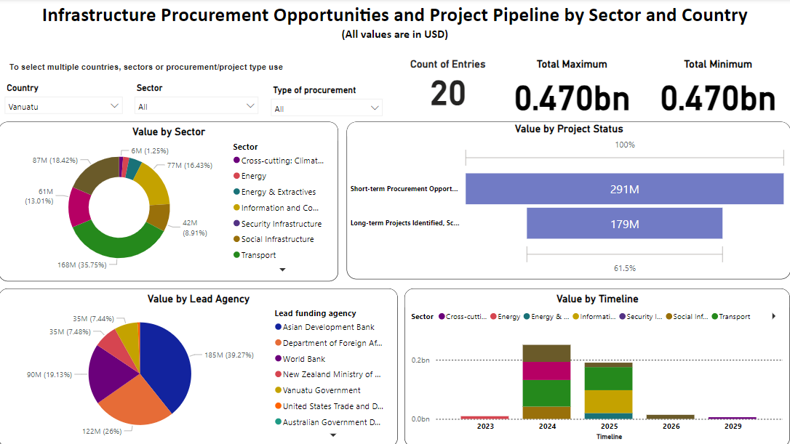
What did we find? Vanuatu (excluding VISIP to be updated)
Notes:
Using the database we can drill down into individual PICs

Slide 11
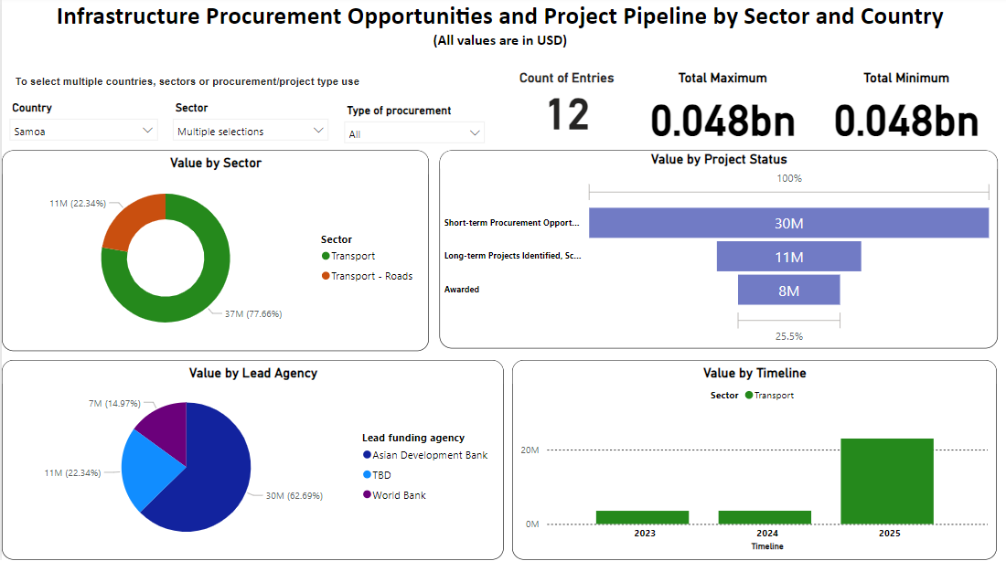
Example: Samoa transport
Notes:
Using the database we can drill down into specific sectors and even the types of inputs required (consulting, equipment, construction) where data exists (only for shorter-term packages and projects).
Note:
Database picks up on work underway and in the procurement market at the moment (e.g. the values for 2023 and 2024)
Packages and projects can be listed under multiple sector categories (due to different arrangements in different development partners)
As projects move into the procurement phase, there is often a break-up of the type of spend (consulting, equipment, construction etc.)
Value by lead Agency. TBD = projects that are in early stages of development, but don’t yet have finding secured. An investment opportunity for good projects.
The bottom line is that there is information available that can be used to see beyond the immediate procurement opportunities and over th the horizon to the medium and longer term (noting the quality of information is not as good).

Slide 12



Can PICs absorb the potential investment?
The ability of PICs to absorb the investment is a vital question.
Higher local capacity means more local content opportunities (supply of inputs).
Lower capacity risks time and cost blowouts.
Possible to overlay demand (pipeline) with data on recent project spends (as proxy indicator of supply).

Slide 13
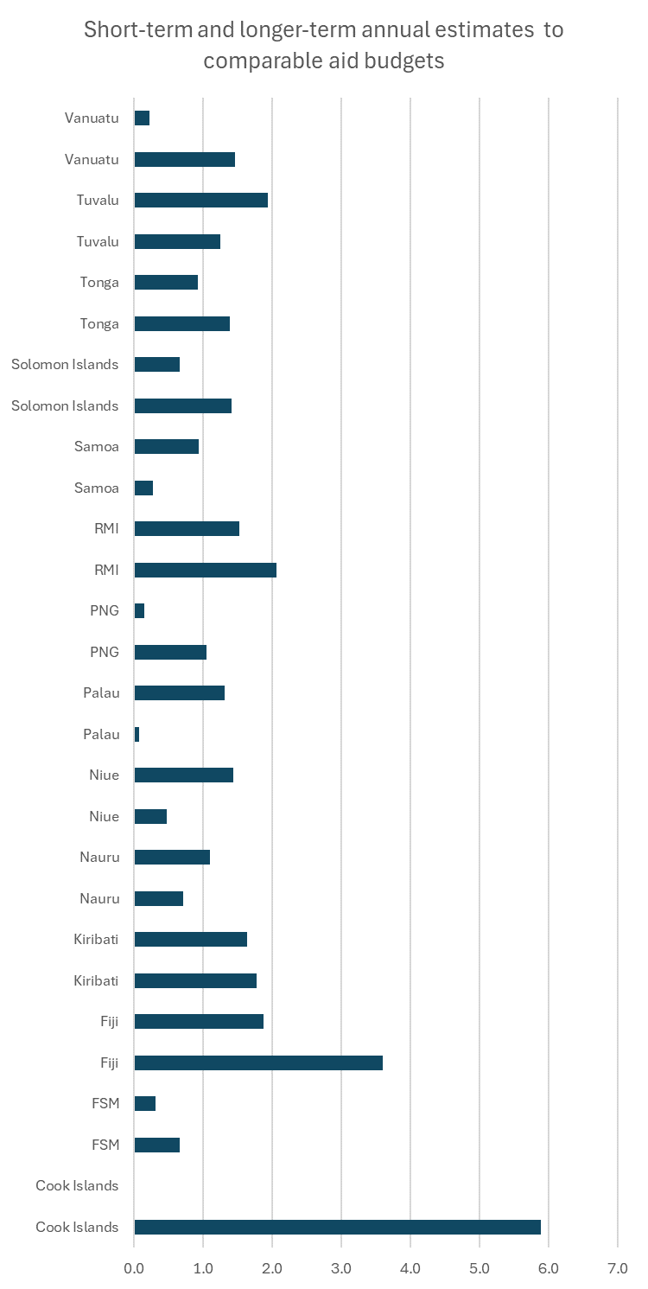
Estimated spend vs. recent comparable aid
Chart shows estimated annual average short-term and long-term infrastructure spend as a as a ratio of average annual aid for comparable sectors (1st line for each PIC is short-term).
Ratios >1 indicate future opportunities will be significantly grater than recent past (need to build capacity).
Note: This is only a partial picture of demand vs. supply.
Regional ratio in short-term is 1.4.
Major demand for inputs and opportunities for PIC businesses and people.
Also, ratios generally sustained for long-term.
Bottom line is that investment demand will need a corresponding uplift in inputs (local content opportunities).
Notes:
The short-term procurement is all for 2024 & 2025. To get annual estimates, the total short-term was simply divided by 2.
Long-term in the pipeline is 2026 to 2033 (in some circumstances). Timing is not really known for these projects. Therefore, annual estimates are simply the total value of long-term identified projects divided by 8. Generally, these are higher than short-term estimates, but many projects won’t proceed.
Figures them compared to annual average from Lowy aid databased for PRIF sectors.

Slide 14
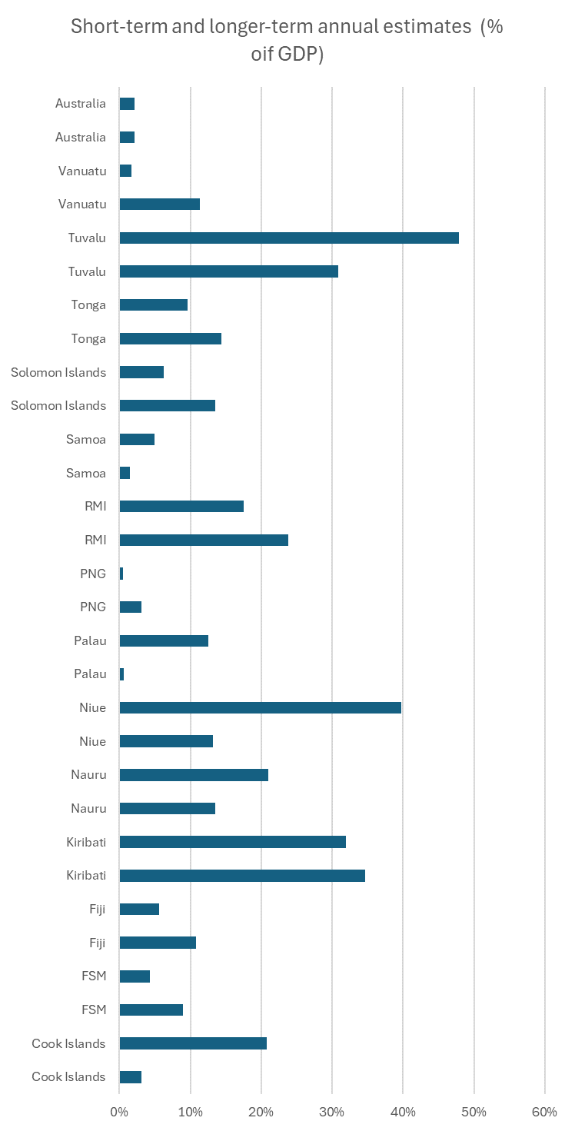
Estimated spend as a % of GDP
Benchmarking can be useful.
Chart shows estimated annual average short-term and long-term infrastructure spend as a % of GDP (1st line for each PIC is short-term).
Australia (for reference) has a mature and efficient infrastructure market, where annual expenditure on government infrastructure projects equates to around 2% of GDP.
Benchmarked PICs indicate much higher ratios, and therefore, much higher relative capacity needs.
Major demand for inputs and opportunities for PIC businesses and people.
Also, high ratios are sustained for long-term.
Bottom line is that infrastructure is a major industry and opportunities for local content could be very significant.
Notes:
The short-term procurement is all for 2024 & 2025. To get annual estimates, the total short-term was simply divided by 2.
Long-term in the pipeline is 2026 to 2033 (in some circumstances). Timing is not really known for these projects. Therefore, annual estimates are simply the total value of long-term identified projects divided by 8. Generally, these are higher than short-term estimates, but many projects won’t proceed.

Slide 15
Procurement opportunities and project pipeline (the pipeline)

Slide 16
Pipeline development
Analysis of infrastructure market shows significant opportunities. But we need to be efficient.
Building in the work presented at the BOS, we have extended the dataset to include longer-term (and less certain) projects.
This information can underpin a more efficient infrastructure market.
Next step is to develop a market-facing Procurement Opportunities and Project Pipeline:
  Searchable.
  Provides basin information by PIC, sector, timing and project sizes.
  Provides information on individual packages and projects (where possible).

Slide 17
Interactive activity
The development of an on-line Pipeline is underway.
We need your help to design it!
This interactive session is to get your views on what is important and useful to you in terms of the features of the Pipeline:
  Search features (how you will search for information).
  Standard reporting features (how outputs should be reported).

Slide 18
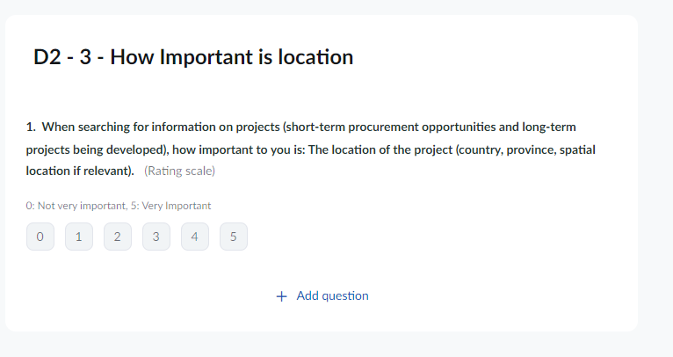
Interactive activity
A series of questions.
Respond showing your views.
Questions will come up on screen one-by-one.
E.g. If knowing the location of opportunities is very important, choose 5

