Slide 1
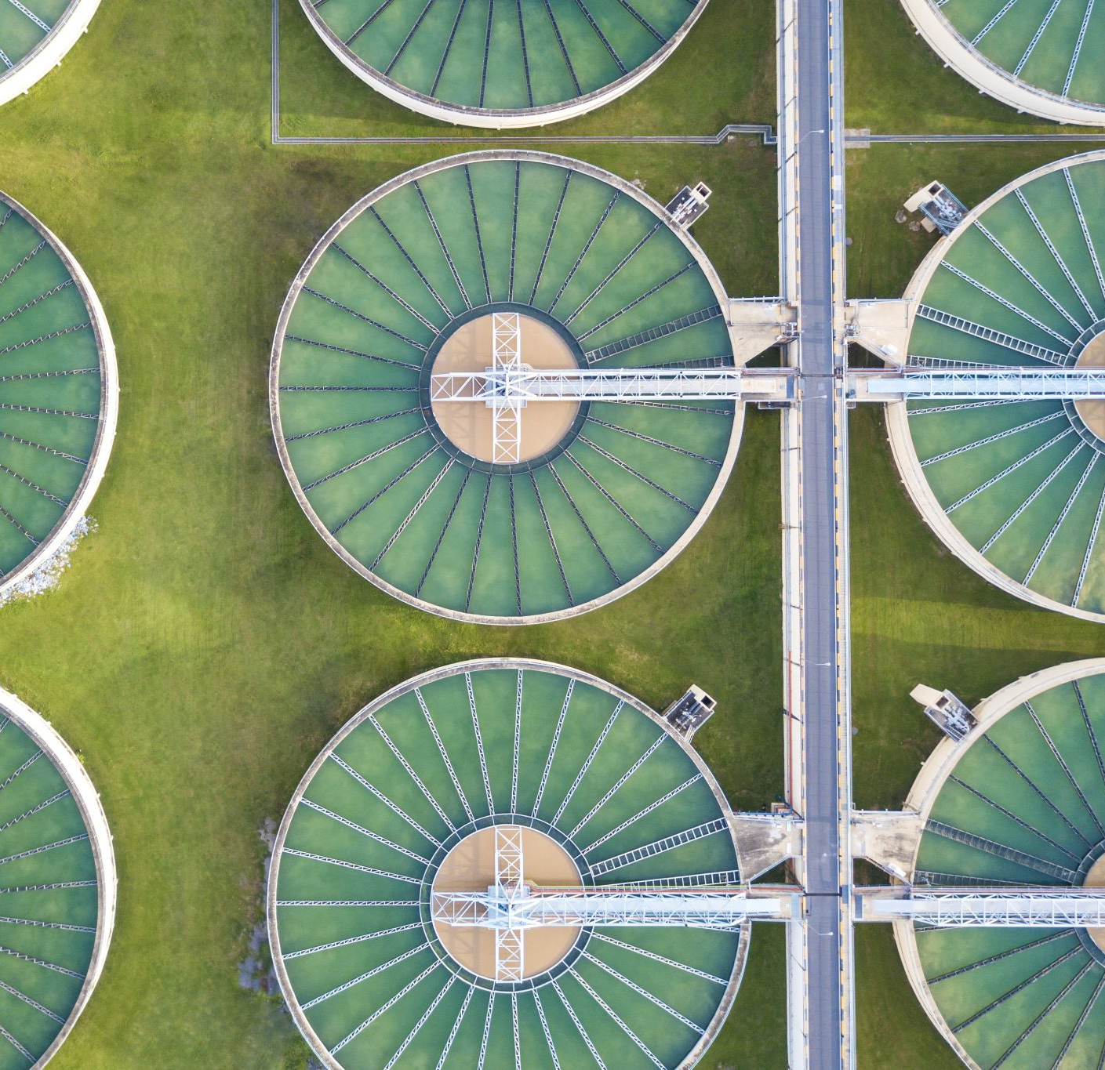
Pacific Region Infrastructure Facility

Slide 2
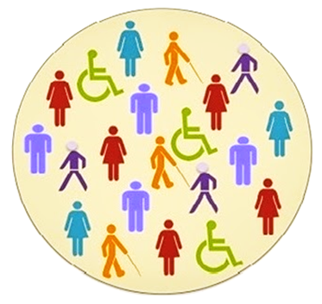
Objectives
To understand definitions and models of disability.
To identify barriers to disability inclusion and approaches for overcoming these.
To identify disability to support and report on the disability inclusion journey.
Best Practices

Slide 3
What is disability?
1. Impairment in the body
2. Caused by barriers in society
3. Impairments + Barriers
4. I don’t know – that’s why I'm here!

Slide 4
What is disability?
DISABILITY
=
Impairment + Barriers or
I + B = D
People with disabilities include those who have long-term physical, mental, intellectual or sensory impairments which in interaction with various barriers may hinder their full and effective participation in society on an equal basis with others.

Slide 5
Diversity of people with disabilities
People with low vision and Blind people
People that are hard of hearing and Deaf people
People with deaf blindness
People with intellectual disabilities
People with physical disabilities
People with psychosocial disabilities
People with autism / other neurodiversity
People with difficulty communicating
Older people who might not consider themselves as people with disability but might have significant functional difficulties and/or restriction of participation

Slide 6
Models of Disability
Charity
Medical
Social

Slide 7
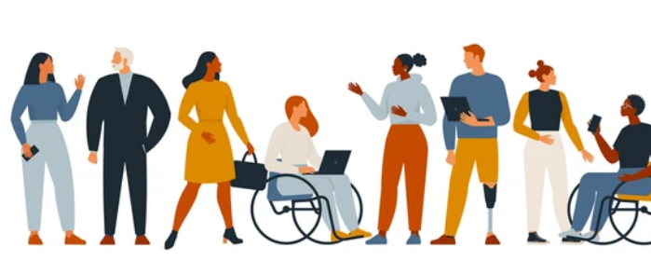
Disability Language - DO or DON’T?
Special needs
Cripple
Crazy
Insane
Person or people with disability
Mad
PWD

Slide 8
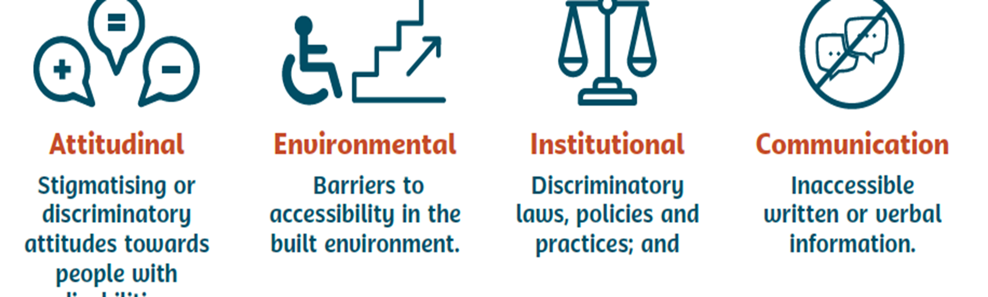
Barriers to inclusion
Disability arises not from impairment alone, but from the interaction between a person’s impairment and the barriers they face to full participation in their community on an equal basis with others.

Slide 9
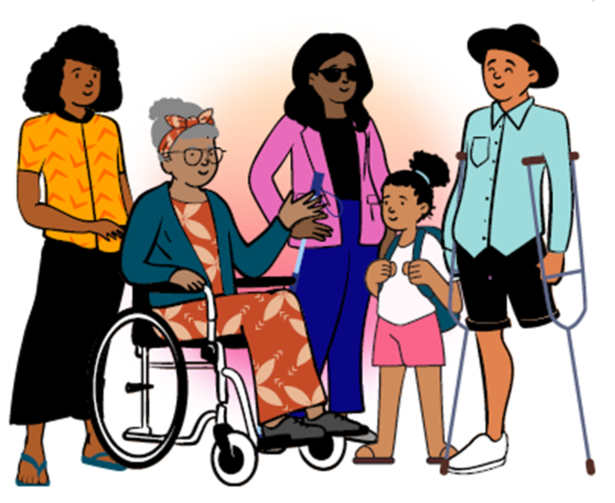
Disability inclusion:
Is a process and an outcome and involves:
  Identifying and removing barriers to participation
  Enabling access to specific supports where needed (reasonable adjustments or accommodations)

Slide 10
Overcoming barriers to inclusion
Attitudinal barriers
Awareness raising
Promote people with disabilities as leaders (and as employees)
Build individuals' self-esteem and confidence
Create networks between people with and without disabilities (this includes working in collaboration with OPDs/ representatives of people with disabilities)
Publicly challenge stereotypes (this includes ensuring that communications materials communicate positively and respectfully about people with disabilities and show them as participating members of society)

Slide 11
Overcoming barriers to inclusion
Environmental barriers
Involve people with disabilities / OPDs in accessibility audits
Use universal design principles:
        Equitable Use
        Flexibility in Use
        Simple and Intuitive Use
        Perceptible Information
        Tolerance for Error
        Low Physical Effort
        Appropriate Size and Space for Approach and Use
Provide reasonable accommodations

Slide 12
Overcoming barriers to inclusion
Communication barriers
Involve people with disabilities / OPDs in developing accessible communication information
Provide Information in multiple formats: written, spoken, pictorial, video. This can also include hiring sign language interpreters if a person is Deaf and can sign; and printing information in Braille or large print format
Use respectful language and inclusive communication
Use a variety of communication methods to make sure information reaches the widest possible range of people. No single method can be accessed by every person.

Slide 13
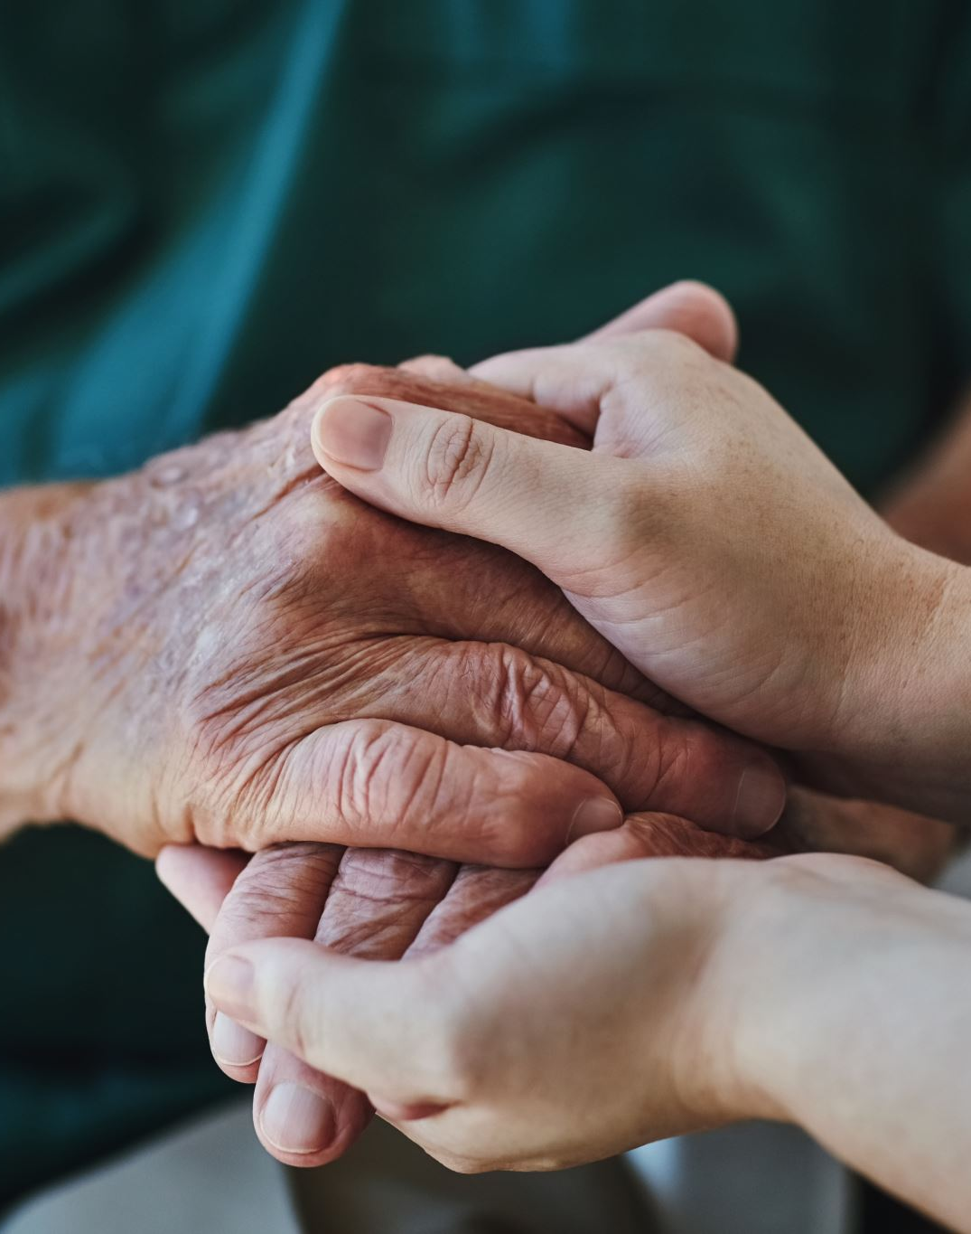
Overcoming barriers to inclusion
Institutional barriers
Awareness raising with decision-makers and staff
Implement (and if needed, develop) inclusive policies
Challenge policies that discriminate
Allocate budget for disability
Support people with disability to claim services
Adapt procedures

Slide 14

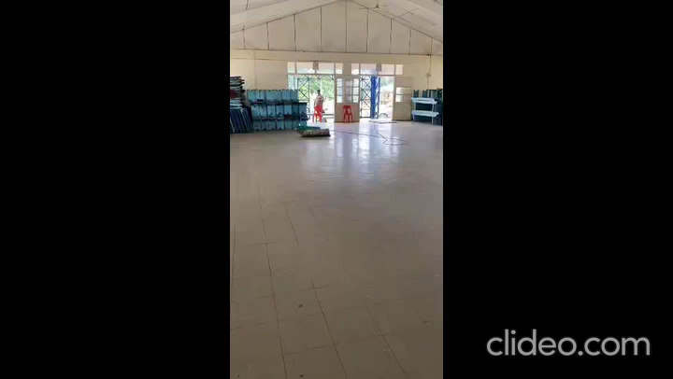
Best Practices
Some of the Pictures from the Evacuation Centers in Tonga which is our Project with the TNCC and ACT for Peace Australia Funded by the USAID.

