Slide 1
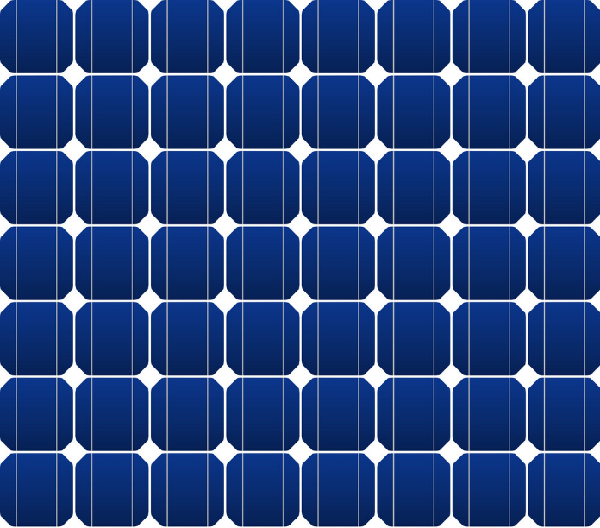
TA-6680 REG
Preparing Floating Solar Plus Projects under the Pacific Renewable Energy Investment Facility
Legal and Regulatory Considerations
FPV Plus PIC-11 Project

Slide 2
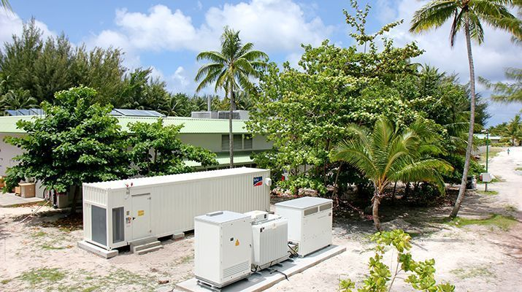
01 Fundamental changes require new thinking, new models
Fundamental changes occurred in electricity sector, especially renewable energy
technological – new ways of generating, transporting and supplying; STORAGE!
commercial – much greater consumer and private sector involvement
Demanded new thinking, new business models
Changes and new models very well suited to Pacific Island nations
Credit: SMA Solar Technology AG

Slide 3
02 Modern legal and regulatory environment is needed
Energy legislation often outdated or does not
implement modern national policy
enable new models, encourage new thinking
Programme to modernise laws (some date from 1970s with only piecemeal amendments)
Legislation provides framework – fundamental principles
Regulations, codes – detailed rules that enable principles to flourish
Credit: Sofar

Slide 4
03 What should modern energy law look like? Private sector participation
Is the legal/regulatory – and contractual – framework conducive to private sector investment?
who is authorised to construct RE generation?
requires certainty of rights to connect and use grid or network
who is the buyer and what impact on tariffs?
structuring of tariffs as countries move away from diesel
incentives
Credit: Wellington Boat Building Co.

Slide 5
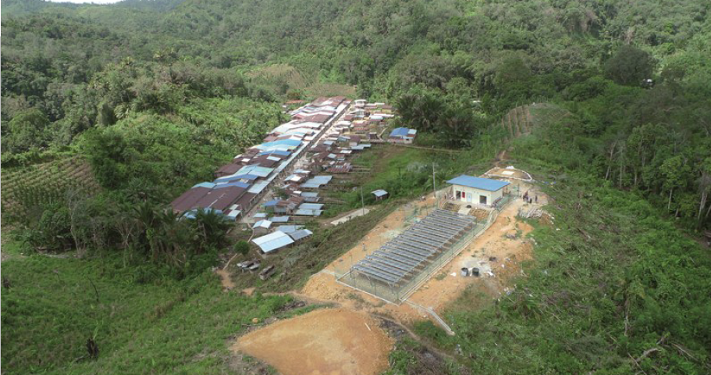
03 What should modern energy law look like? Electrification
Does law enable villages and entrepreneurs to take advantage of modern technology
mini-grids and micro-grids to supply remote villages?
simple system of permitting (or licensing)
should be designed to enable light-handed regulatory oversight
focused on protecting consumers (price and safety)
limited bureaucracy
Credit: Reiner Lemoine Institut

Slide 6
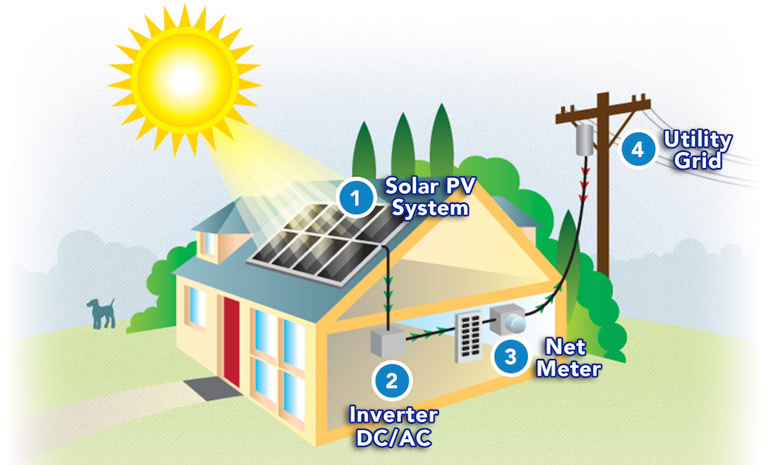
03 What should modern energy law look like? Can consumers benefit from technology
Does law enable consumers to play their part in country meeting ambitious goals
Installation of solar panels by consumers who still use network when need to?
structuring net-metering programmes
must understand technical constraints
Energy efficiency programmes
Credit: Amplus Solar

Slide 7
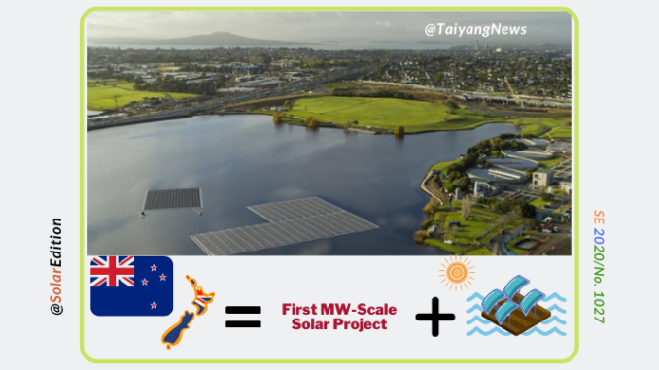
03 What should modern energy law look like? Ministry and utility goals
Is the ministry responsible structured to be aligned with government policy goals?
Is the utility onside with policy goals?
commercial imperatives or national imperatives?
Sector planning responsibilities – clear mandate is important

Slide 8
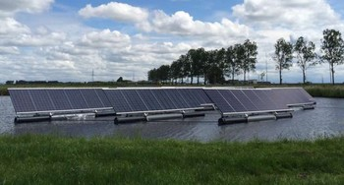
03 What should modern energy law look like? Standards, compliance and oversight
Regulatory oversight – who performs and level of independence?
Essential to have clear rules
rules must be developed under fair and consultative procedure
Non-compliance – allow for good industry practice
Enforcement
Credit: Better World Solutions

Slide 9
THANK YOU Looking forward to working with you Ko Rabwa Malo opito Fakafetai David Lockhart International Legal and Energy Consultant david@lockhartda.com

